Slide 1




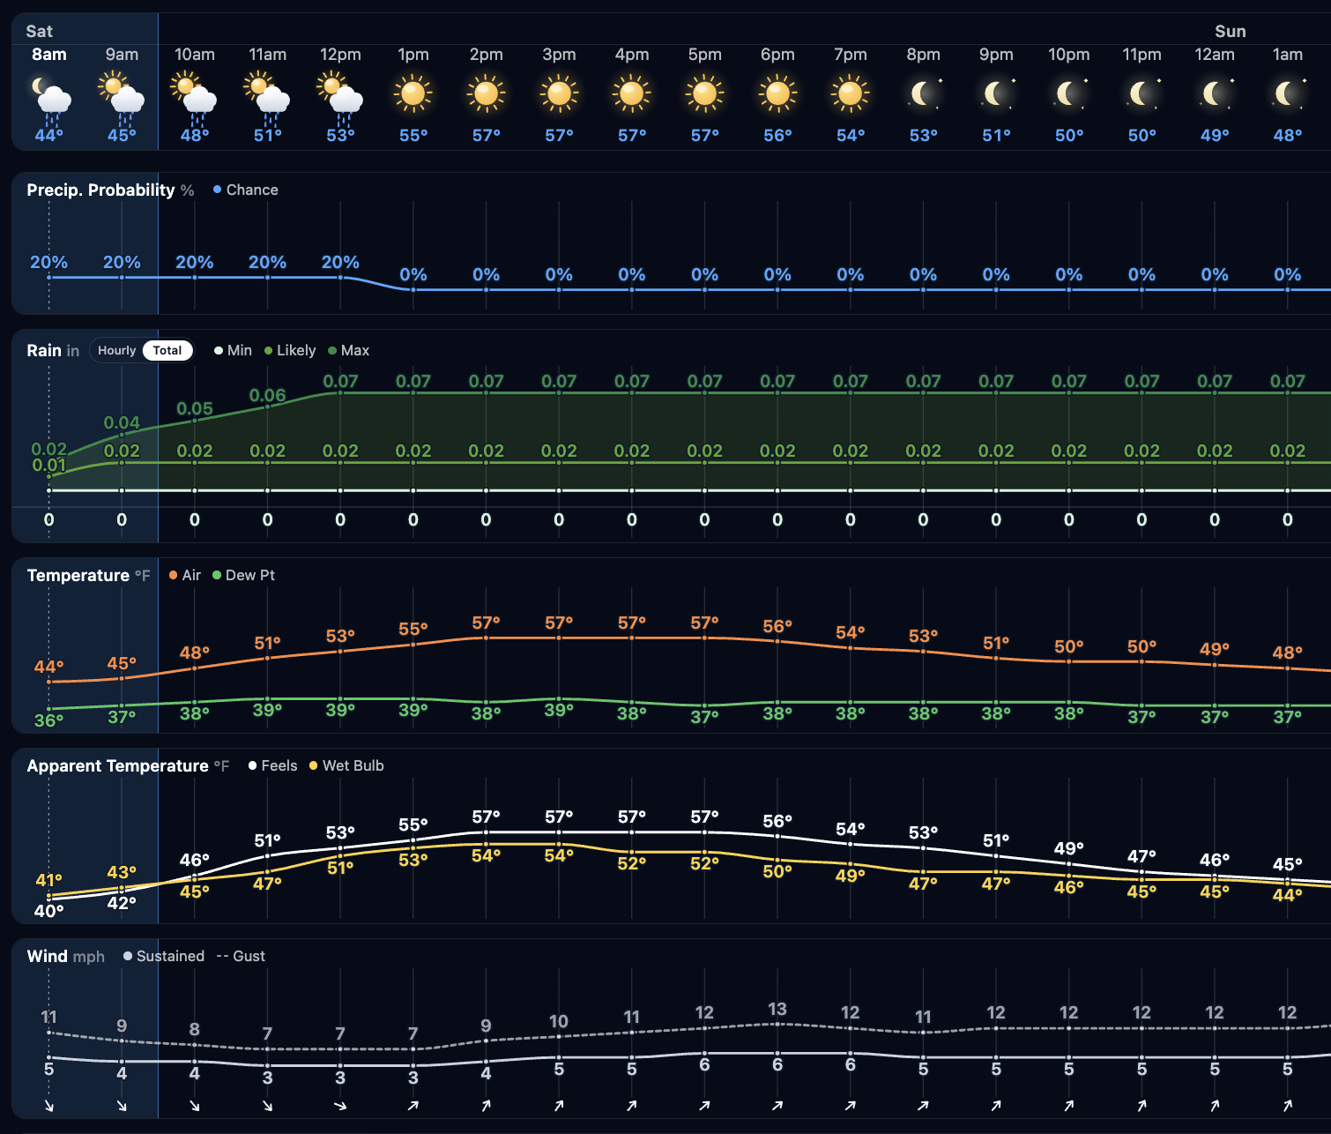
CHICAGO CUBS
Saturday, October 17, 2026
6:45 AM CT Weather Forecast
WINDS TODAY
HOUR BY HOUR FORECAST:
SUN AM DEW: Possible
TEMPERATURES & WINDS
TEMPERATURES:
Temperatures to peak at 57F today, falling into the mid-40s F overnight.
WINDS/CLOUDS:
Mostly clear skies expected throughout the day. Clouds from lake effect sprinkles/showers possible through at 12PM.
WIND DIRECTION:
Winds will generally blow from LF to HP through 10AM, turning from HP to CF the rest of the day.
FORECAST NOTES
r
TODAY’S PRECIP CHANCES/RAIN TOTALS:
Scattered lake effect showers will be possible through 10am. Rainfall of 0.01” – 0.05” is favored. Between 10am – 12pm, an isolated sprinkle can be possible, however, confidence is low. Trace amounts would be favored between 10am – 12pm.

Slide 2
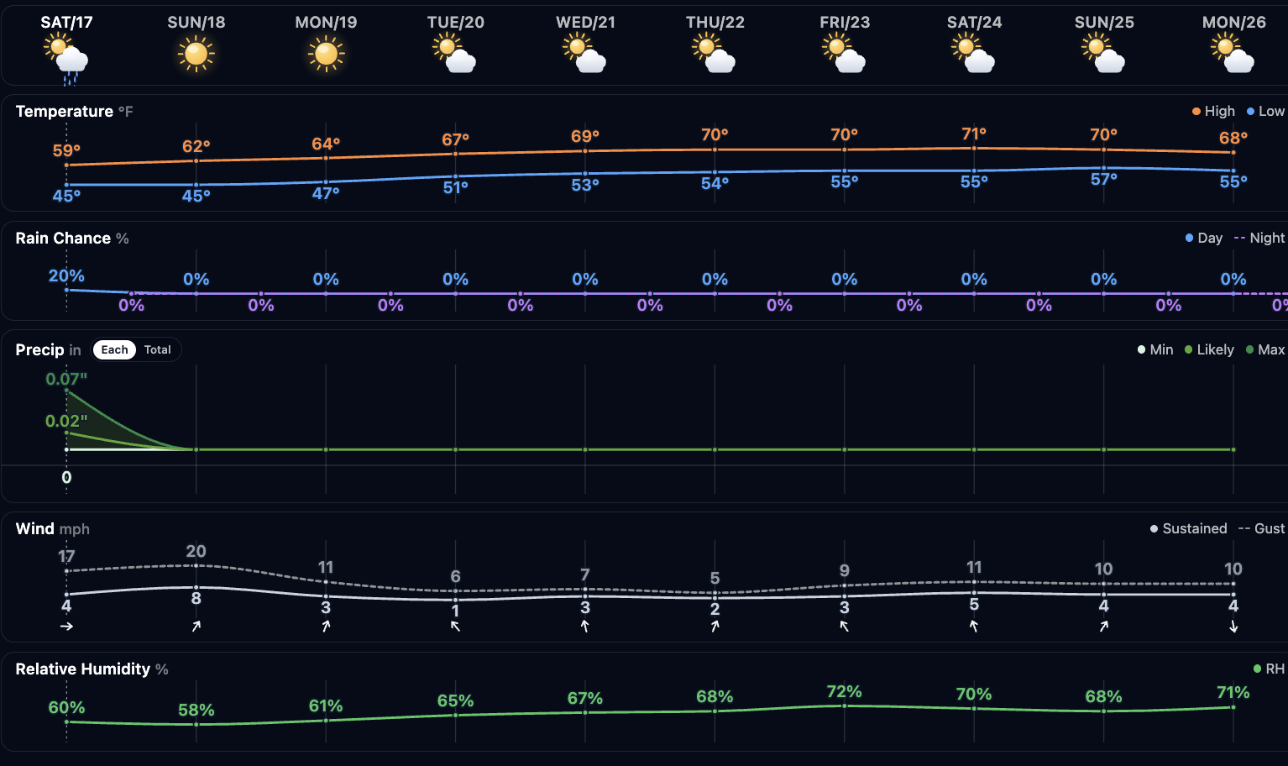

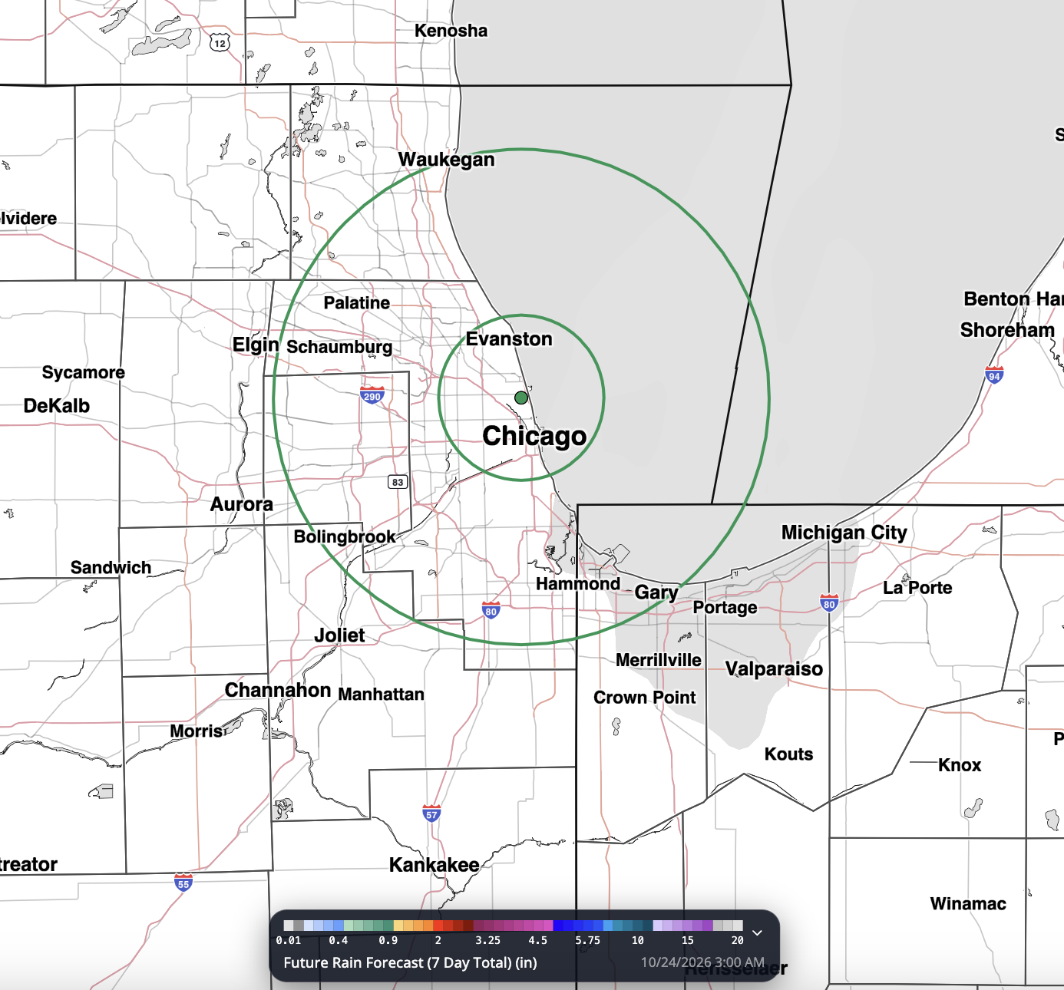
CHICAGO CUBS
Saturday, October 17, 2026
6:45 AM CT Weather Forecast
WINDS Tomorrow
10 DAY FORECAST
Light snow showers move in late AM, ending by sundown. 0.25 – 0.75” favored.
IMPORTANT FORECAST NOTES AHEAD
Sat:
SUN
Dry Conditions Expected
MON
Dry Conditions Expected
NEXT 7 DAY RAINFALL
Sun:
Isolated showers in the AM; showers/thunderstorms in the PM
TUE
Dry conditions expected.
Mon:
Scattered showers/storms possible
WED
Dry conditions expected.
Tue:
Isolated showers/storms possible in the PM
THU
Dry conditions expected.
TEMPERATURES
High temperatures will slowly rise throughout the week, getting into the low-70s F by Thursday.
Dey conditions favored. Storms to push in overnight.
WIND DIRECTION (SUN)
Winds will blow from 3B to RF through the day.
CLOUDS
Partly to mostly sunny conditions are expected most days this week.
WINDS
Sustained winds to stay generally calm through the week. Wind gusts between 15 – 20 mph will be possible Sunday.
Wed:
Favoring dry conditions
Notes:
| MapLibre

