Slide 1




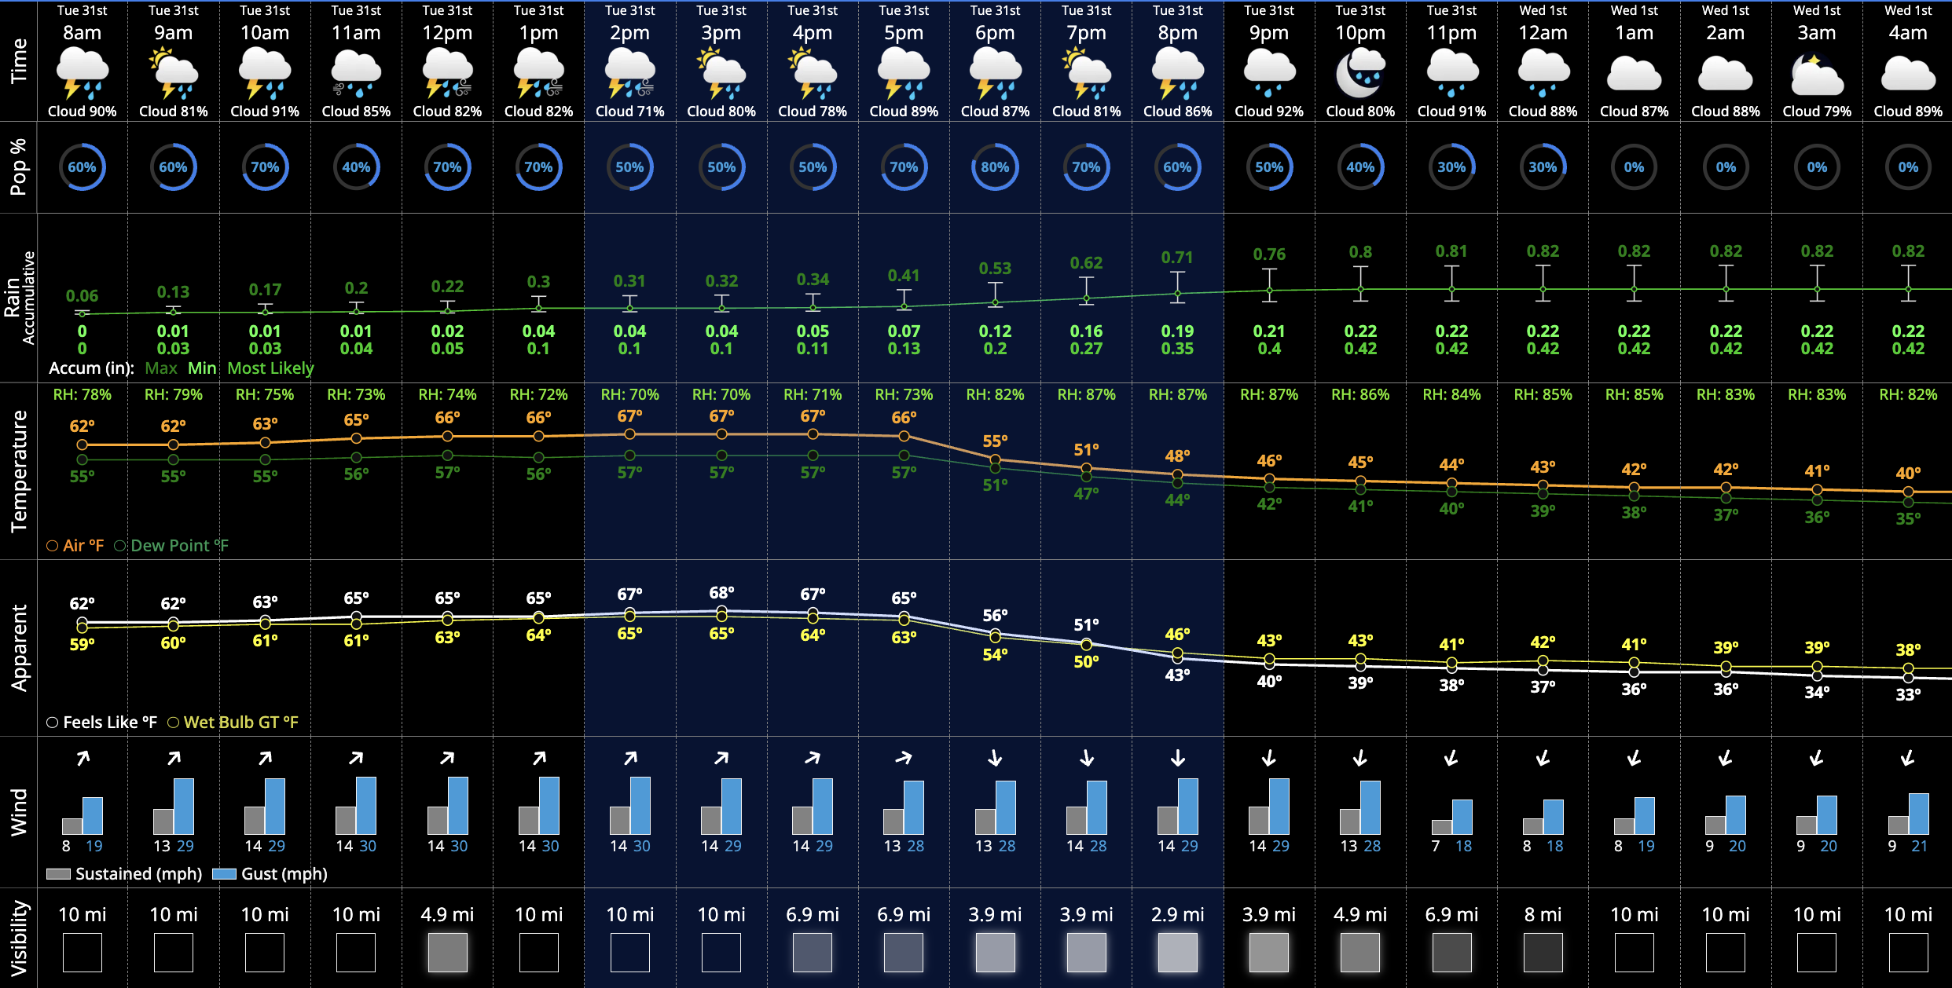
CHICAGO CUBS
Tuesday, March 31, 2026
8:00 AM CT Weather Forecast
Winds Today
WINTER WEATHER ADVISORY
Hour by Hour Forecast:
Temperatures & Winds
Temperatures:
Highs in the upper 60s today, dropping to the high 30s overnight.
Wind/Clouds:
Mostly cloudy to overcast skies expected all day.
Sustained winds near 10-15mph, gusting up to 30MPH
Gusts within Severe T-Storms can reach up to 60MPH. Primary risk between 2pm and 6pm.
Wind Direction:
Winds generally will blow from HP to CF through 6pm, then shifting to LF to 1st Base.
FORECAST NOTES
Today's Precipitation Chances:
r
Scattered showers/storms throughout today. Scattered showers/storms this morning between between 8:30 and 11:30am (some dry pockets possible between 10-11:30am.) Widespread rain/storms between 11:30 and 2pm. 2pm to 6pm scattered storms with strong/severe risk. 6pm to 9pm light, scattered showers expected. (Severe risks include large hail of 1+”, wind gusts up to 60MPH and an isolated tornado or two possible.)
Rain/Snow Totals:
Morning showers: 0.1-0.15” expected --- 11:30am to 2pm: 0.35-0.4” expected --- 2pm to 6pm: 0.15-0.2” expected ---- 6pm to 9pm: trace to 0.05”
Frost/Fog:
No fog/frost is expected.

Slide 2
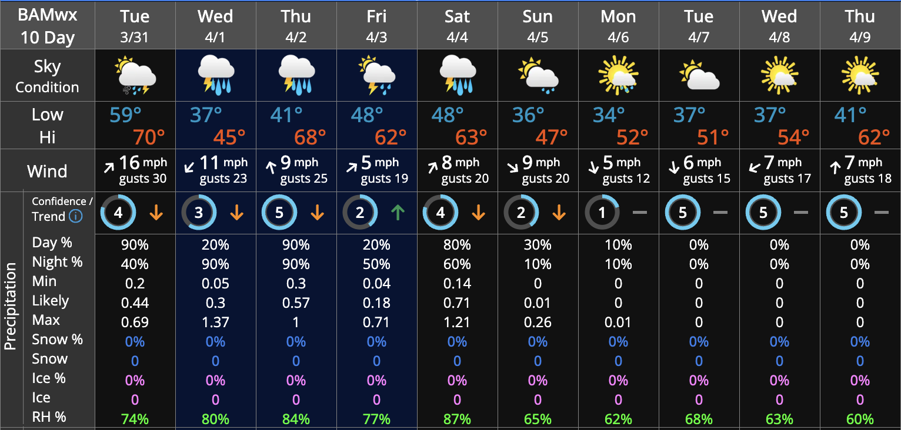
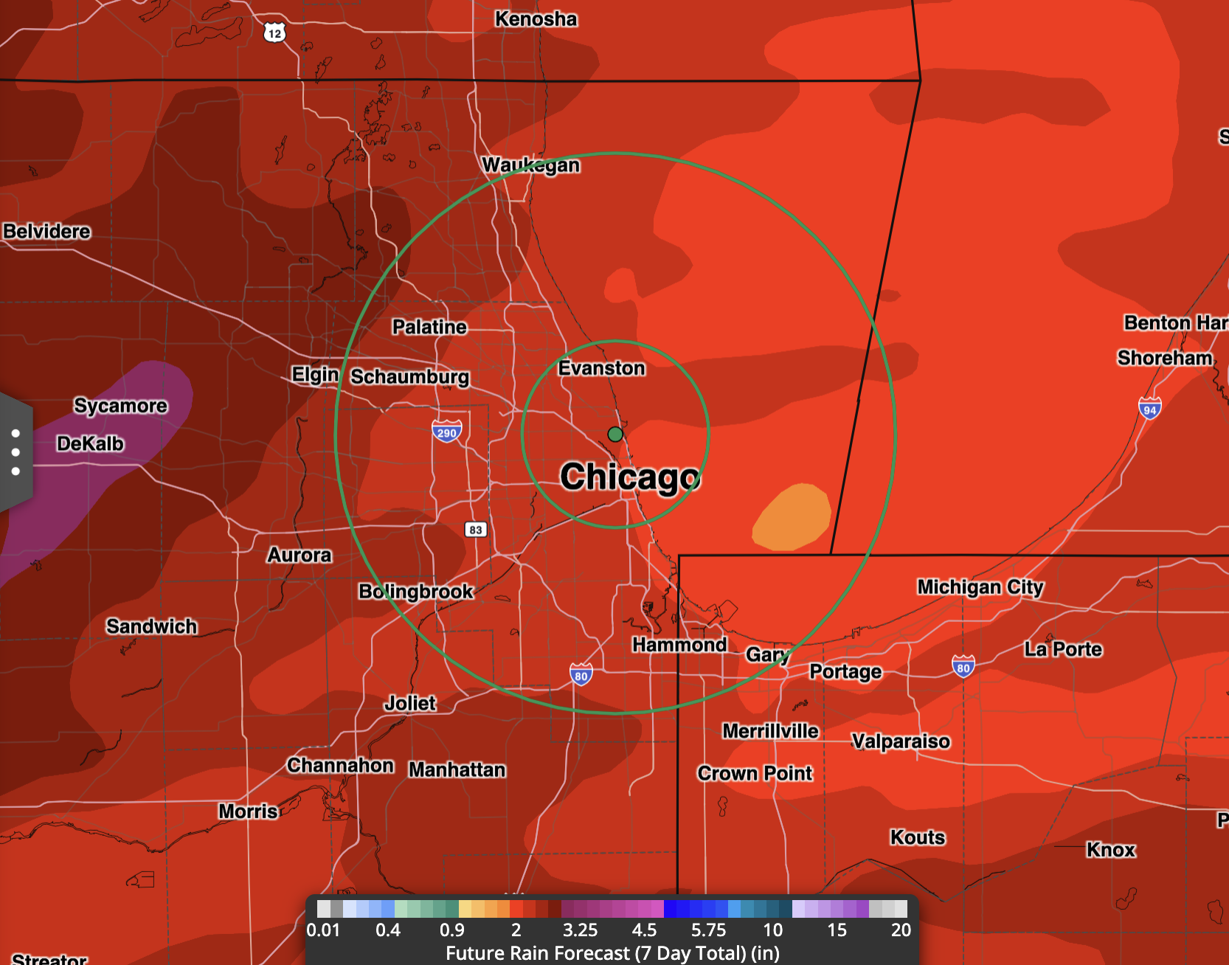
CHICAGO CUBS
Tuesday, March 31, 2026
8:00 AM CT Weather Forecast
Tomorrow’s Winds
10-Day Forecast:
Next 7 Day Rainfall Totals
Light snow showers move in late AM, ending by sundown. 0.25 – 0.75” favored.
NEXT FEW DAYS: IMPORTANT FORECAST NOTES
Sat:
WED
Isolated showers possible in the morning.
Expecting gametime to be mostly dry.
Widespread rain late night.
Temperatures:
Clouds:
Temperatures cool off tonight and tomorrow with cold front passage. Rebounding to low 60s Thu and Fri.
No freeze concerns expected.
Cloud cover building and persisting through THU, expected to break up on Friday.
THU
Widespread rain continues from early in the AM through the day and into the night hours.
Sun:
Isolated showers in the AM; showers/thunderstorms in the PM
FRI
Isolated showers taper off early morning, then dry conditions favored.
Winds:
SAT
Scattered showers in the AM, then dry conditions favored
Wind Direction (tomorrow):
Non-thunderstorm gusts near 30mph Wed, decreasing late week.
Mon:
Scattered showers/storms possible
SUN
A few lingering showers possible in the AM, with dry conditions in the PM.
Winds will generally blow from CF to HP, shifting and blowing from RF to 3rd Base
Tue:
Isolated showers/storms possible in the PM
Wed:
Favoring dry conditions

