Slide 1
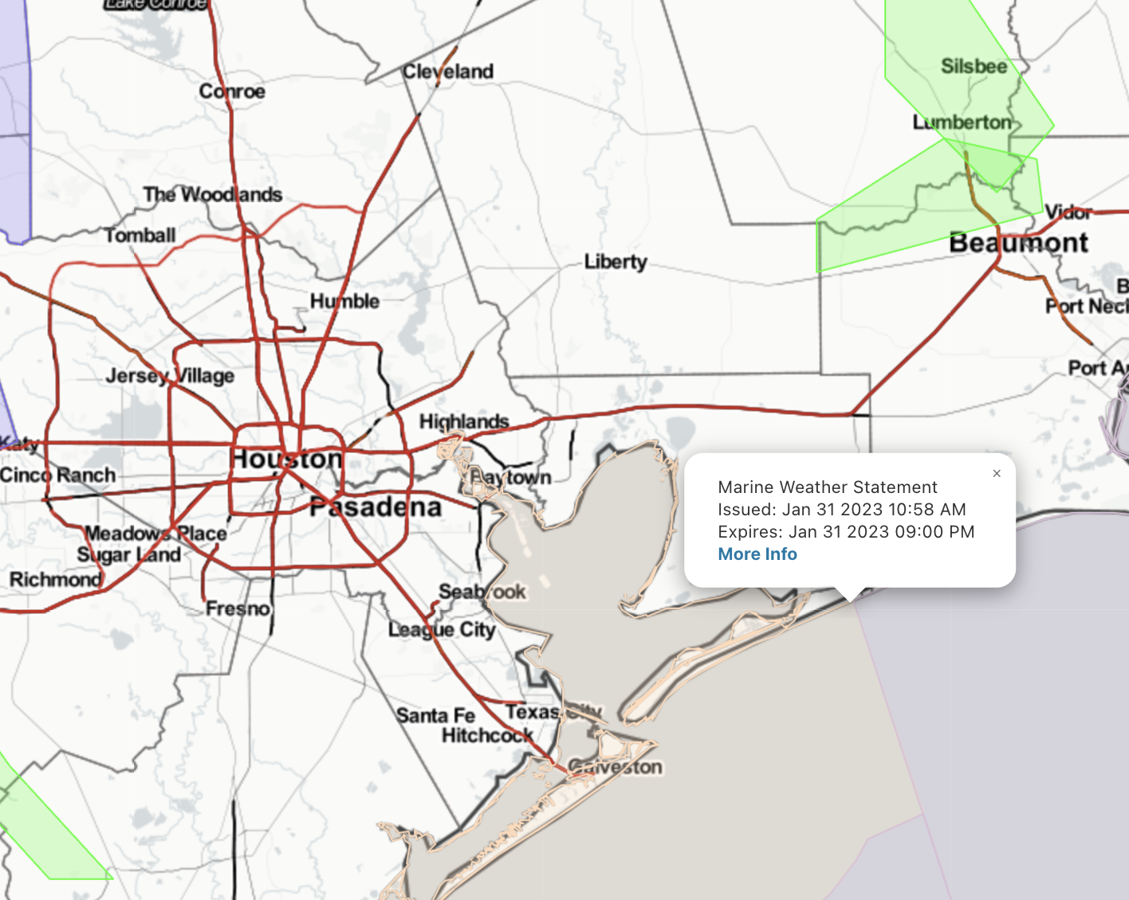
Houston Pilots Forecast Package
Updated: 2:15 PM CT
Tuesday, January 31, 2023
Forecaster: Will Danby
Weather Headlines
Please check fog slide below for the best thinking on fog chances for this PM extending through Wednesday AM.
Scattered showers/storm chances expected to continue over the next few days.
Favoring the next three days to hold winds in the 10-20 kt range, with a few gusts of 20-25 kts possible at times at the Boarding Station.
Radar/NWS Alerts: 2:16 PM CT
As always, please do not hesitate to reach out to us with any forecast questions via the chat option on the Weather Porthole or our on-call number, (317)-560-8122 press 1 for forecast questions.

Slide 2
Houston Pilots Tropical Update
Updated: 5:00 AM CT
Thursday, June 23, 2022
Forecaster: Matt Griffin

Slide 3
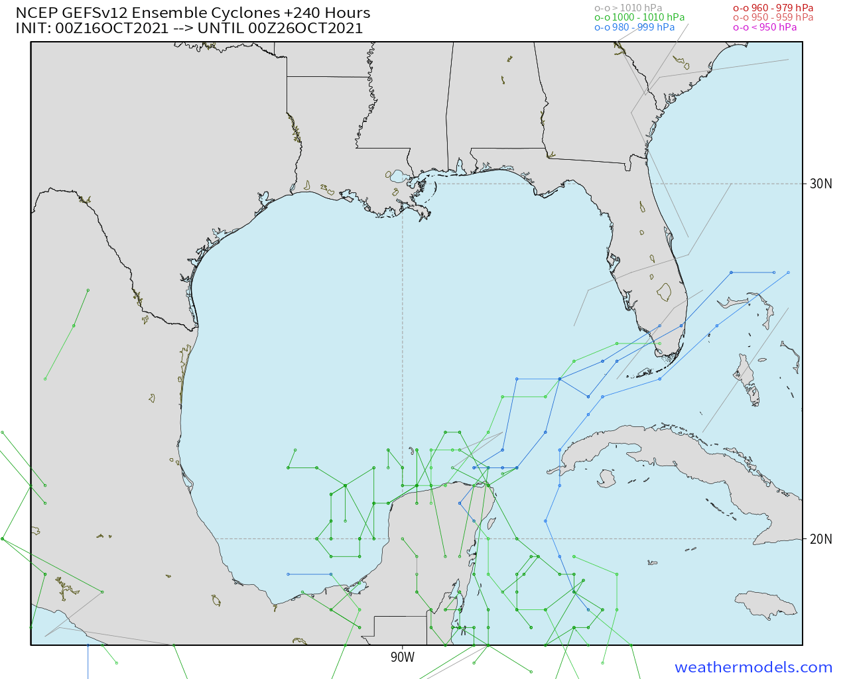
Houston Pilots Tropical Update
GEFS 10-Day Tracks
We continue to favor the Gulf to remain quiet at least for the next 7-10 days.

Slide 4
Houston Pilots Tropical Update
Boarding Station Winds
Time | Direction | Sustained | Gusts
Monday 5AM – 5PM | WSW | 15 – 25 MPH | 25 – 30 MPH
Mon. 5PM – Tue. 10PM | ESE | 25 – 35 MPH | 30 – 40 MPH
Tuesday 10PM – 5AM | SSE | 35 – 50 MPH | 45 – 60 MPH
Tue. 5AM – Wed. 7AM | S | 20 – 30 MPH | 25 – 40 MPH
Boarding Station Winds
Time | Max Wave Heights
Monday 5AM – 5PM | 6– 9 Feet
Mon. 5PM – Tue. 10PM | 9 – 12 Feet
Tuesday 10PM – 5AM | 8 – 10 Feet
Tue. 5AM – Wed. 7AM | 5 – 8 Feet
6 Foot Wave Start: Mon 6AM CT
6 Foot Wave End: Wed 6AM CT

Slide 5
Houston Pilots Tropical Update
Port Condition | 39 MPH Sustained Winds | 6 Foot Waves | Time Remaining/Trigger End
Victor | N/A | N/A | N/A
Whiskey | N/A | N/A | N/A
X-Ray | N/A | N/A | N/A
Yankee | N/A | N/A | N/A
Zulu | N/A | N/A | N/A
Port Condition | Trigger Definition | Trigger Reached?
Victor | Hurricane entering/developing in Gulf of Mexico that’s a threat to the area | No
Whiskey | 72 hours prior to predicted sustained winds of 39+ MPH | No
X-Ray | 48 hours prior to predicted sustained winds of 39+ MPH or 6’ wave height | No
Yankee | 24 hours prior to predicted sustained winds of 39+ MPH or 6’ wave height | No
Zulu | 12 hours prior to predicted sustained winds of 39+ MPH or 6’ wave height | No
Trigger conditions are not expected to be met to change the Port Conditions. Hurricane Ian is currently making landfall in western FL.
See the daily slides for more on winds over the next 2-3 days. Wave heights of up to 4 feet possible at the boarding station through 3 PM today, and Thu 6 AM – 3 PM, but not expected to cross 6’ threshold.

Slide 6
Weak Tropical Disturbance Update
European Data
Rainfall Totals The Next 7 Days
Model Data Low Pressure Track
American Data
A loosely organized area of lower pressure will continue to stick around the Gulf of Mexico out through Saturday. To be clear, we are not expecting wave heights of 6+ feet or winds to meet trigger thresholds. This weakly organized wave will bring some elevated winds and rain chances the next several days (more details on slides below), but looks to be out of the area by ~Saturday. Confidence is higher than normal that the highest impacts from this system looks to be rain.
Above Normal
Confidence
Below Normal

Slide 7
Houston Pilots Visibility Report
REDUCED VISIBILITY RISK – Today After Sundown Through Saturday Morning
Model data continuing to struggle with this potential event; however the threat cannot be completely ruled out as winds remain out of the SE creating more favorable conditions for sea fog.
The sea fog threat is for late this evening into early tomorrow morning and is favored to be patchy in nature and locally dense at times if developed.
If fog occurs, favoring the threat to begin at the Boarding Station then gradually work into the Galv. Bay. Stations north of Morgan’s Point would have a better chance to see fog Saturday AM.
Low confidence on timing, coverage and likelihood of this sea fog risk.
European Data Tracks Next 10 Days
THREAT
Low - Med
Confidence
Above Normal
Below Normal

Slide 8
Houston Pilots Visibility Report
Confidence
Above Normal
Below Normal
A blanket of clouds aloft has allowed for fog to not lift as quickly across the N half of stations vs the S half where visibilities are much better.
Confidence on when this will lift the area is a bit lower than average as there is 0 data handling the current fog setup well.
With that said, we do think the areas outlined in blue do run the risk of continuing to see fog/ reduced visibility for at least the next 2-3 hours.
Clouds look to stick around, which will help limit sunshine in those areas and thus limit how fast fog can lift.
TIMEFRAME DISCUSSED | THREAT
CURRENT– Early PM | MEDIUM - HIGH
Notes:
When does potential reduced visibilities start? What is the best window WITHIN that window? Is this patchy or widespread? Is reduced visibility via dense fog, mist/drizzle, or a combo? What stations are most likely to be impacted? What mile visibility range are they looking at? When do visibilities end? What are the risks?(poor model agreement/ borderline conditions….etc.) What areas (if any) do you have higher confidence to see reduced visibilities ?

Slide 9
Houston Pilots Visibility Report
10 PM SAT VISIBILITY
Confidence
Above Normal
5 AM SUN VISIBILITY
Below Normal
Low end risk for patchy fog development Sat. PM into Sun. AM as showers/storms work through the area. With that being said, favoring heavy rain to be the main cause for reduced visibility as we get into the early Sunday AM hours.
Favoring the area at “greatest risk” for fog development to be between stations 63/64 and Morgan’s Point (mainly for stations within the northern half of the Bay.)
Any fog that develops could temporarily reduce visibility down to 3 – 5 miles.
Lower confidence for likelihood of fog development as not all models show this threat.
TIMEFRAME DISCUSSED | THREAT
9 PM SAT – 12 AM SUN | Low
Notes:
When does potential reduced visibilities start? What is the best window WITHIN that window? Is this patchy or widespread? Is reduced visibility via dense fog, mist/drizzle, or a combo? What stations are most likely to be impacted? What mile visibility range are they looking at? When do visibilities end? What are the risks?(poor model agreement/ borderline conditions….etc.) What areas (if any) do you have higher confidence to see reduced visibilities ?

Slide 10
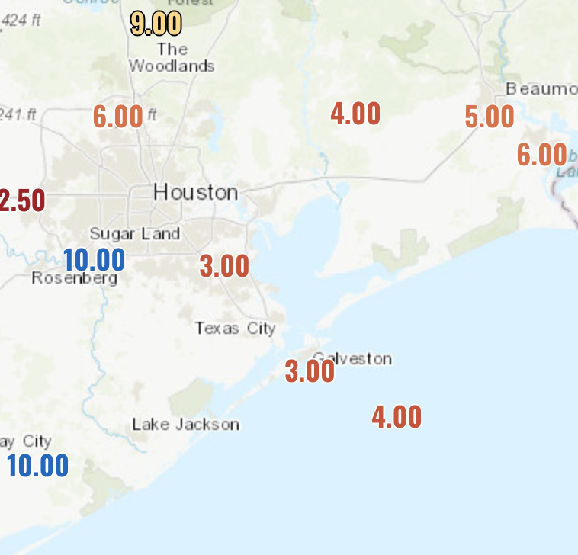
Houston Pilots Visibility Report
CURRENT VISIBILITY
Visibility Chart - Next 22 Hours
Confidence
Above Normal
Below Normal
Latest forecast data across the board is essentially blind to the ongoing low visibility across SE TX. Verification from the chart above from the AM visibility report continues to perform well. With that being said, visibilities of 3 – 5 miles will likely continue throughout the afternoon hours and into the overnight.
A low end risk is still present for a couple areas of patchy fog to reduce visibilities less than 2 miles between 75/76 and the boarding station, but a better window for the opportunity for this to happen will come after sundown.
Independent of low end patchy dense fog risks after sundown, a low cloud deck of less than 500 feet will be continuous throughout the overnight. There is higher confidence here with that aspect of the forecast, as mist and on and off light showers will persist over the next 12 hours.
However, there will continue to remain lower confidence on specifics as there is *very* little support for the ongoing fog.
TIMEFRAME DISCUSSED | THREAT
CURRENT– Wed AM | Medium
Notes:
When does potential reduced visibilities start? What is the best window WITHIN that window? Is this patchy or widespread? Is reduced visibility via dense fog, mist/drizzle, or a combo? What stations are most likely to be impacted? What mile visibility range are they looking at? When do visibilities end? What are the risks?(poor model agreement/ borderline conditions….etc.) What areas (if any) do you have higher confidence to see reduced visibilities ?

Slide 11
Houston Pilots Extended Range Visibility Report
Friday 2/3/23
Saturday 2/4/23
Not anticipating any visibility concerns for Friday as AM winds will be from the NW possibly shifting from the NE during the late PM hours.
NE winds during the AM hours will begin to veer from the SE towards the late evening hours. Winds will be quite calm however, making sea fog transport unlikely.
Confidence
Confidence
Below Normal
Below Normal
Above Normal
Above Normal
Sunday 2/5/23
Chance for Reduced Visibility
Friday AM | Unlikely
Friday PM | Unlikely
Saturday AM | Unlikely
Saturday PM | Unlikely
Sunday AM | Unlikely
Sunday PM | Unlikely
Light and variable winds with favorability from the SE will be possible. Again, due to the light nature of the winds, it will be hard to tap into sea fog transport with SE winds.
Confidence
Below Normal
Above Normal

Slide 12
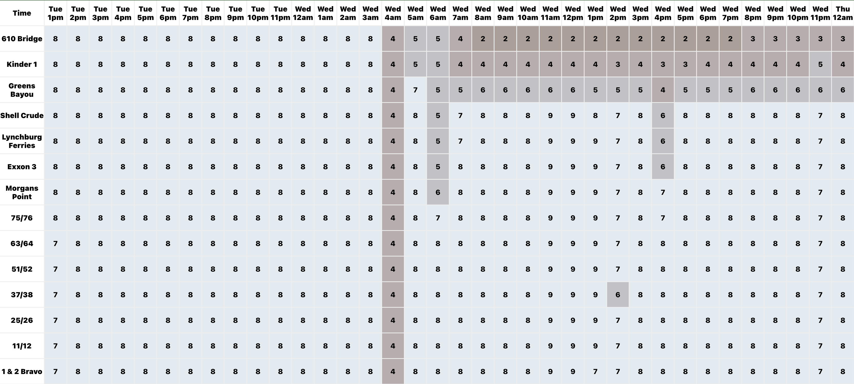
Houston Pilots Visibility Report
Confidence
Above Normal
Below Normal
Refer to the slide above for the official BAM forecast. The chart is likely not 100% accurate with fog.

Slide 13
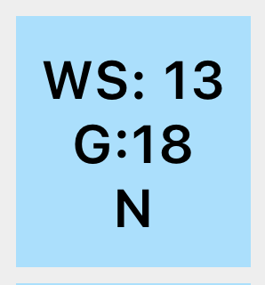
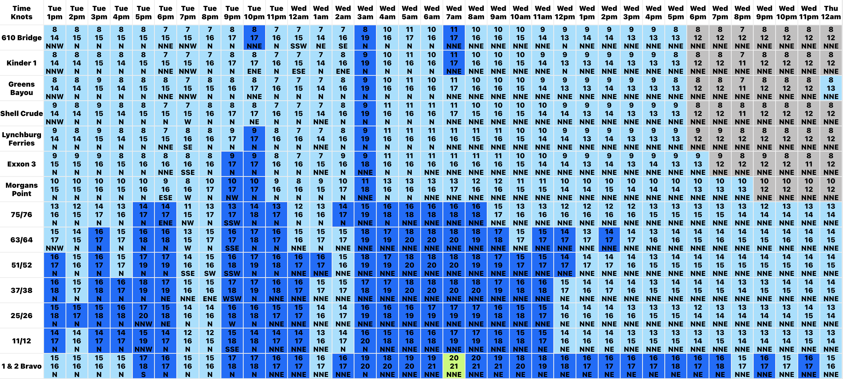
Houston Pilots Wind Report
Example
Confidence
Sustained wind 13 Knots
Gusts 18 Knots
Wind from the N
Above Normal
Below Normal
See slides below for official thoughts on winds.

Slide 14
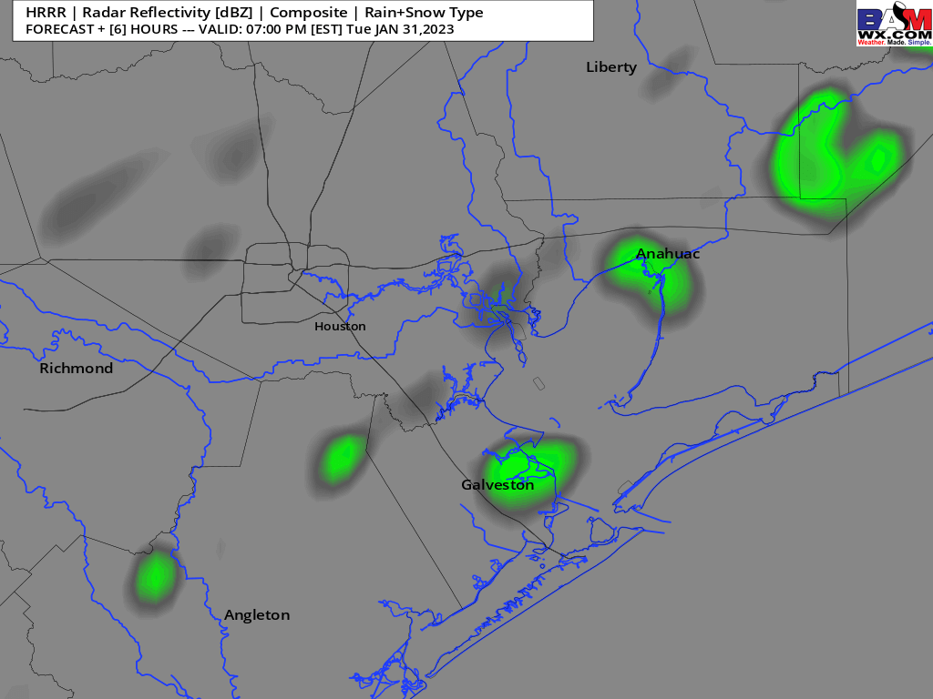
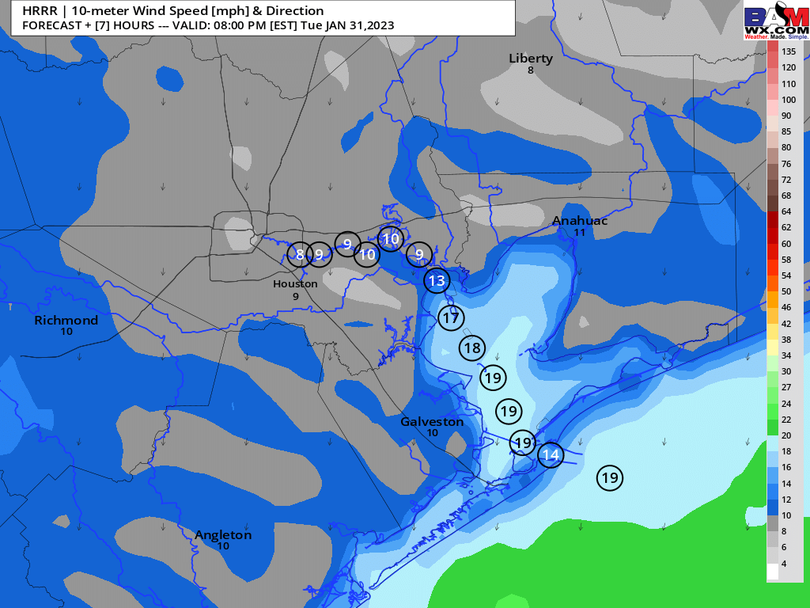
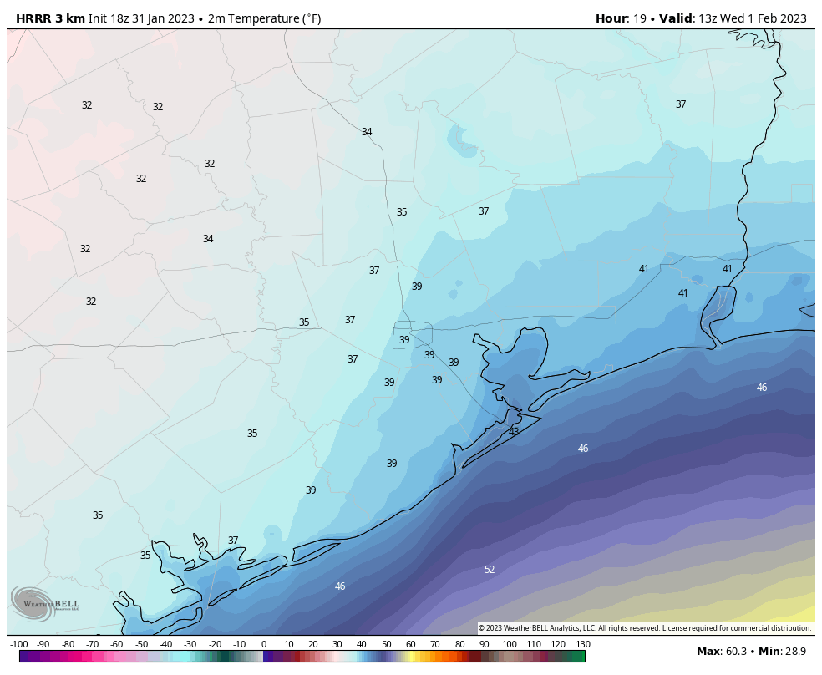
Houston Pilots: Tue. 1/31/2023
Forecast Discussion
Precip Forecast: 6 PM CT
Precip: A continuation of light spotty showers in coverage will continue for the afternoon and evening. A better pulse of scattered showers looks to enter the region as early as 4 AM.
Wind: Expecting northerly winds to continue for this afternoon, with a slight veer from the NNE around 9 PM. Winds north of Morgan’s Point will be 5 - 10 kts and south of Morgan’s point will be 12 – 19 kts. A few gusts of 21 – 23 kts will be possible throughout the afternoon hours, mainly at 11/12 and the Boarding Station.
Temps: Low temperatures Wednesday morning will drop to the upper 30s F north of Morgan’s Point and in the low to mid 40s south of Morgan’s Point.
Visibility: Please check slides above for reduced visibility potential.
Wind Speed
8 PM CT
Low Temps
WED AM

Slide 15
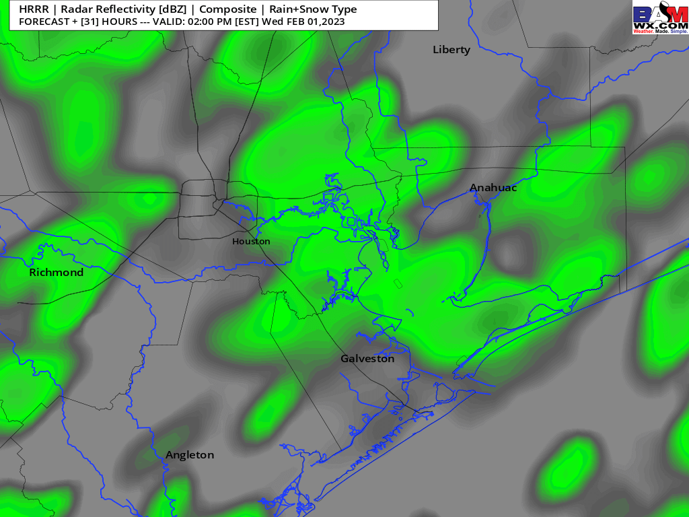
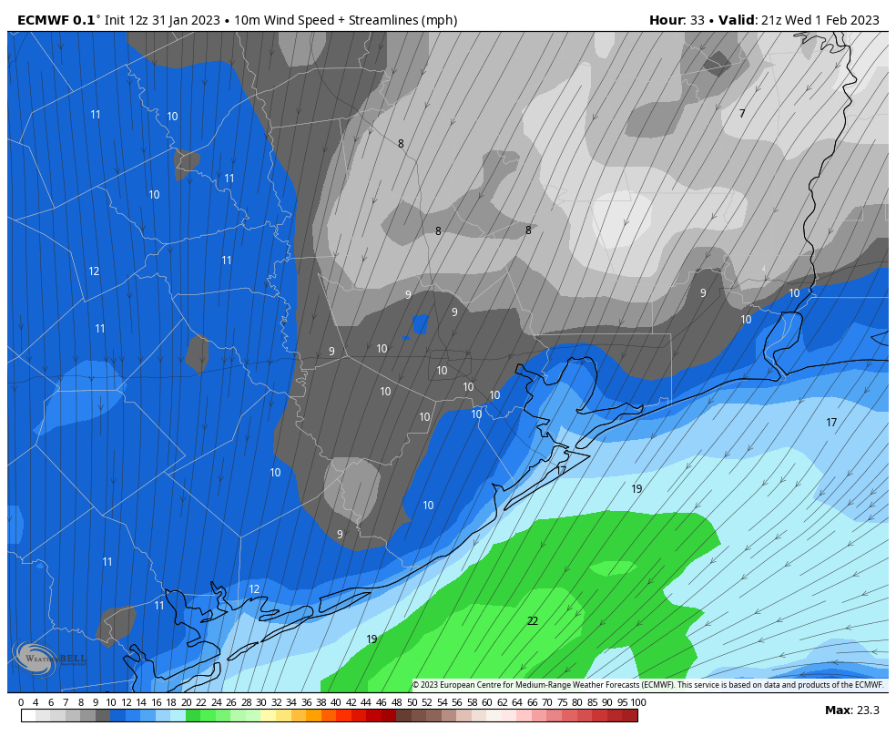
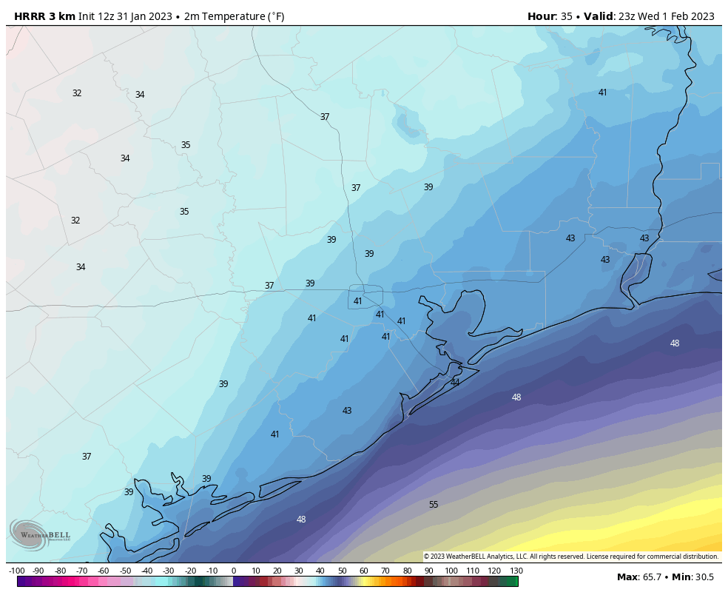
Houston Pilots: Wed. 2/1/2023
Forecast Discussion
Precip Forecast: 2 PM CT
Precip: Anticipating another wet day on Wednesday. Expecting 30% isolated chance of showers to continue through the early morning until 6 AM. Coverage will then increase with chances to 60-70% through Noon. The main wave works out in the early afternoon with a 30% chance of hit and miss showers into the afternoon/evening hours. A few rumbles of thunder will be possible.
Wind: Sustained northerly winds throughout the day Wednesday. Winds will generally stay at 14 - 19 kts for stations south of Morgan’s Point and 7 – 12 kts for stations north of Morgan’s Point through most of the day. Gusts of 20 kts are possible out through 1 PM.
Temps: Highs Wednesday will be in the lower to mid 40s. The Boarding Station will be near 50 F
Visibility: Not anticipating fog activity at this time, however, visibilities may be reduced due to shower activity. Lower confidence on this risk.
Wind Speed
3 PM CT
High Temps Wednesday

Slide 16
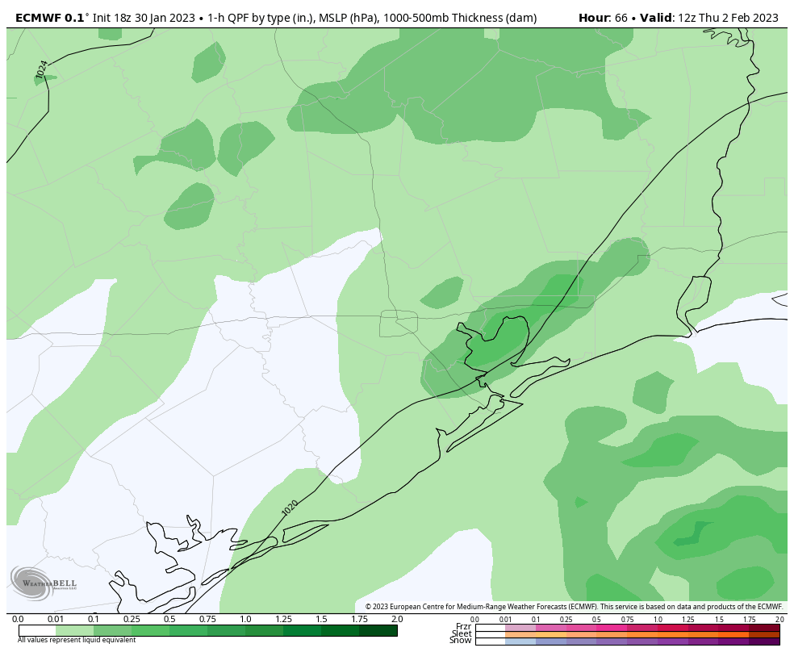
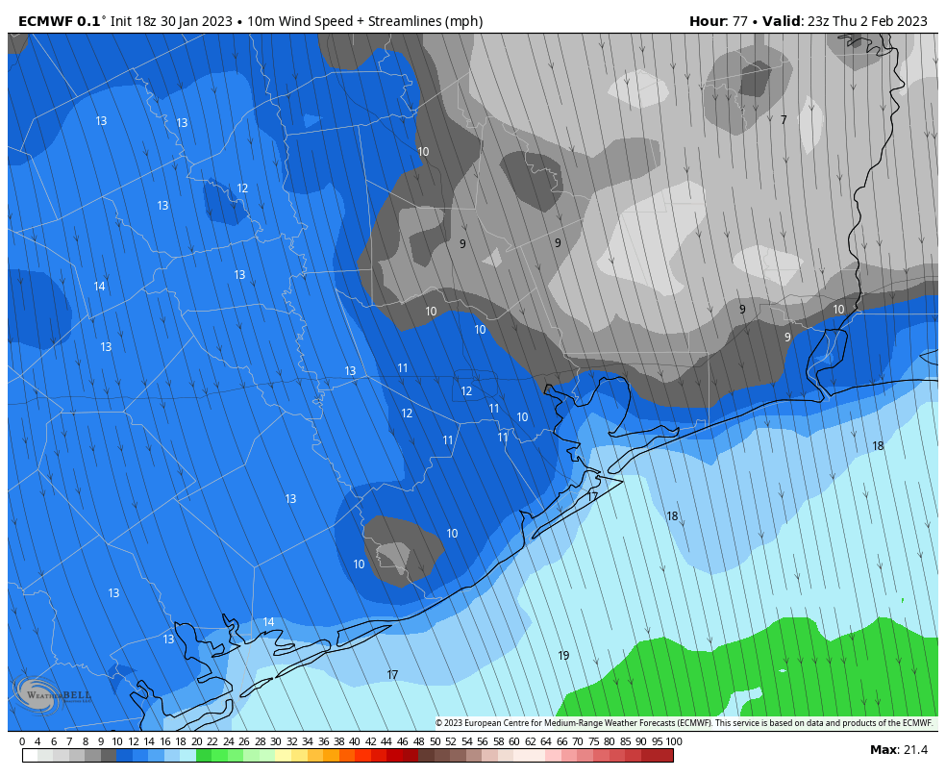
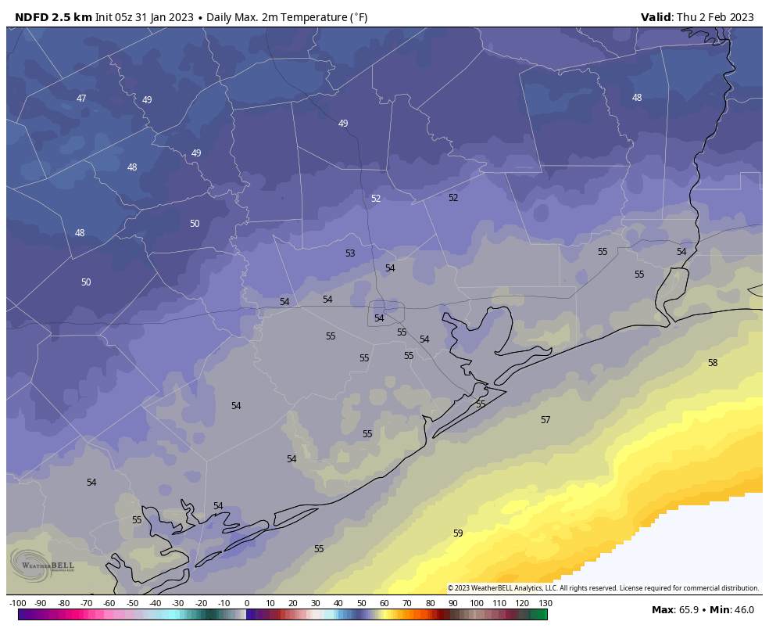
Houston Pilots: Thur. 2/2/2023
Forecast Discussion
Precip Forecast: 6 AM CT
Precip: Light to moderate rain showers look to enter the picture around 4 AM and could linger on as late as 6 PM. After 6 PM favoring dry conditions. The best window to receive rain will be from 5 – 8 AM (60%) outside of this window precipitation chances will be 40%.
Wind: Sustained northerly winds in the AM hours will veer from the NNW around 2 PM and remain as such for the rest of the evening. Winds north of Morgan’s Point will be 7 – 12 kts for the entire day. Winds south of Morgan’s Point to 25/26 will be at 9 – 15 kts. The Boarding Station and 11/12 will be at risk for slightly higher winds at 14 – 18 kts. Wind gusts of 22 – 25 kts will be possible at 11/12 and the Boarding Station mainly between 6 and 11 AM.
Temps: High temperatures Thursday will be in the mid 50s F across all stations.
Visibility: Not anticipating widespread fog threats for Thursday, however a low cloud deck will be likely with mist and few pockets of patchy fog will be possible as rain showers work their way into the picture during the morning hours. Low clouds could look to lift around 6 PM with better improvements in visibility by the late evening hours.
Wind Speed
5 PM CT
High Temps Thursday

Slide 17
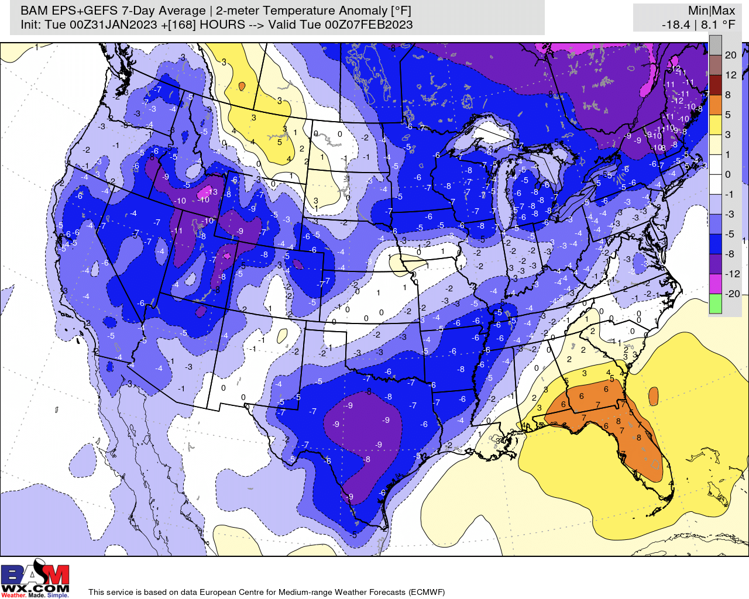
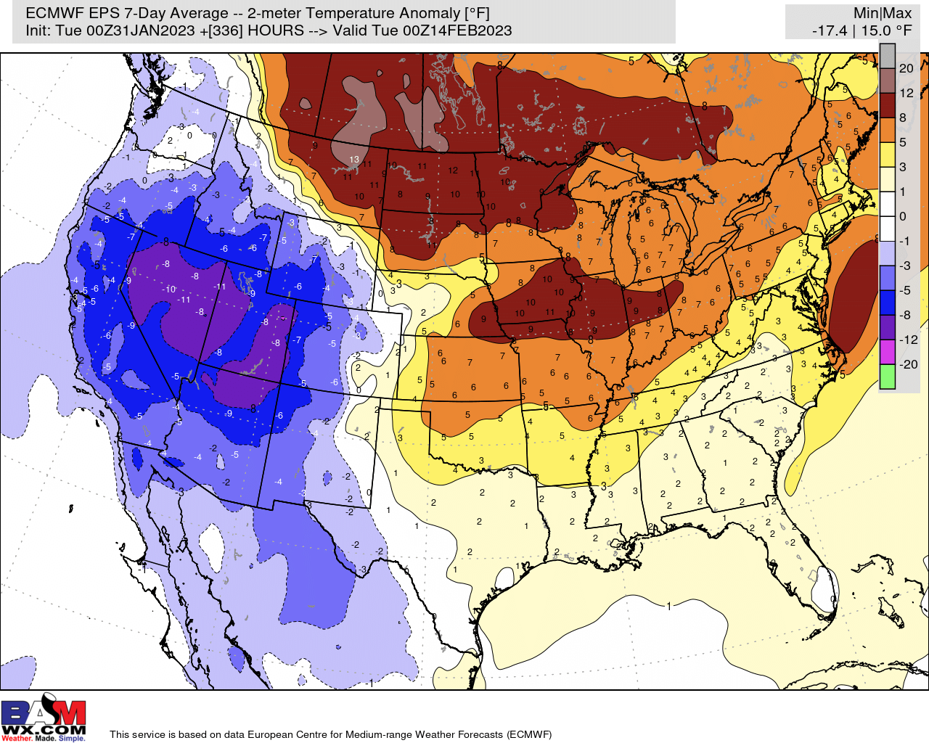
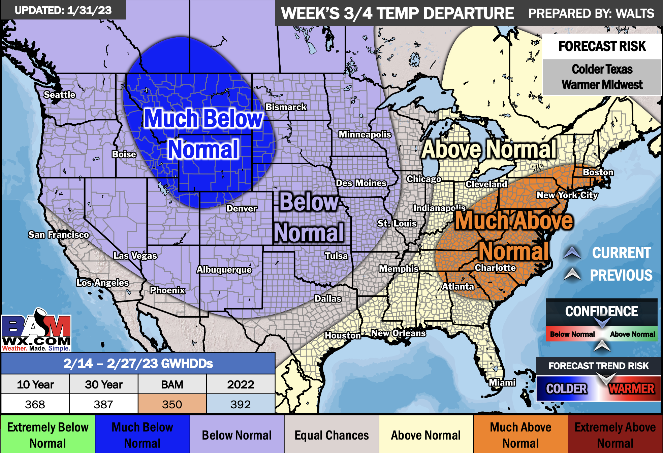
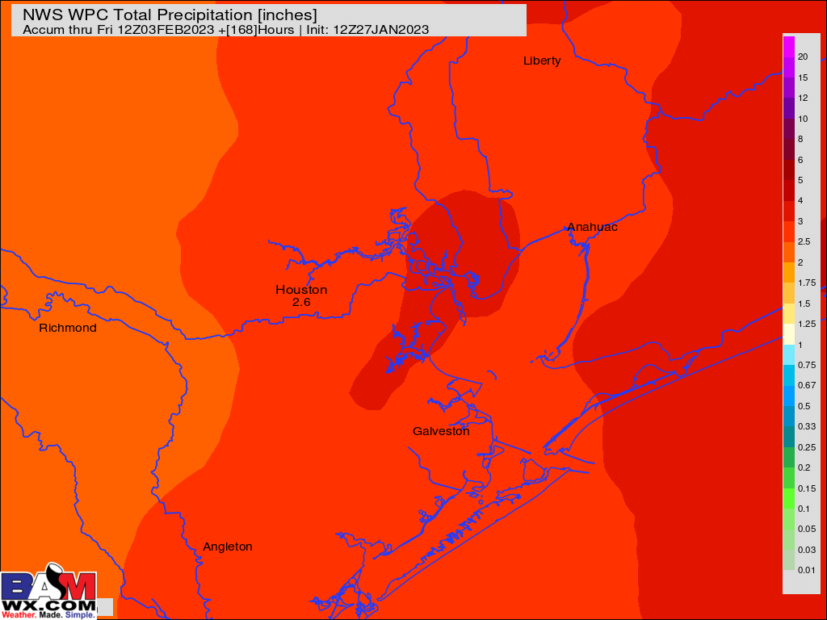
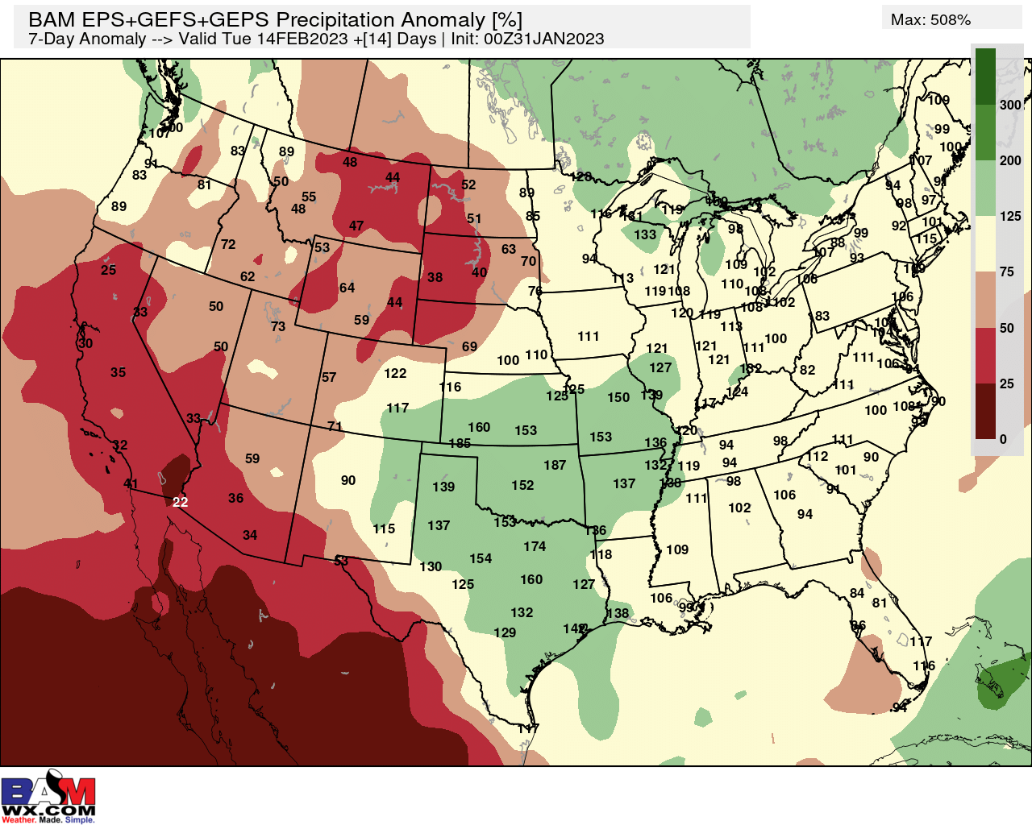
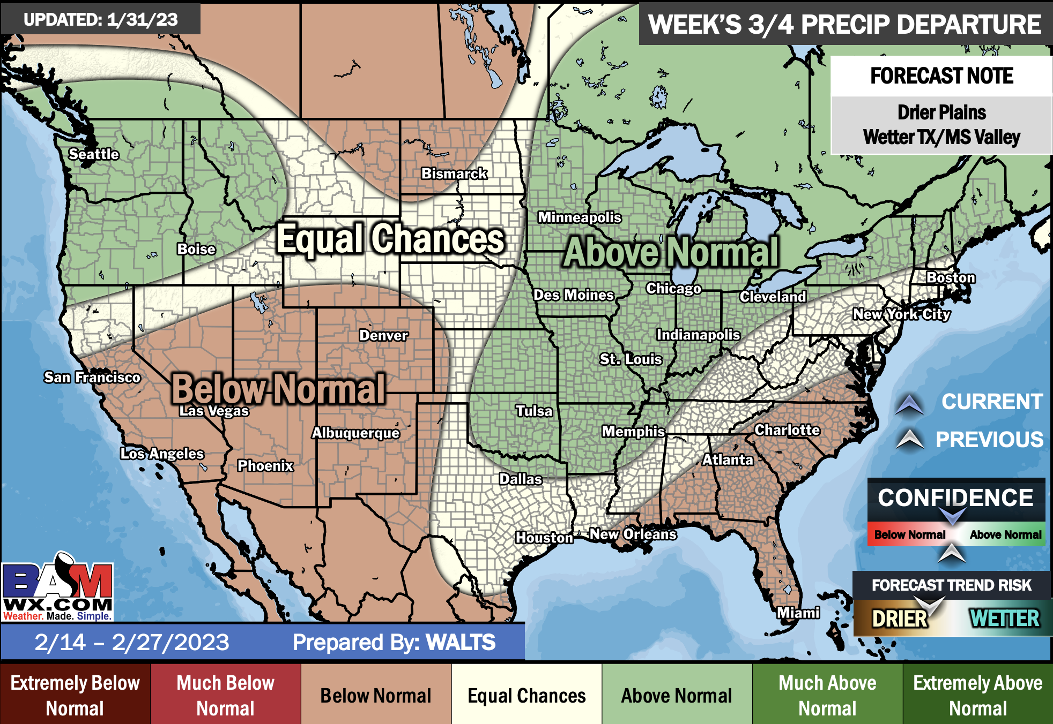
Houston Pilots: 1/31/23
Week 1
Week 2
Weeks 3/4
Daily rain chances through Friday before clearing into the weekend. Temperatures will be below average for the remainder of the week.
Expecting above normal precipitation and near normal temperatures for the week 2 timeframe.
Above normal precipitation chances and below normal temperatures expected in the weeks ¾ timeframe.

