Slide 1
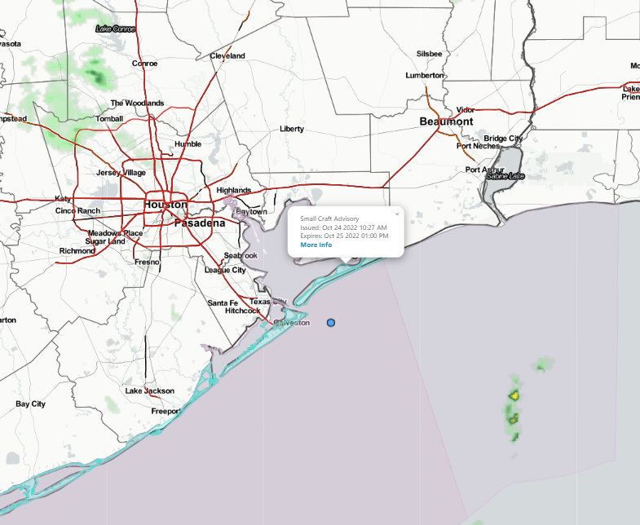
Houston Pilots Forecast Package
Updated: 1:15 PM CT
Monday, October 24, 2022
Forecaster: Will Danby
Weather Headlines
Chances of scattered showers/storms this evening with best chances of widespread rain late Mon. into early Tues. morning.
No direct tropical activity is favored in SE TX over the next 7-10 days.
Some gusts of 45 – 50 MPH possible for the next few days. More details on wind forecasts for each day below.
No visibility concerns over the next few days.
Radar/ NWS Alerts: 1:02 PM CT
As always, please do not hesitate to reach out to us with any forecast questions via the chat option on the Weather Porthole or our on-call number, (317)-560-8122 press 1 for forecast questions.

Slide 2
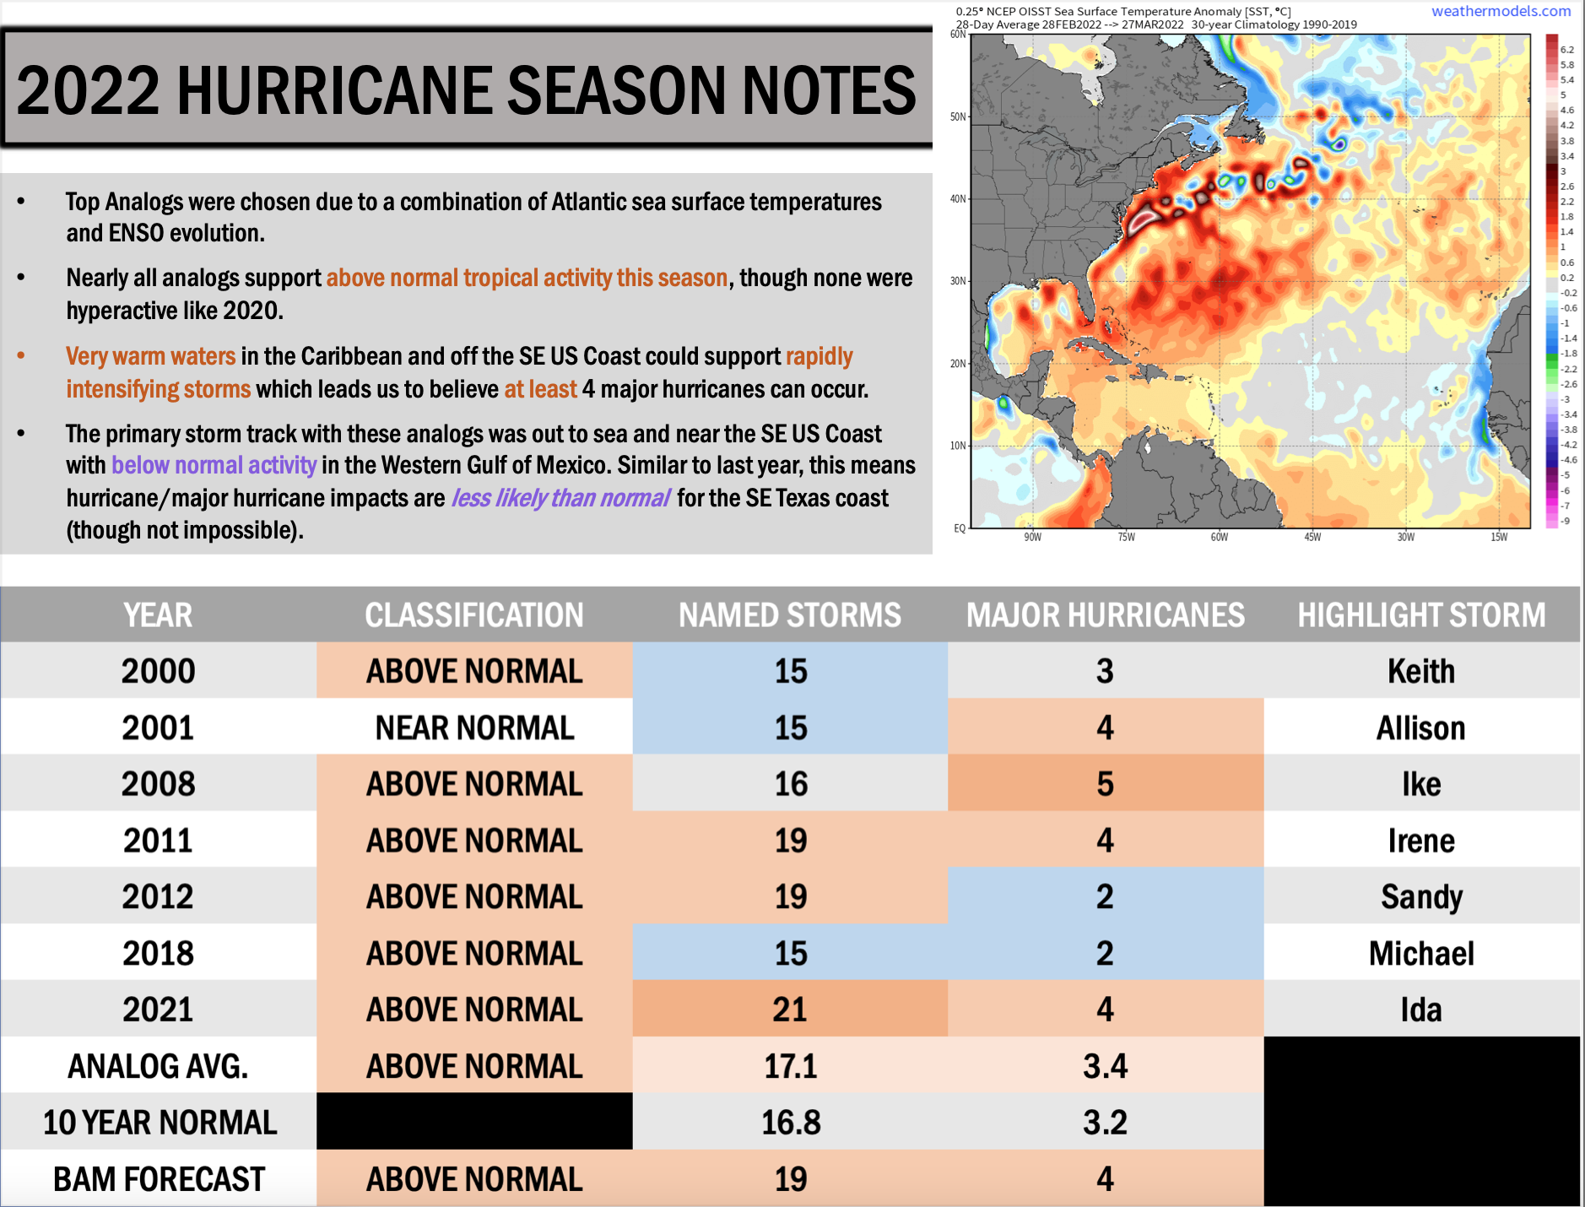
Houston Pilots Tropical Update
Updated: 5:00 AM CT
Thursday, June 23, 2022
Forecaster: Matt Griffin

Slide 3
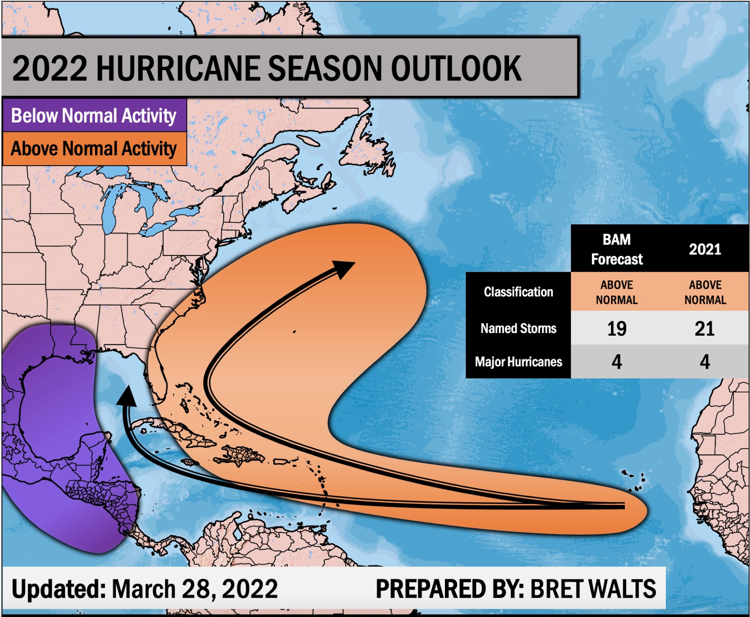
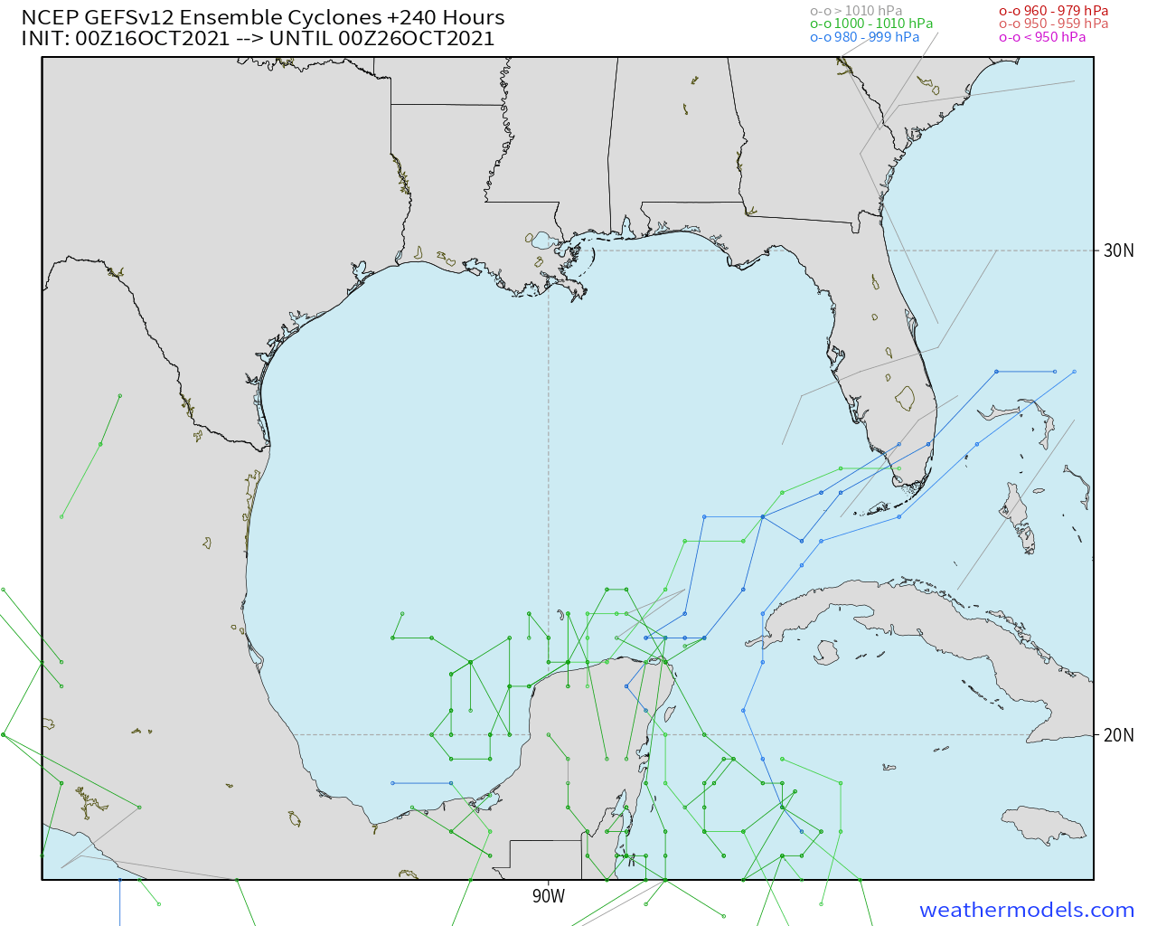
Houston Pilots Tropical Update
GEFS 10-Day Tracks
We continue to favor the Gulf to remain quiet at least for the next 7-10 days.

Slide 4
Houston Pilots Tropical Update
Boarding Station Winds
Time | Direction | Sustained | Gusts
Monday 5AM – 5PM | WSW | 15 – 25 MPH | 25 – 30 MPH
Mon. 5PM – Tue. 10PM | ESE | 25 – 35 MPH | 30 – 40 MPH
Tuesday 10PM – 5AM | SSE | 35 – 50 MPH | 45 – 60 MPH
Tue. 5AM – Wed. 7AM | S | 20 – 30 MPH | 25 – 40 MPH
Boarding Station Winds
Time | Max Wave Heights
Monday 5AM – 5PM | 6– 9 Feet
Mon. 5PM – Tue. 10PM | 9 – 12 Feet
Tuesday 10PM – 5AM | 8 – 10 Feet
Tue. 5AM – Wed. 7AM | 5 – 8 Feet
6 Foot Wave Start: Mon 6AM CT
6 Foot Wave End: Wed 6AM CT

Slide 5
Houston Pilots Tropical Update
Port Condition | 39 MPH Sustained Winds | 6 Foot Waves | Time Remaining/Trigger End
Victor | N/A | N/A | N/A
Whiskey | N/A | N/A | N/A
X-Ray | N/A | N/A | N/A
Yankee | N/A | N/A | N/A
Zulu | N/A | N/A | N/A
Port Condition | Trigger Definition | Trigger Reached?
Victor | Hurricane entering/developing in Gulf of Mexico that’s a threat to the area | No
Whiskey | 72 hours prior to predicted sustained winds of 39+ MPH | No
X-Ray | 48 hours prior to predicted sustained winds of 39+ MPH or 6’ wave height | No
Yankee | 24 hours prior to predicted sustained winds of 39+ MPH or 6’ wave height | No
Zulu | 12 hours prior to predicted sustained winds of 39+ MPH or 6’ wave height | No
Trigger conditions are not expected to be met to change the Port Conditions. Hurricane Ian is currently making landfall in western FL.
See the daily slides for more on winds over the next 2-3 days. Wave heights of up to 4 feet possible at the boarding station through 3 PM today, and Thu 6 AM – 3 PM, but not expected to cross 6’ threshold.

Slide 6
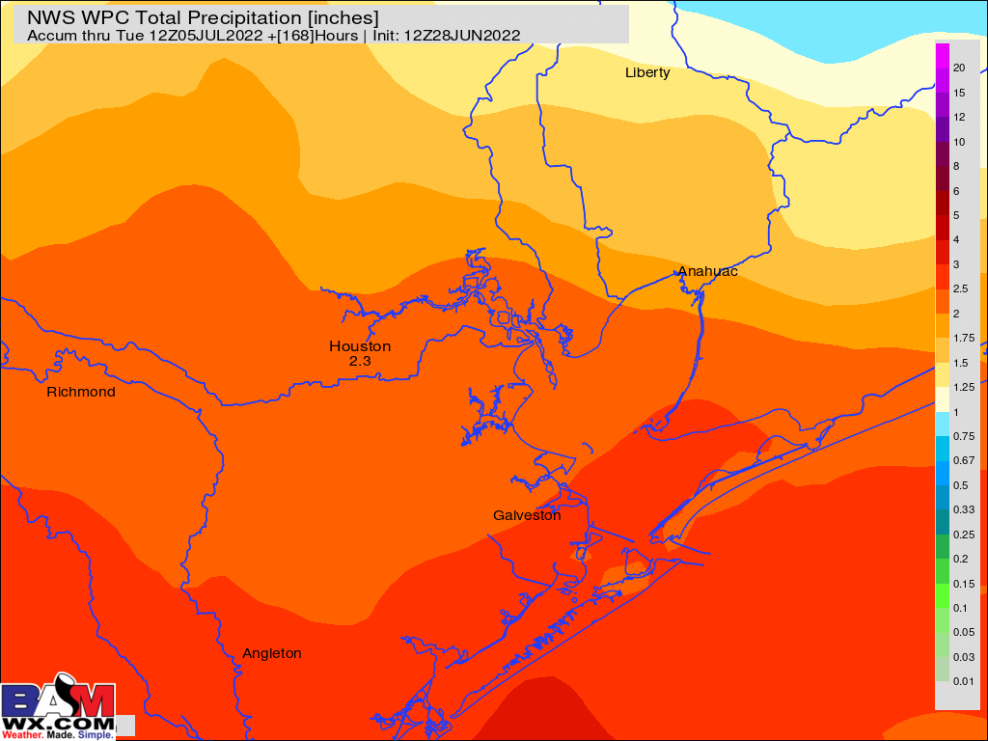
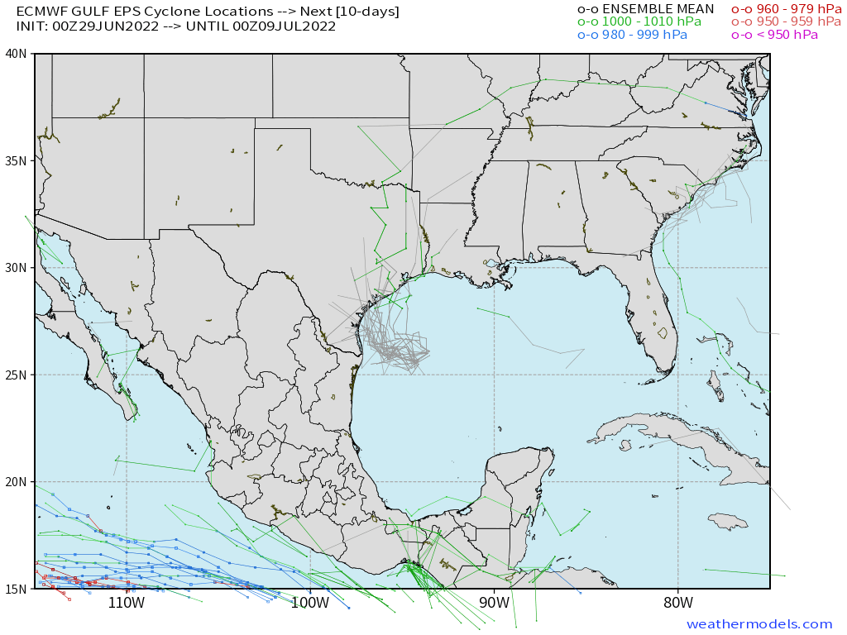
Weak Tropical Disturbance Update
European Data
Rainfall Totals The Next 7 Days
Model Data Low Pressure Track
American Data
A loosely organized area of lower pressure will continue to stick around the Gulf of Mexico out through Saturday. To be clear, we are not expecting wave heights of 6+ feet or winds to meet trigger thresholds. This weakly organized wave will bring some elevated winds and rain chances the next several days (more details on slides below), but looks to be out of the area by ~Saturday. Confidence is higher than normal that the highest impacts from this system looks to be rain.
Confidence
Above Normal
Below Normal

Slide 7
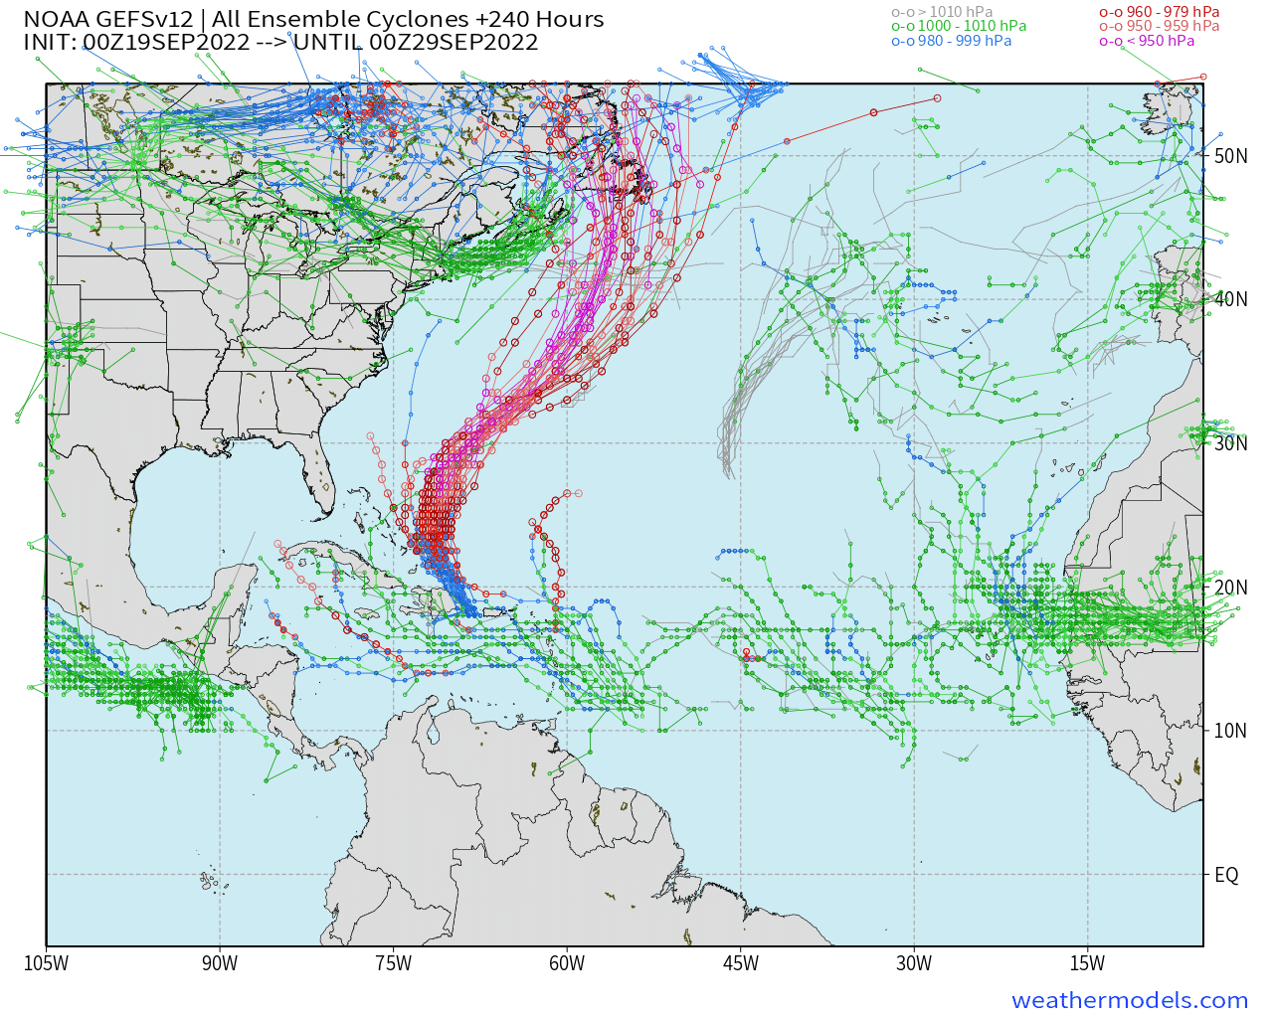
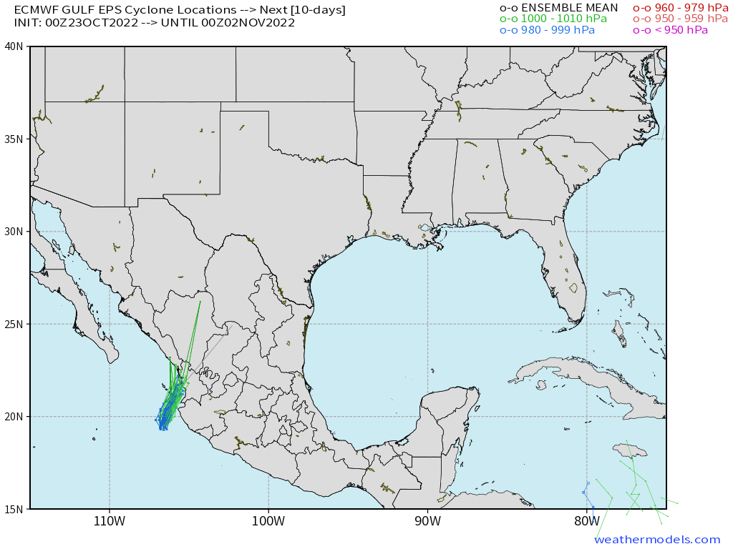
Houston Pilots Extended Range Tropical Report
American Data Tracks Next 10 Days
European Data
European Data Tracks Next 10 Days
American Data
Euro data in much better agreement vs American data. Still several solutions in play as we will need to allow this system to develop before having a better idea on potential track (likely by Sat)
Confidence is above average that both of these potential systems stay “out to sea” in the Atlantic and are not a threat to the Gulf.
High uncertainty into early next week on exact track
There are no tropical threats anticipated for SE TX over the next 7-10 days.
Confidence
Above Normal
Below Normal

Slide 8
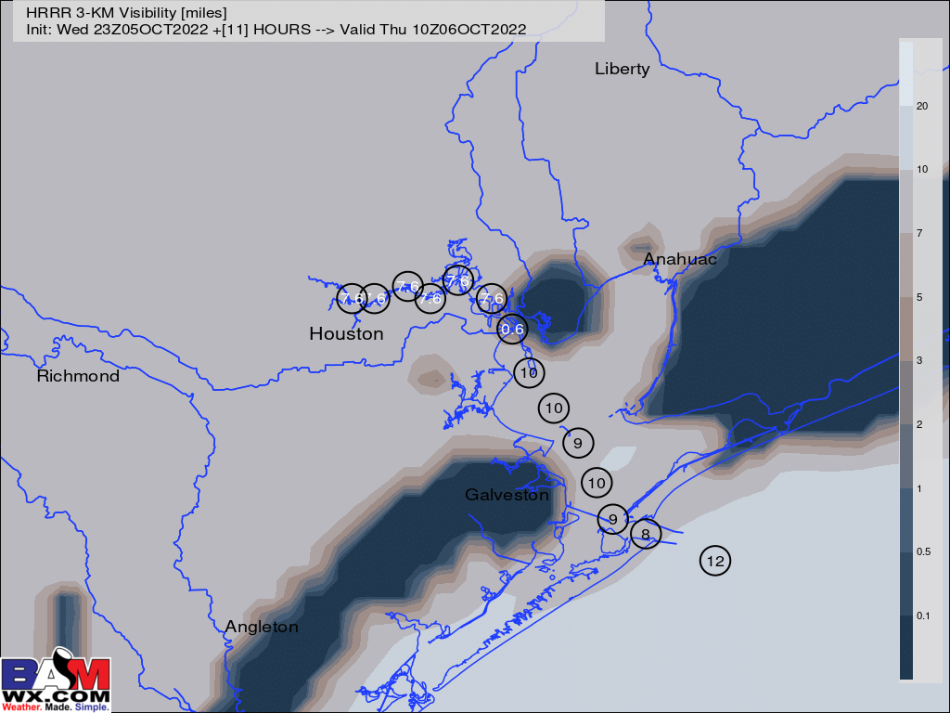
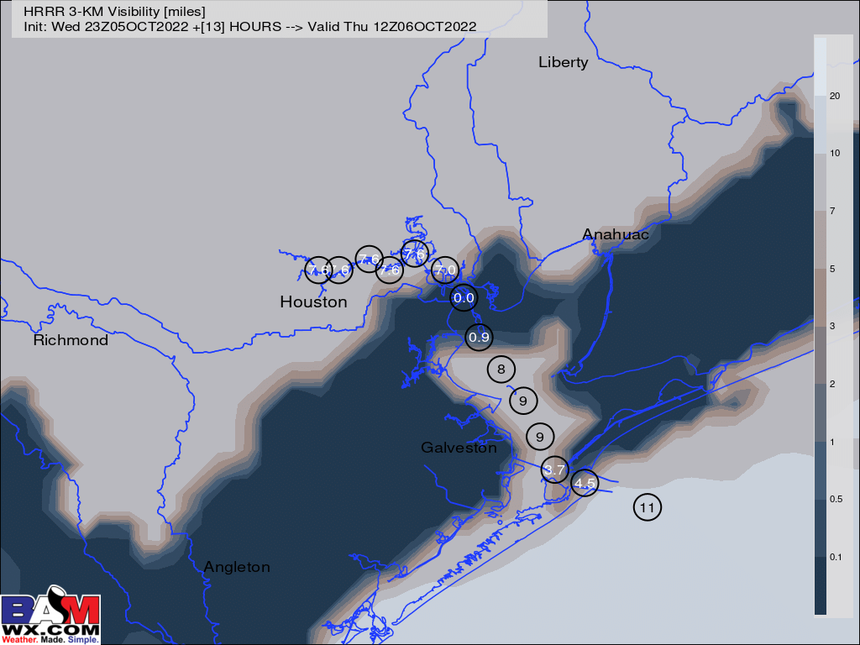
Houston Pilots Visibility Report
5 AM CT THU Visibility (miles)
7 AM CT THU Visibility (miles)
Confidence
Above Normal
Below Normal
Majority of data continues to suggest areas of fog, with greatest widespread risk to the east and west of the bay area.
While model/application may be a bit aggressive with this setup, localized areas of patchy fog with visibilities less than <3mi will be possible for stations 51/52 through Kinder 1 between 5AM and 9AM CT Thursday morning.
Lower confidence still exists on how long patchy reduced visibility/fog can linger Thursday morning, but favoring areas of reduced visibility to recede no later than 9AM-CT Thursday Morning.
Patchy fog risk may be possible once again Friday morning.
Reduced Visibility Threat
5-6 AM THU ~ 9 AM THU | Low to Medium

Slide 9
Houston Pilots Visibility Report
Confidence
Above Normal
Below Normal
Check slides below for more info on the low-end fog risk tomorrow AM.
Localized patchy fog potential NE of stations Monday AM.

Slide 10
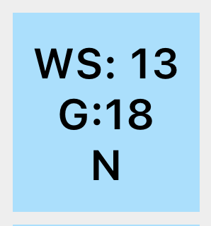
Houston Pilots Wind Report
Example
Above Normal
Confidence
Sustained wind 13 MPH
Gusts 18 MPH
Wind from the N
Below Normal
See slides below for official thoughts on winds.

Slide 11
Houston Pilots Extended Range Visibility Report
Tuesday 6/4/22
Sunday 6/5/22
Currently not anticipating fog on Saturday.
Not seeing a fog signal for the stations on Sunday.
Above Normal
Above Normal
Confidence
Confidence
Below Normal
Below Normal
Monday 6/6/22
Continuing to not see a fog signal for Monday.
Daily Fog Chance
Friday AM | Unlikely
Saturday AM | Unlikely
Sunday AM | Unlikely
Above Normal
Confidence
Below Normal

Slide 12
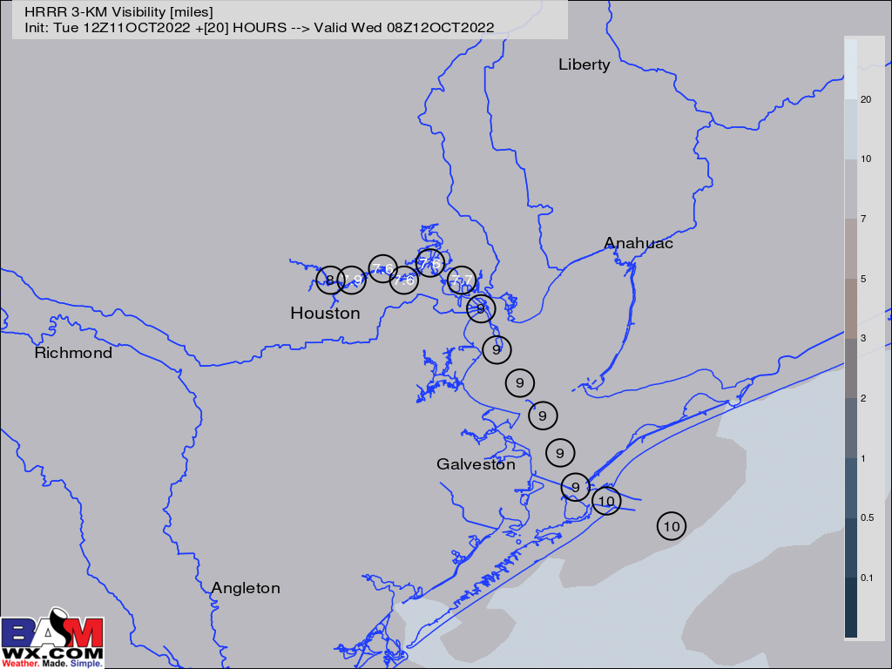
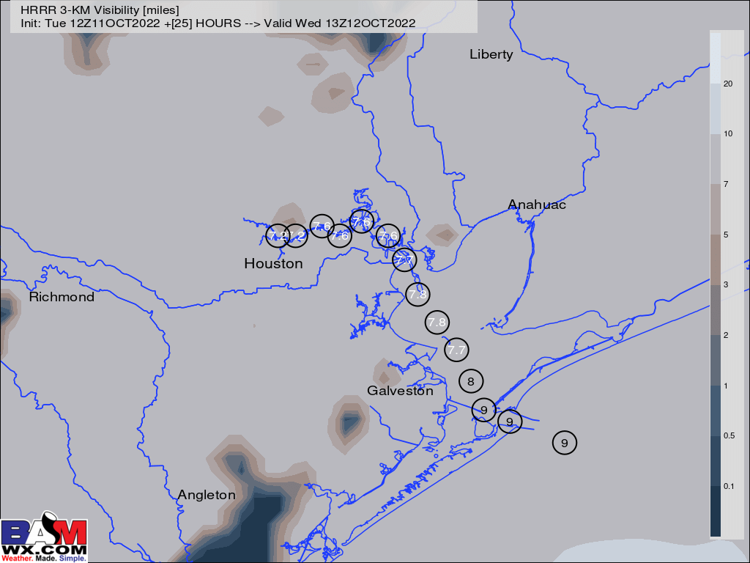
Houston Pilots Visibility Report
11 PM THU Visibility (miles)
4 AM FRI Visibility (miles)
Confidence
Above Normal
Below Normal
Reduced Visibility Threat
5 – 9 AM WED | Low-Medium
Patchy, hit and miss reduced visibilities are possible from stations I – N. These stations
Currently we are in favor of winds staying staying just elevated enough to make limited visibility likely come in the form of rain/mist/drizzle, however we want to make the note that if winds weaken any, a few instance of patchy fog would be possible for any stations S of Morgan’s Point.
After ~6 AM, the front should pass the area and sweep away any visibility concerns.

Slide 13
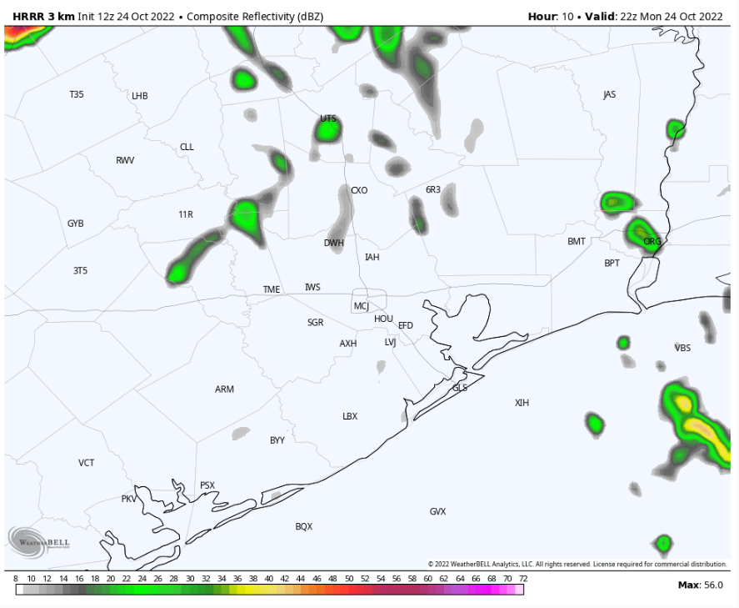
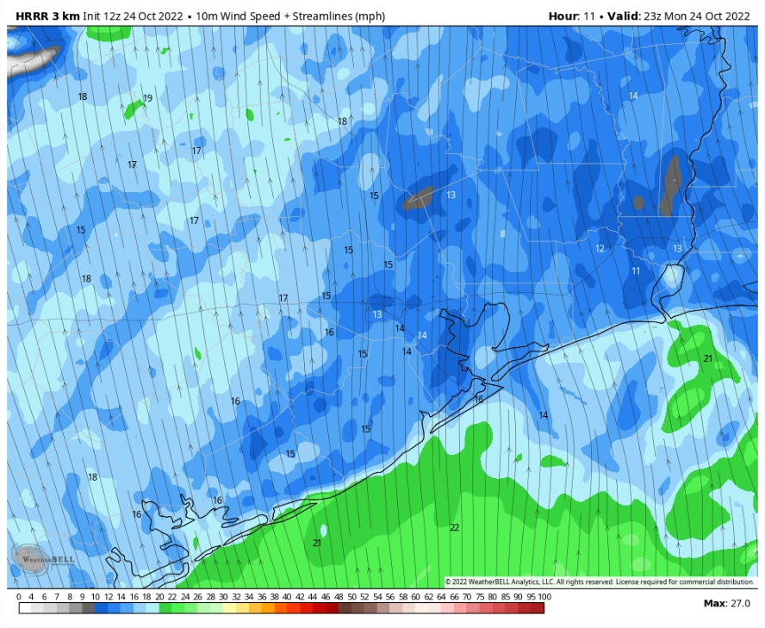
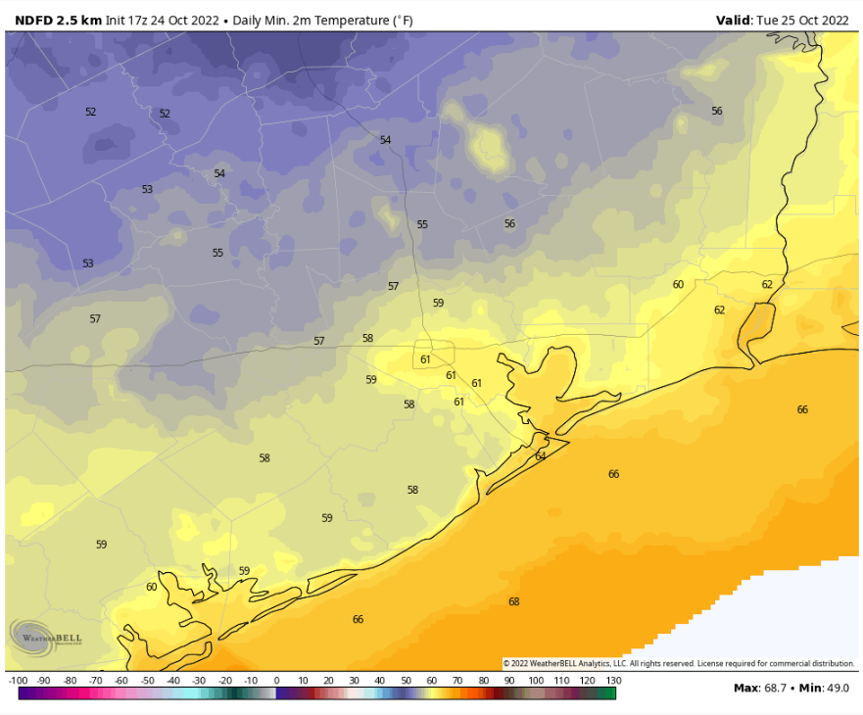
Houston Pilots: Mon. 10/24/2022
Forecast Discussion
Precip Forecast: 4 PM CT
Precip:. Anticipating a 40% chance of scattered showers and thunderstorms about the area for the afternoon and evening. See next slide for more details on anticipated cold front to arrive in the area in the early morning.
Wind: Sustained S winds throughout the afternoon and evening. Winds N of Morgan’s point will be 12-16 MPH, while winds south of Morgan’s point will be 15-20 MPH. All stations can expect wind gusts of 27 – 32 MPH during the 2PM-12AM timeframe.
Temps: Low temps will be in the mid 60s F S of Morgan’s Point, and low 60s N of Morgan’s Point.
Visibility: Not favoring any concerns for reduced visibility.
Wind Speed
6 PM CT
Low Temps Tues AM

Slide 14
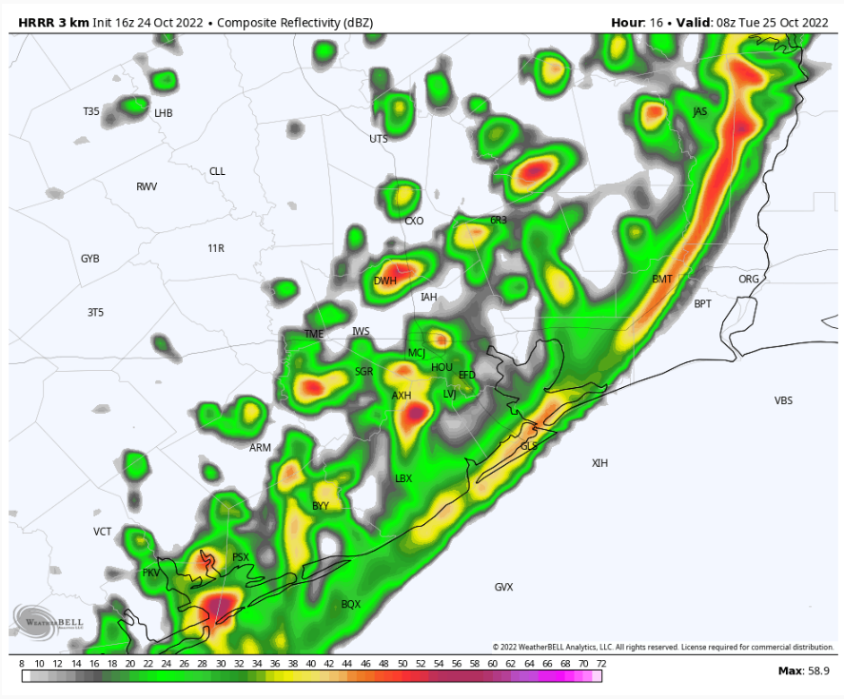
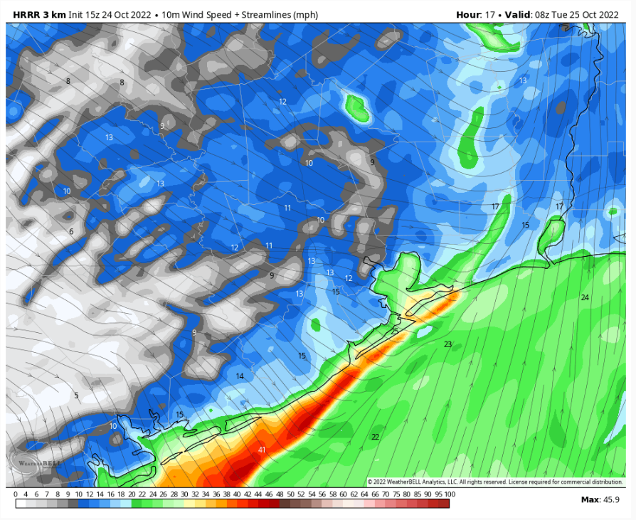
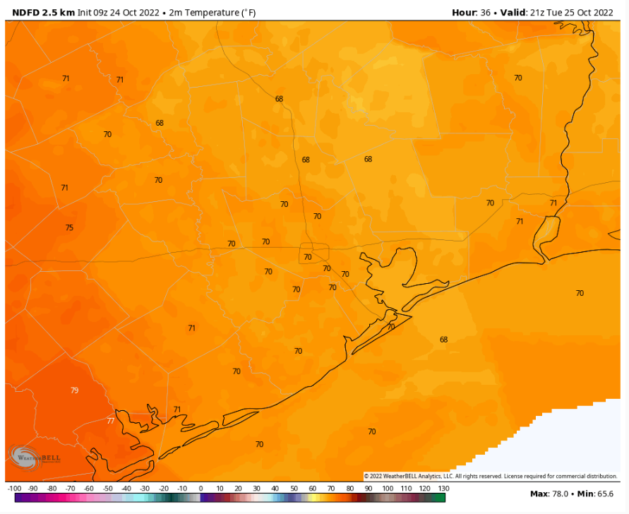
Houston Pilots: Tue. 10/25/2022
Forecast Discussion
Precip Forecast: 3 AM CT
Precip: Anticipating a line of showers/thunderstorms to move into the HOU Metro area beginning around 2AM. By 7 AM these showers/storms will have moved out of the area leaving clearing conditions the rest of the day. Gusty winds and a brief period of lightning, heavy rain, reduced visibilities of < 2 mi and wind gusts of 45 – 50 MPH are expected with this line of storms. Cannot rule out the chance for a brief tornado (roughly 5%)
Wind: Sustained S winds in the very early AM with a front moving through from the NW starting around 2AM Tuesday. Winds will be 20-25 MPH veering from the SW ahead of the front south of Morgan’s Point. Winds north of Morgan’s Point will be 12-17 MPH. Winds associated the cold front are expected to be 22-27 MPH with gusts to 45-50 MPH. Anticipated timeframe of frontal passage will be from 2-5 AM. After the front moves through, winds will shift from the NW and lull for a brief period N of Morgan’s point to 6-11 MPH, then pick back up by 7 AM to 11-16 MPH. After the passage of the cold front around 5 AM, winds remain elevated for all stations S of Morgan’s point, with winds of 21-26 MPH and gusts of 25 – 30 MPH. By 7 PM, winds rapidly diminish N of Morgan’s point 2-7 MPH, while S of Morgan’s point winds will be 13-18 MPH.
Temps: High temps Tuesday for all stations in the low 70s F.
Visibility: Not anticipating visibility concerns at this time.
Wind Speed
3 AM CT
High Temps Tuesday

Slide 15
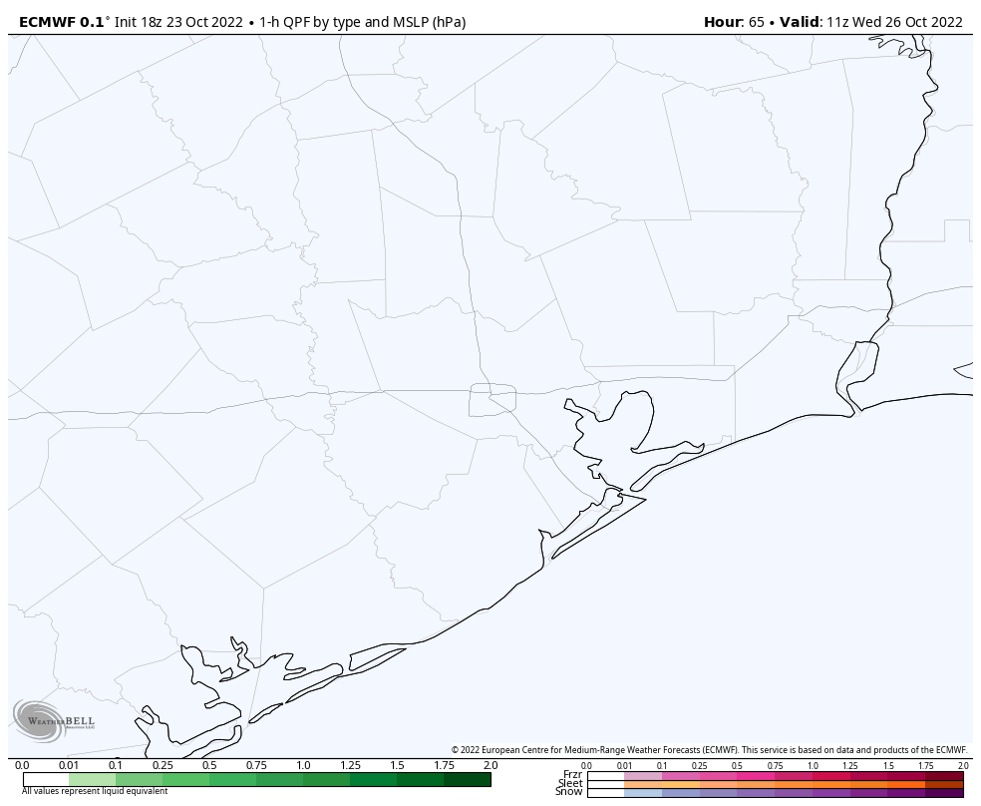
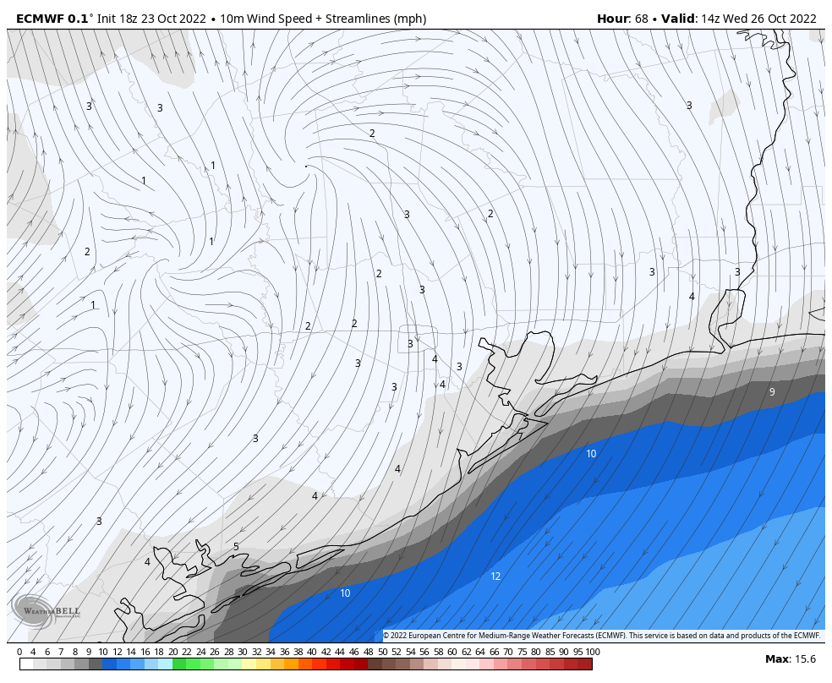
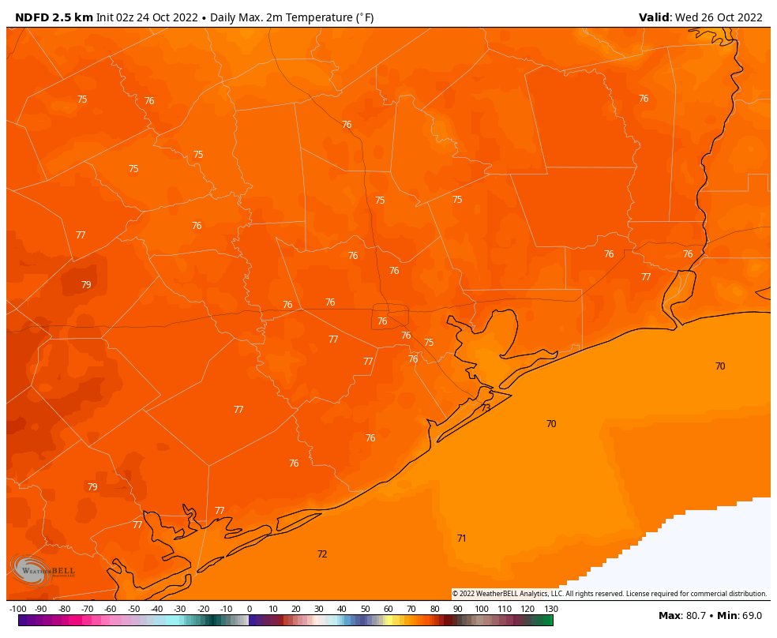
Houston Pilots: Wed. 10/26/2022
Forecast Discussion
Precip Forecast: 6 AM CT
Precip: Anticipating dry conditions Wednesday.
Wind: Sustained wind Wednesday AM out of the NNE at 3-8 MPH north of Morgan’s Point and 10-15 MPH south of Morgan’s Point. Winds will gradually veer out of the east by 4PM and all sustained winds will be with the 3-8 MPH range. After 7, winds will veer out of the SSE where they will continue the rest of the night.
Temps: High temps Wednesday near 70 F at the boarding station and in the mid 70s F at all other stations.
Visibility: Not anticipating visibility concerns at this time.
Wind Speed
9 AM CT
High Temps Wednesday

Slide 16
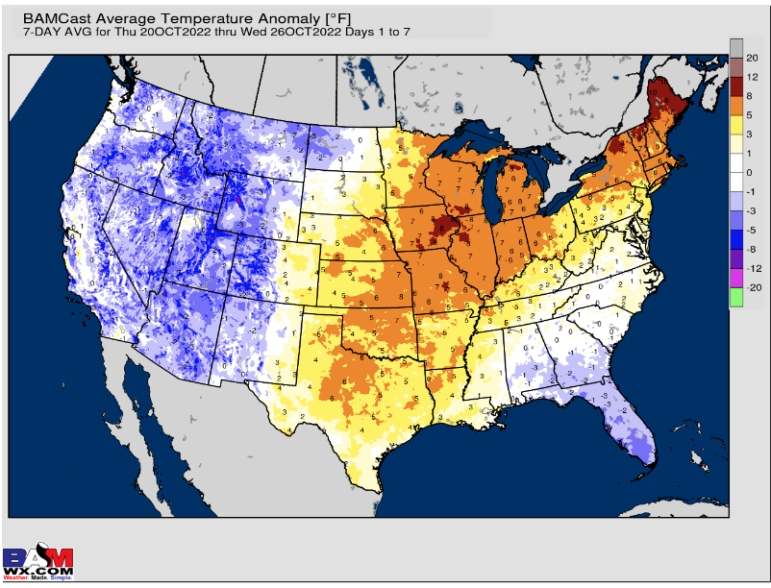
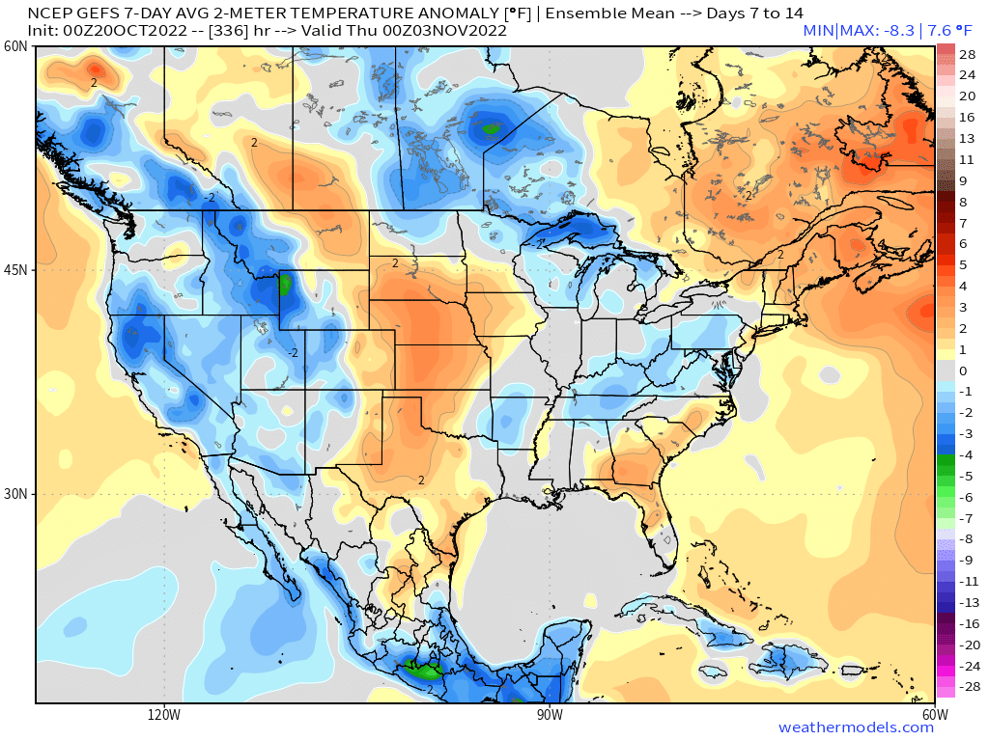
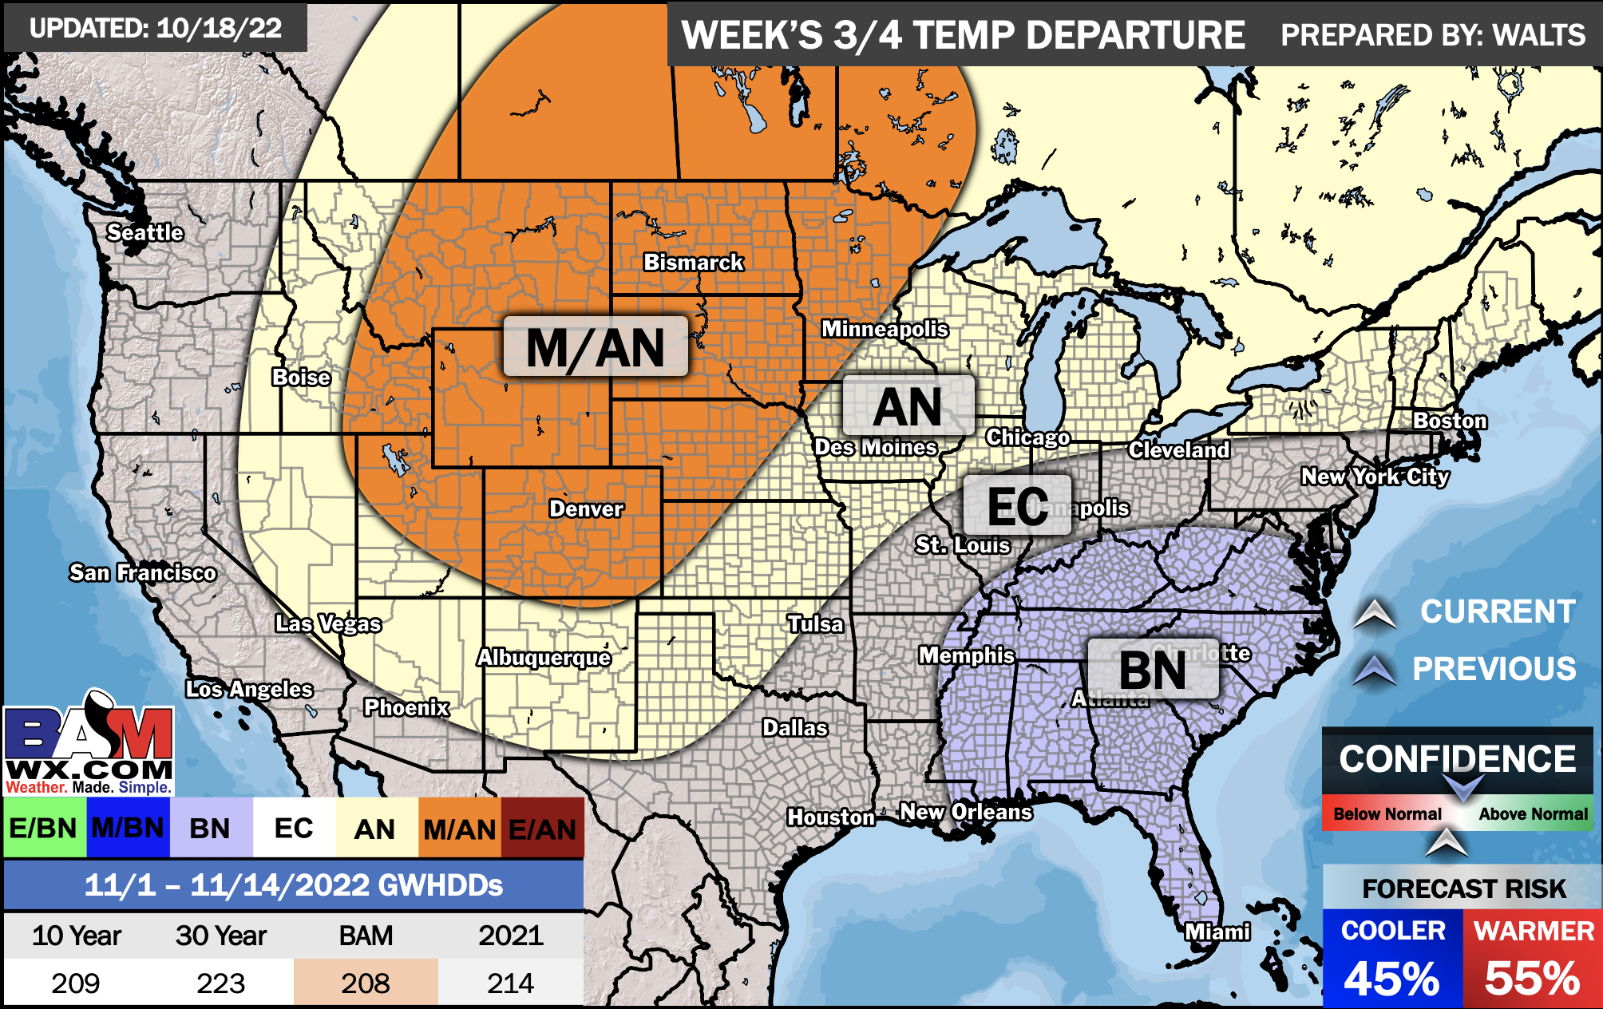
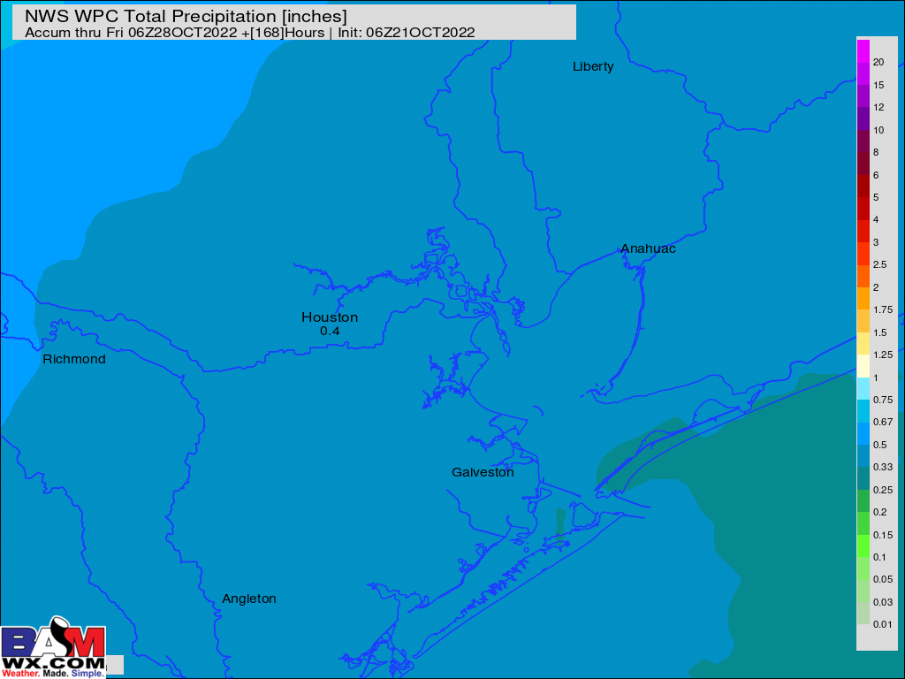
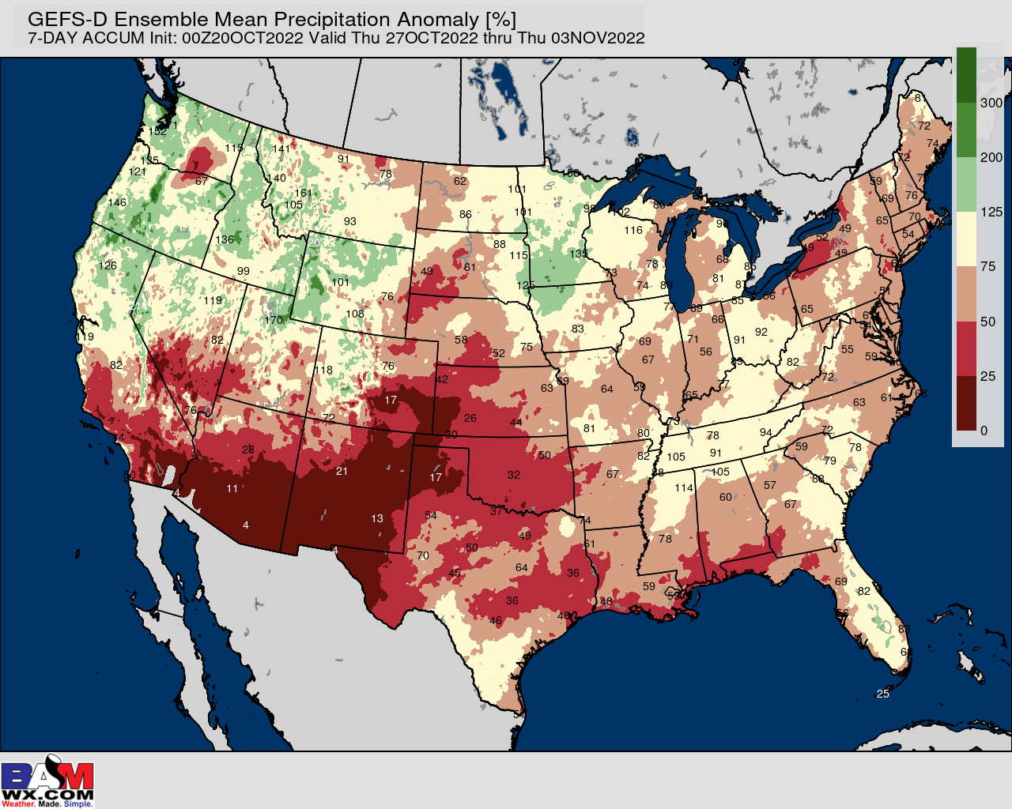
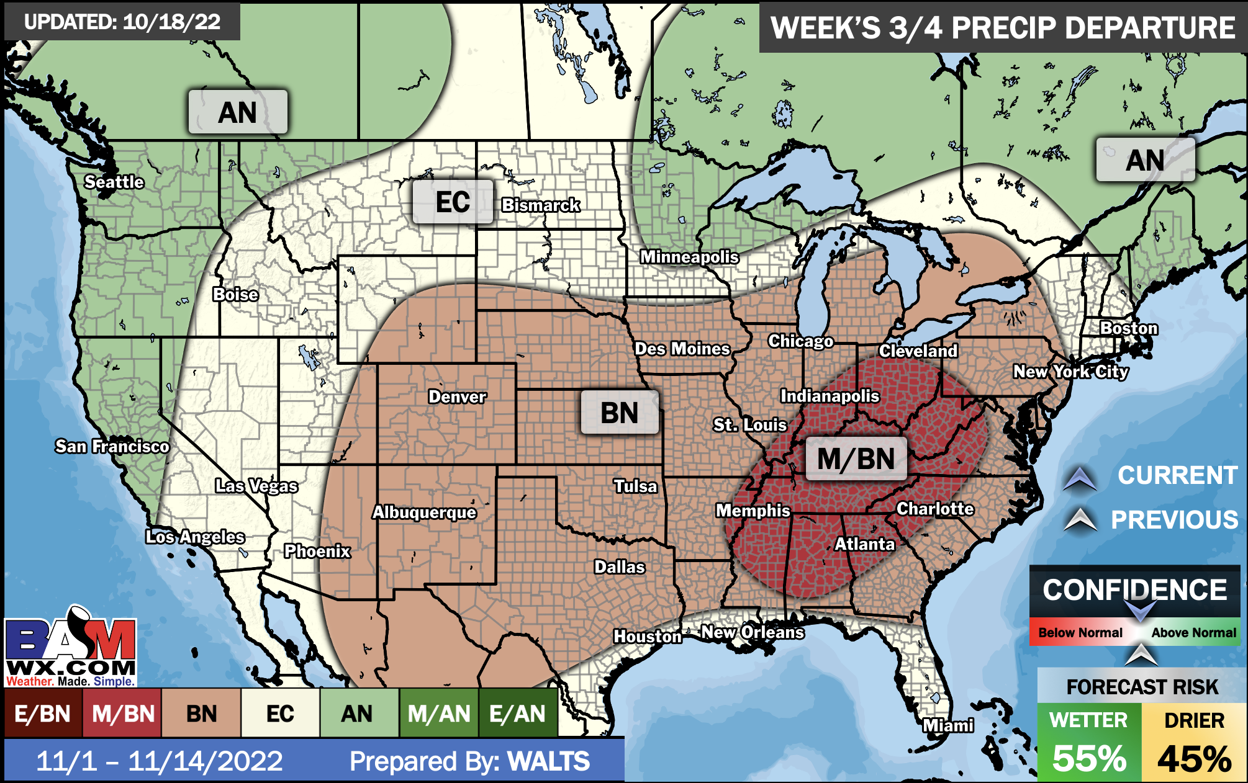
Houston Pilots: 10/24/2022
Week 1
Week 2
Week’s 3/4
Temperatures expected to be near or slightly above normal next week. More widespread chances of rain going into Tuesday - Wednesday.
Week 2 to feature near or slightly above normal temperatures and below normal precipitation.
The weeks ¾ timeframe into late October looks to feature normal temperatures and below normal to normal risks for precip.

