Slide 1
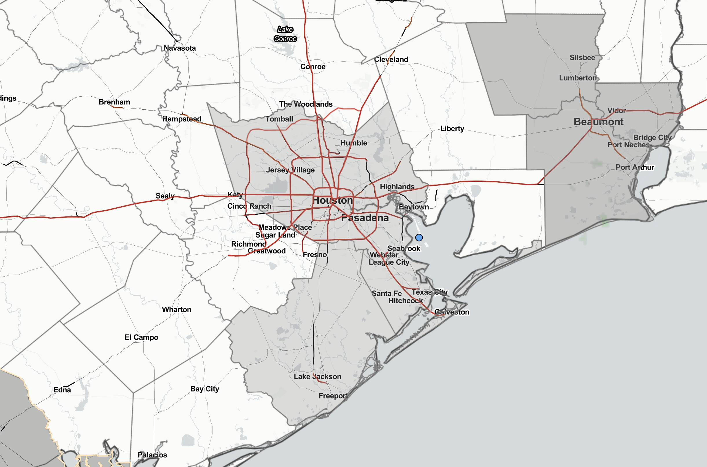
Houston Pilots Forecast Package
Updated: 7:00 AM CT
Saturday, June 18th, 2022
Forecaster: John Kemper
Chances of Isolated/Scattered Showers/Storms will gradually increase over the next 3 days
Temperatures are continued to stay above average with temp highs reaching the 90’s.
A general southerly wind (varying at times to SE & SW) will continue.
No tropical threats anticipated over the next 10 days.
Weather Headlines
Radar/ NWS Alerts: 7:00 AM CT
As always, please do not hesitate to reach out to us with any forecast questions via the chat option on the Weather Porthole or our on-call number, (317)-560-8122 press 1 for forecast questions.

Slide 2
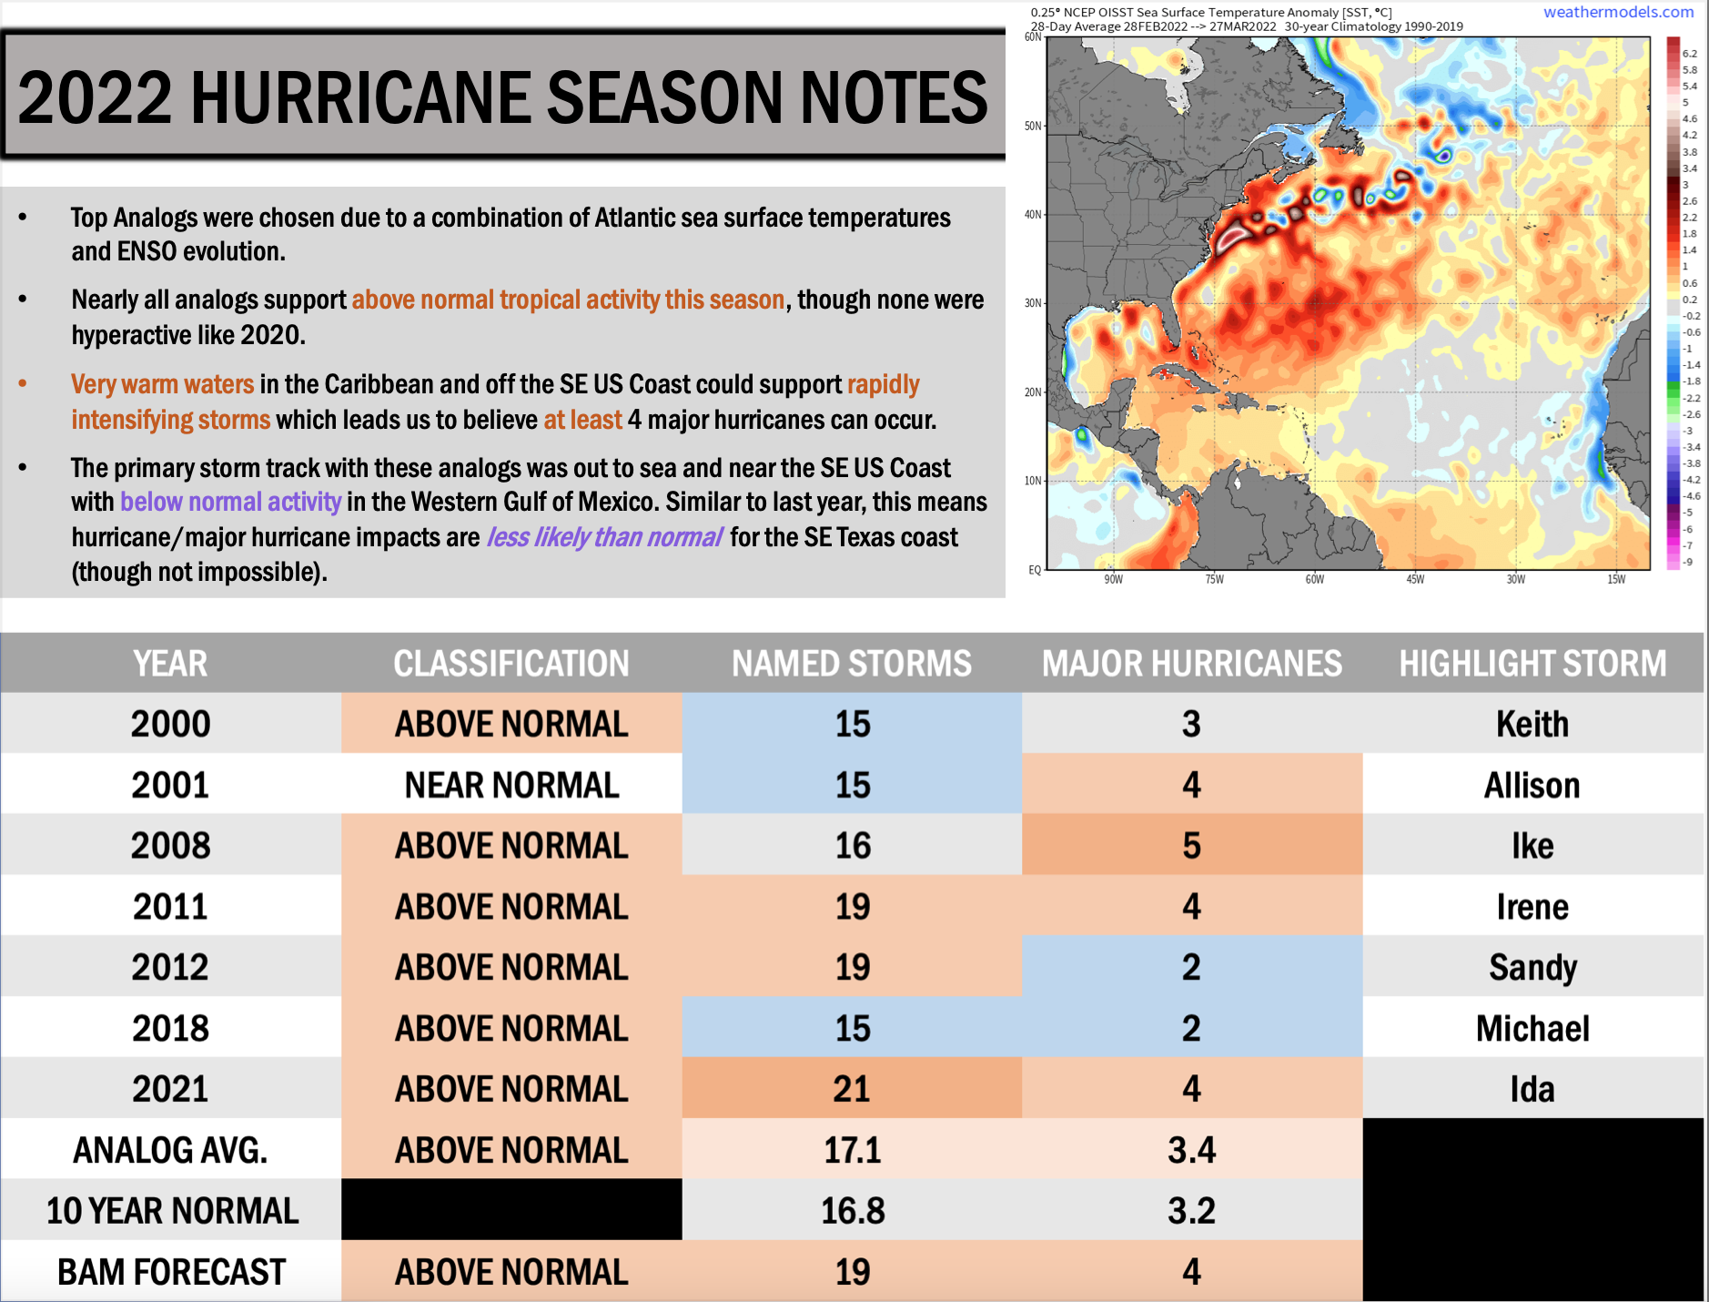
Houston Pilots Tropical Update
Updated: 5:00 AM CT
Saturday, June 18, 2022
Forecaster: Matt Griffin

Slide 3
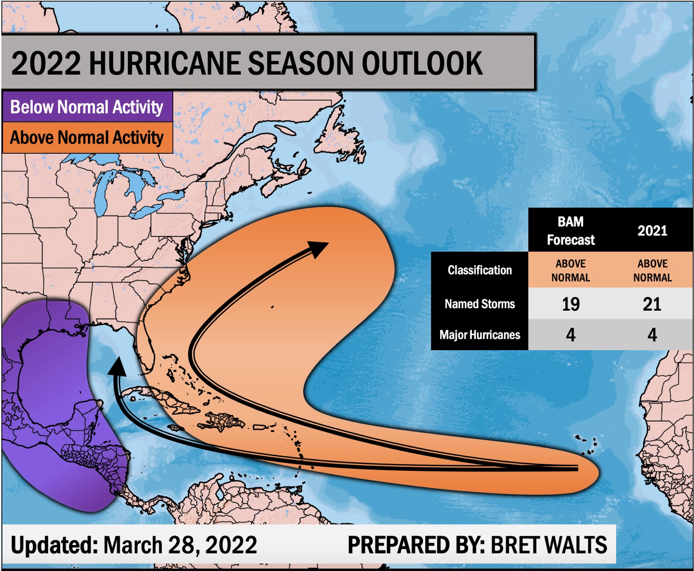
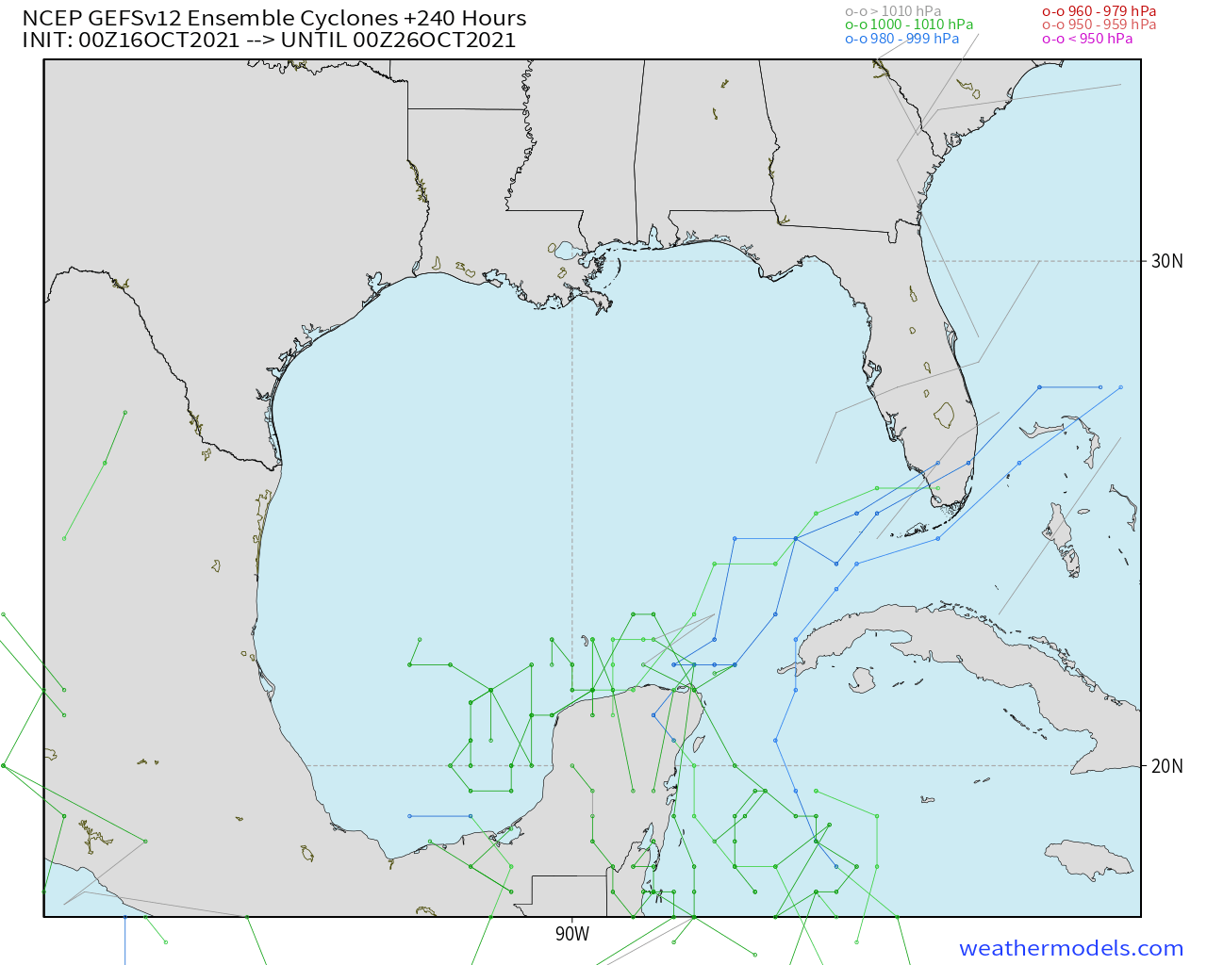
Houston Pilots Tropical Update
GEFS 10-Day Tracks
We continue to favor the Gulf to remain quiet at least for the next 7-10 days.

Slide 4
Houston Pilots Tropical Update
Boarding Station Winds
Time | Direction | Sustained | Gusts
Monday 5AM – 5PM | WSW | 15 – 25 MPH | 25 – 30 MPH
Mon. 5PM – Tue. 10PM | ESE | 25 – 35 MPH | 30 – 40 MPH
Tuesday 10PM – 5AM | SSE | 35 – 50 MPH | 45 – 60 MPH
Tue. 5AM – Wed. 7AM | S | 20 – 30 MPH | 25 – 40 MPH
Boarding Station Winds
Time | Max Wave Heights
Monday 5AM – 5PM | 6– 9 Feet
Mon. 5PM – Tue. 10PM | 9 – 12 Feet
Tuesday 10PM – 5AM | 8 – 10 Feet
Tue. 5AM – Wed. 7AM | 5 – 8 Feet
6 Foot Wave Start: Mon 6AM CT
6 Foot Wave End: Wed 6AM CT

Slide 5
Houston Pilots Tropical Update
Port Condition | 39 MPH Sustained Winds | 6 Foot Waves | Time Remaining/Trigger End
Victor | IN EFFECT | IN EFFECT | 72 Hours/7PM Wed.
Whiskey | IN EFFECT | IN EFFECT | 72 Hours/7PM Wed.
X-Ray | Initiated at 7PM Mon. | Initiated at 7PM Mon. | N/A
Yankee | N/A | N/A | N/A
Zulu | N/A | N/A | N/A
Port Condition | Trigger Definition | Trigger Reached?
Victor | Hurricane entering/developing in Gulf of Mexico | Yes
Whiskey | 72 hours prior to predicted sustained winds of 39+ MPH | Yes
X-Ray | 48 hours prior to predicted sustained winds of 39+ MPH or 6’ wave height | No
Yankee | 24 hours prior to predicted sustained winds of 39+ MPH or 6’ wave height | No
Zulu | 12 hours prior to predicted sustained winds of 39+ MPH or 6’ wave height | No
We remain in Zulu this morning as tropical storm force winds continue. These continue for at least the next few hours but weaken as the storm moves north late this morning/early afternoon.
However, we expect Zulu to remain in effect until this evening due to high wave heights. Latest guidance would suggest we drop waves to below 6 feet by 8 – 9 PM.

Slide 6
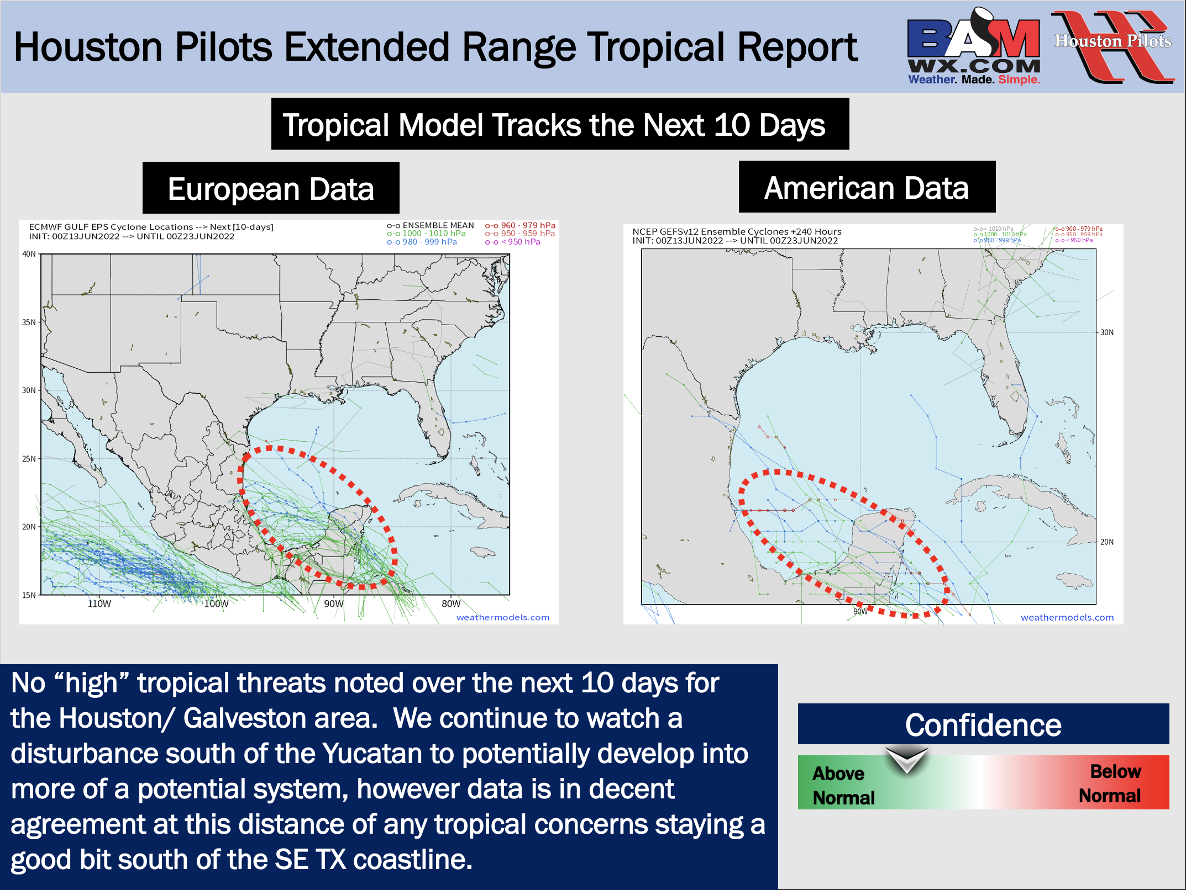
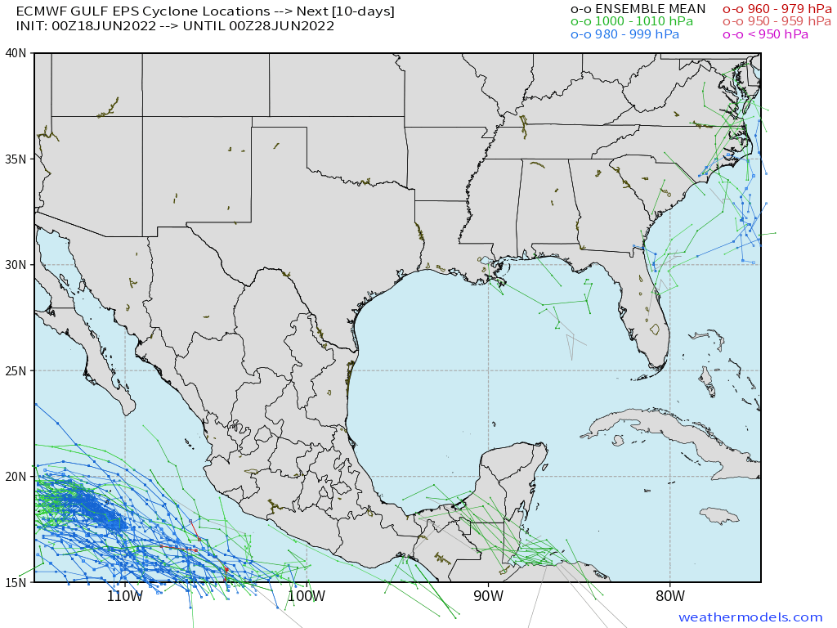
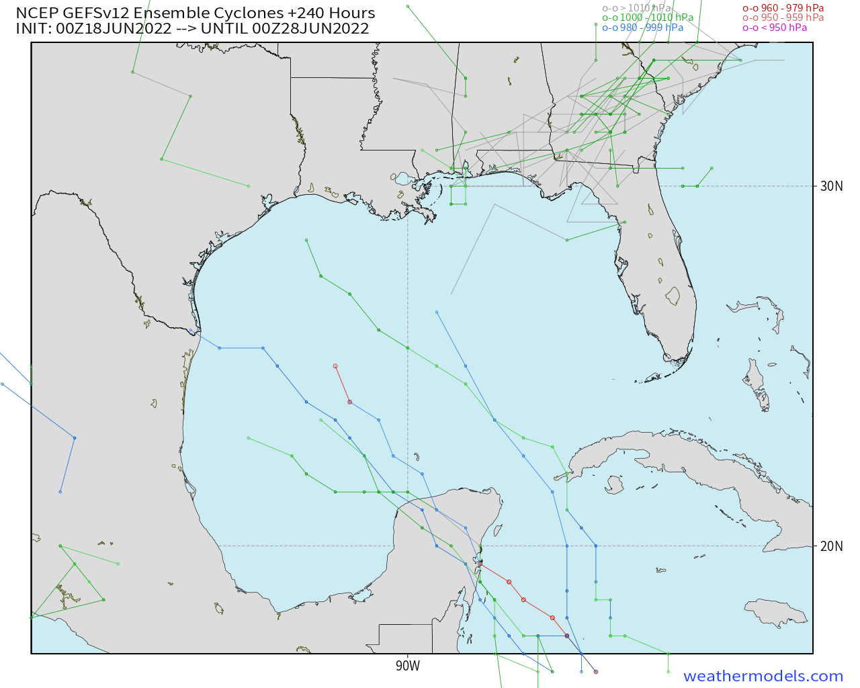
Houston Pilots Extended Range Tropical Report
Tropical Model Tracks the Next 10 Days
European Data
American Data
No tropical threats noted over the next 10 days for the Houston/ Galveston area.
Confidence
Above Normal
Below Normal

Slide 7
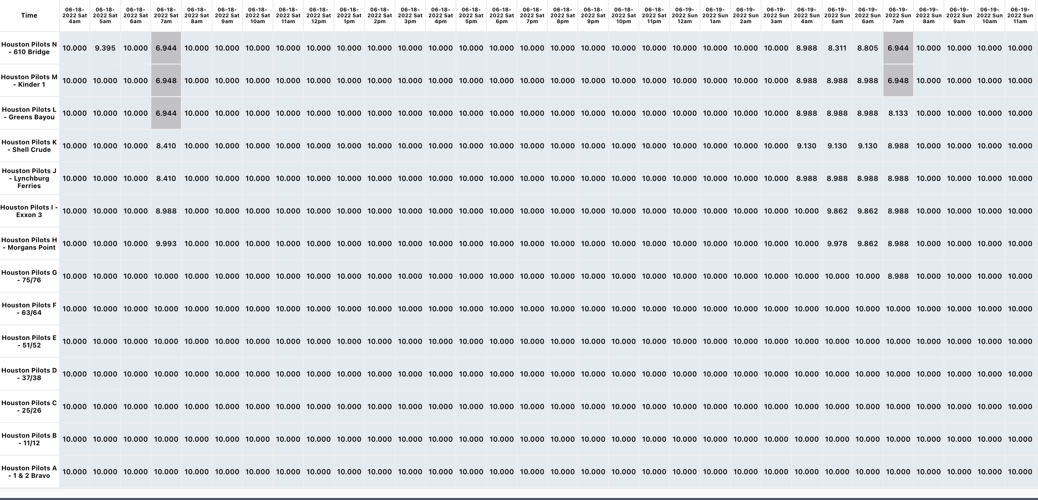
Houston Pilots Visibility Report
Above Normal
Confidence
Below Normal
Check slides below for more info on the low-end fog risk tomorrow AM.
Not anticipating fog tonight/Sat AM.

Slide 8
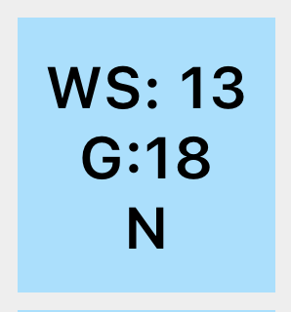
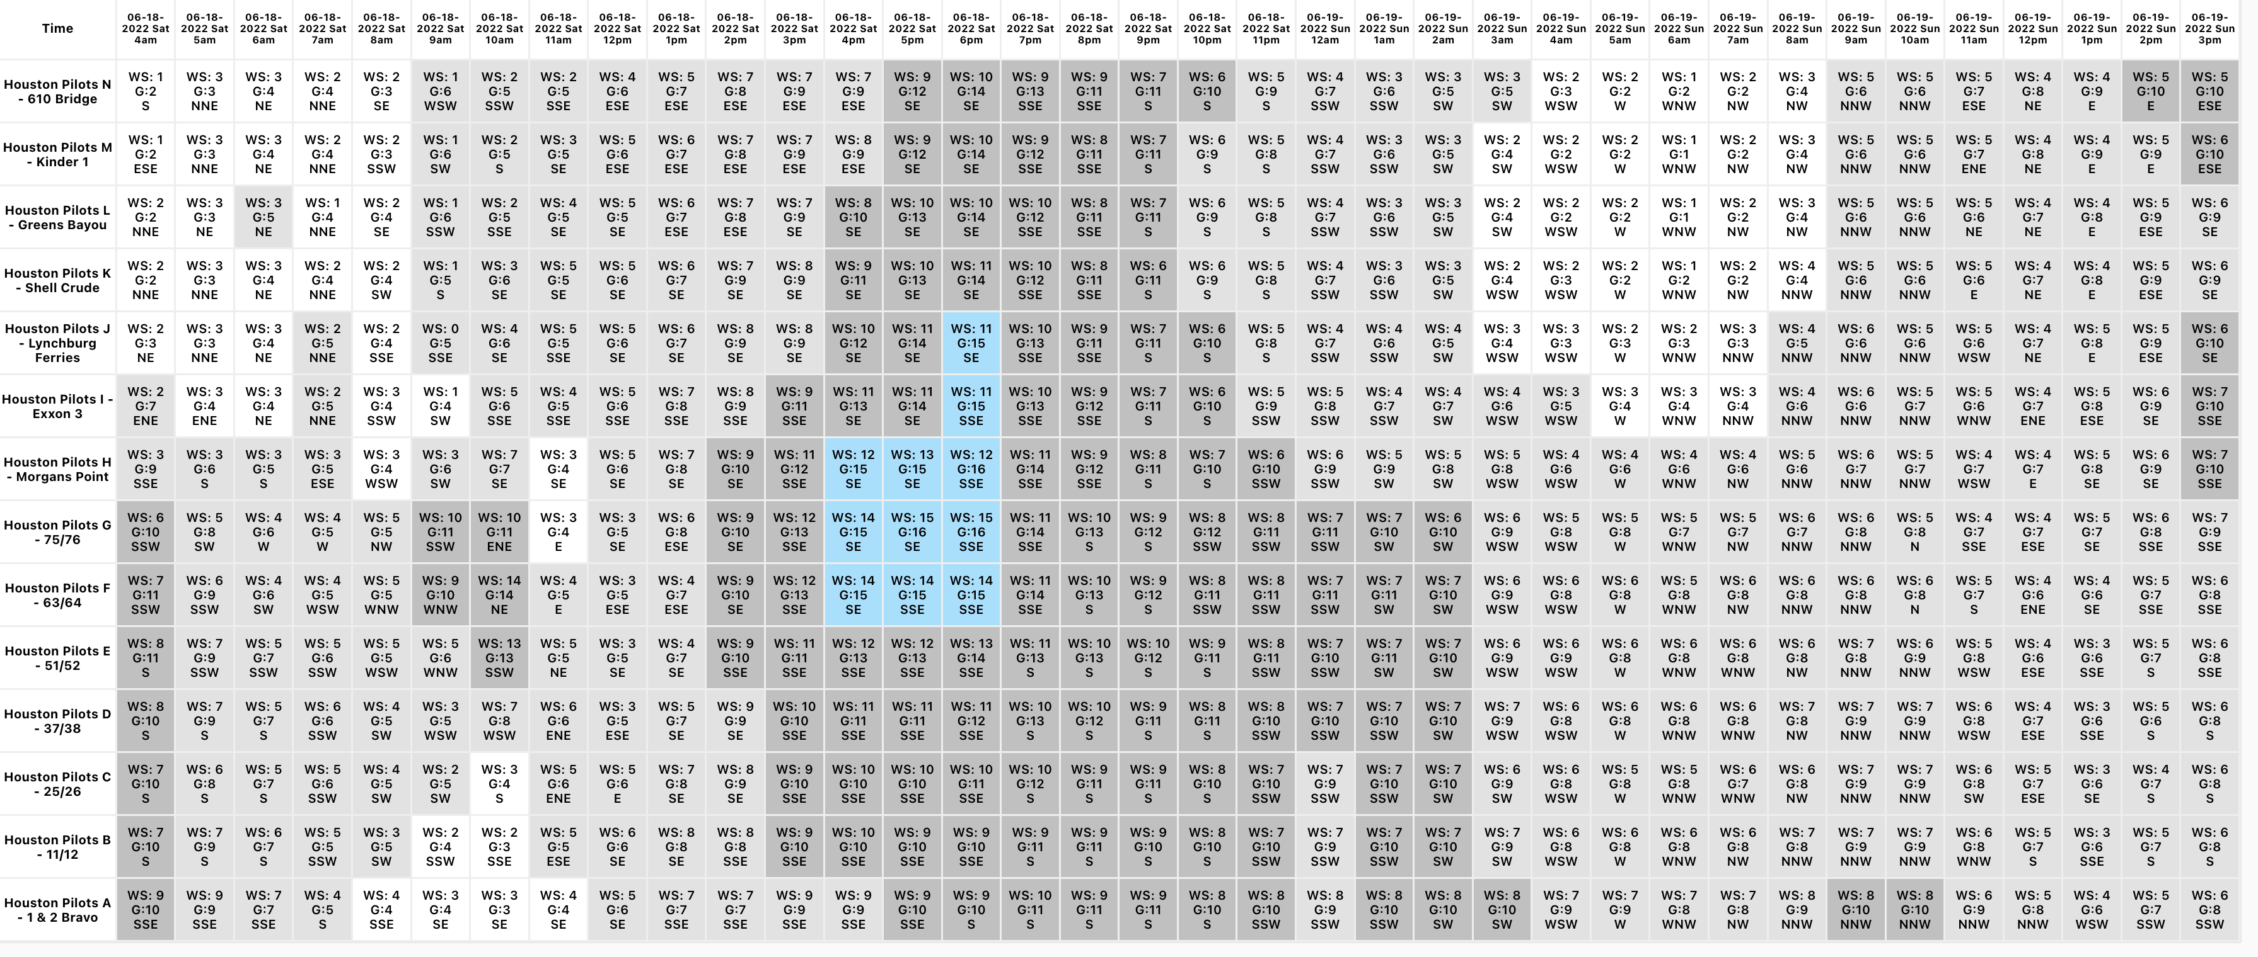
Houston Pilots Wind Report
Example
Above Normal
Confidence
Sustained wind 13 MPH
Gusts 18 MPH
Wind from the N
Below Normal
Check slides below for more info on the low-end fog risk tomorrow AM.
See slides below for official thoughts on winds.

Slide 9
Houston Pilots Extended Range Visibility Report
Saturday 6/4/22
Sunday 6/5/22
Currently not anticipating fog on Saturday.
Not seeing a fog signal for the stations on Sunday.
Confidence
Confidence
Above Normal
Above Normal
Below Normal
Below Normal
Monday 6/6/22
Continuing to not see a fog signal for Monday.
Daily Fog Chance | Max Wave Heights
Friday AM | Unlikely
Saturday AM | Unlikely
Sunday AM | Unlikely
Confidence
Above Normal
Below Normal

Slide 10
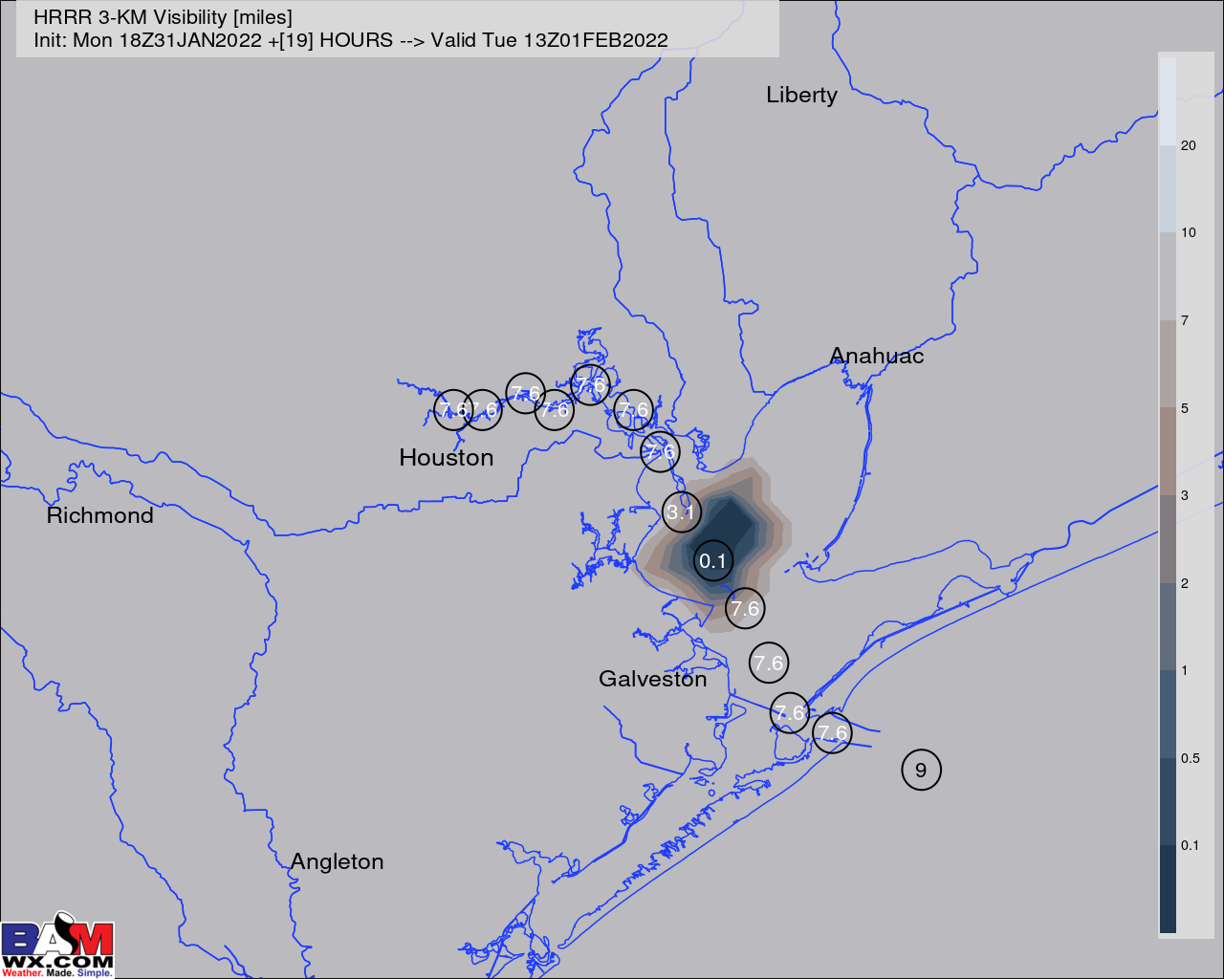
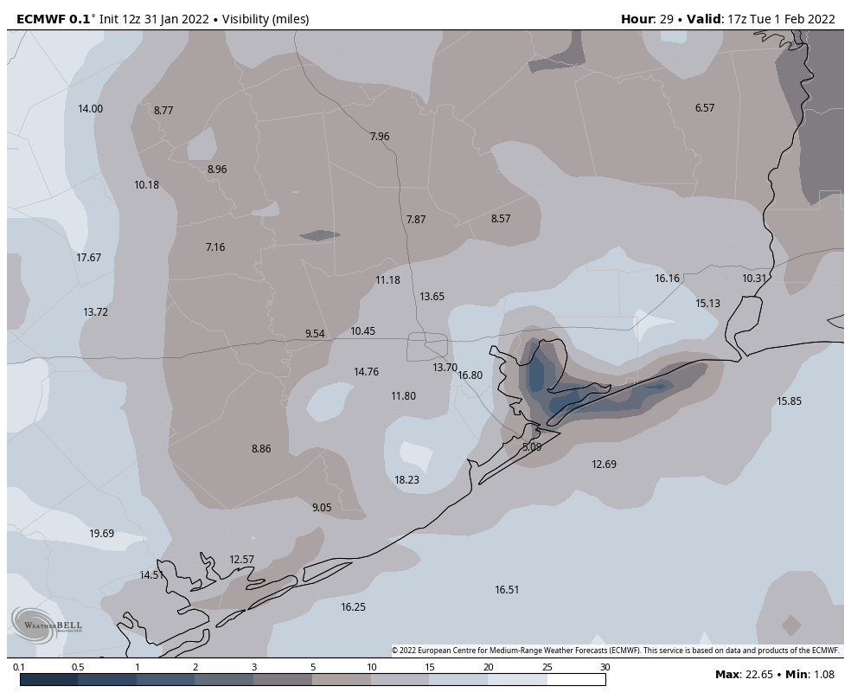
Houston Pilots Visibility Report
7 AM CT TUE Visibility (miles)
11 AM CT TUE Visibility (miles)
Confidence
Above Normal
Below Normal
Data is still in disagreement on exact timing of reduced visibility/fog Tuesday AM, but most data continues to show the potential for patchy fog tomorrow morning.
Patchy reduced visibilities/fog will be possible beginning around 5-6 AM tomorrow morning from around the 25/26 station through Morgan’s Point. Patchy fog around the boarding station is not favored till around the 8-9 AM timeframe.
Lower confidence still exists on how long patchy reduced visibility/fog can linger into Tuesday, but data suggests most reduced visibility can be clear by the ~noon timeframe. Not anticipating this to be a widespread nor dense fog risk over our stations.
Widespread possibly dense fog will be a threat as we go into Tuesday night and into Wednesday morning. See two slides below for more details on this.
Reduced Visibility Threat | Max Wave Heights
5-6 AM TUE ~ 12 PM TUE | Low to Medium

Slide 11
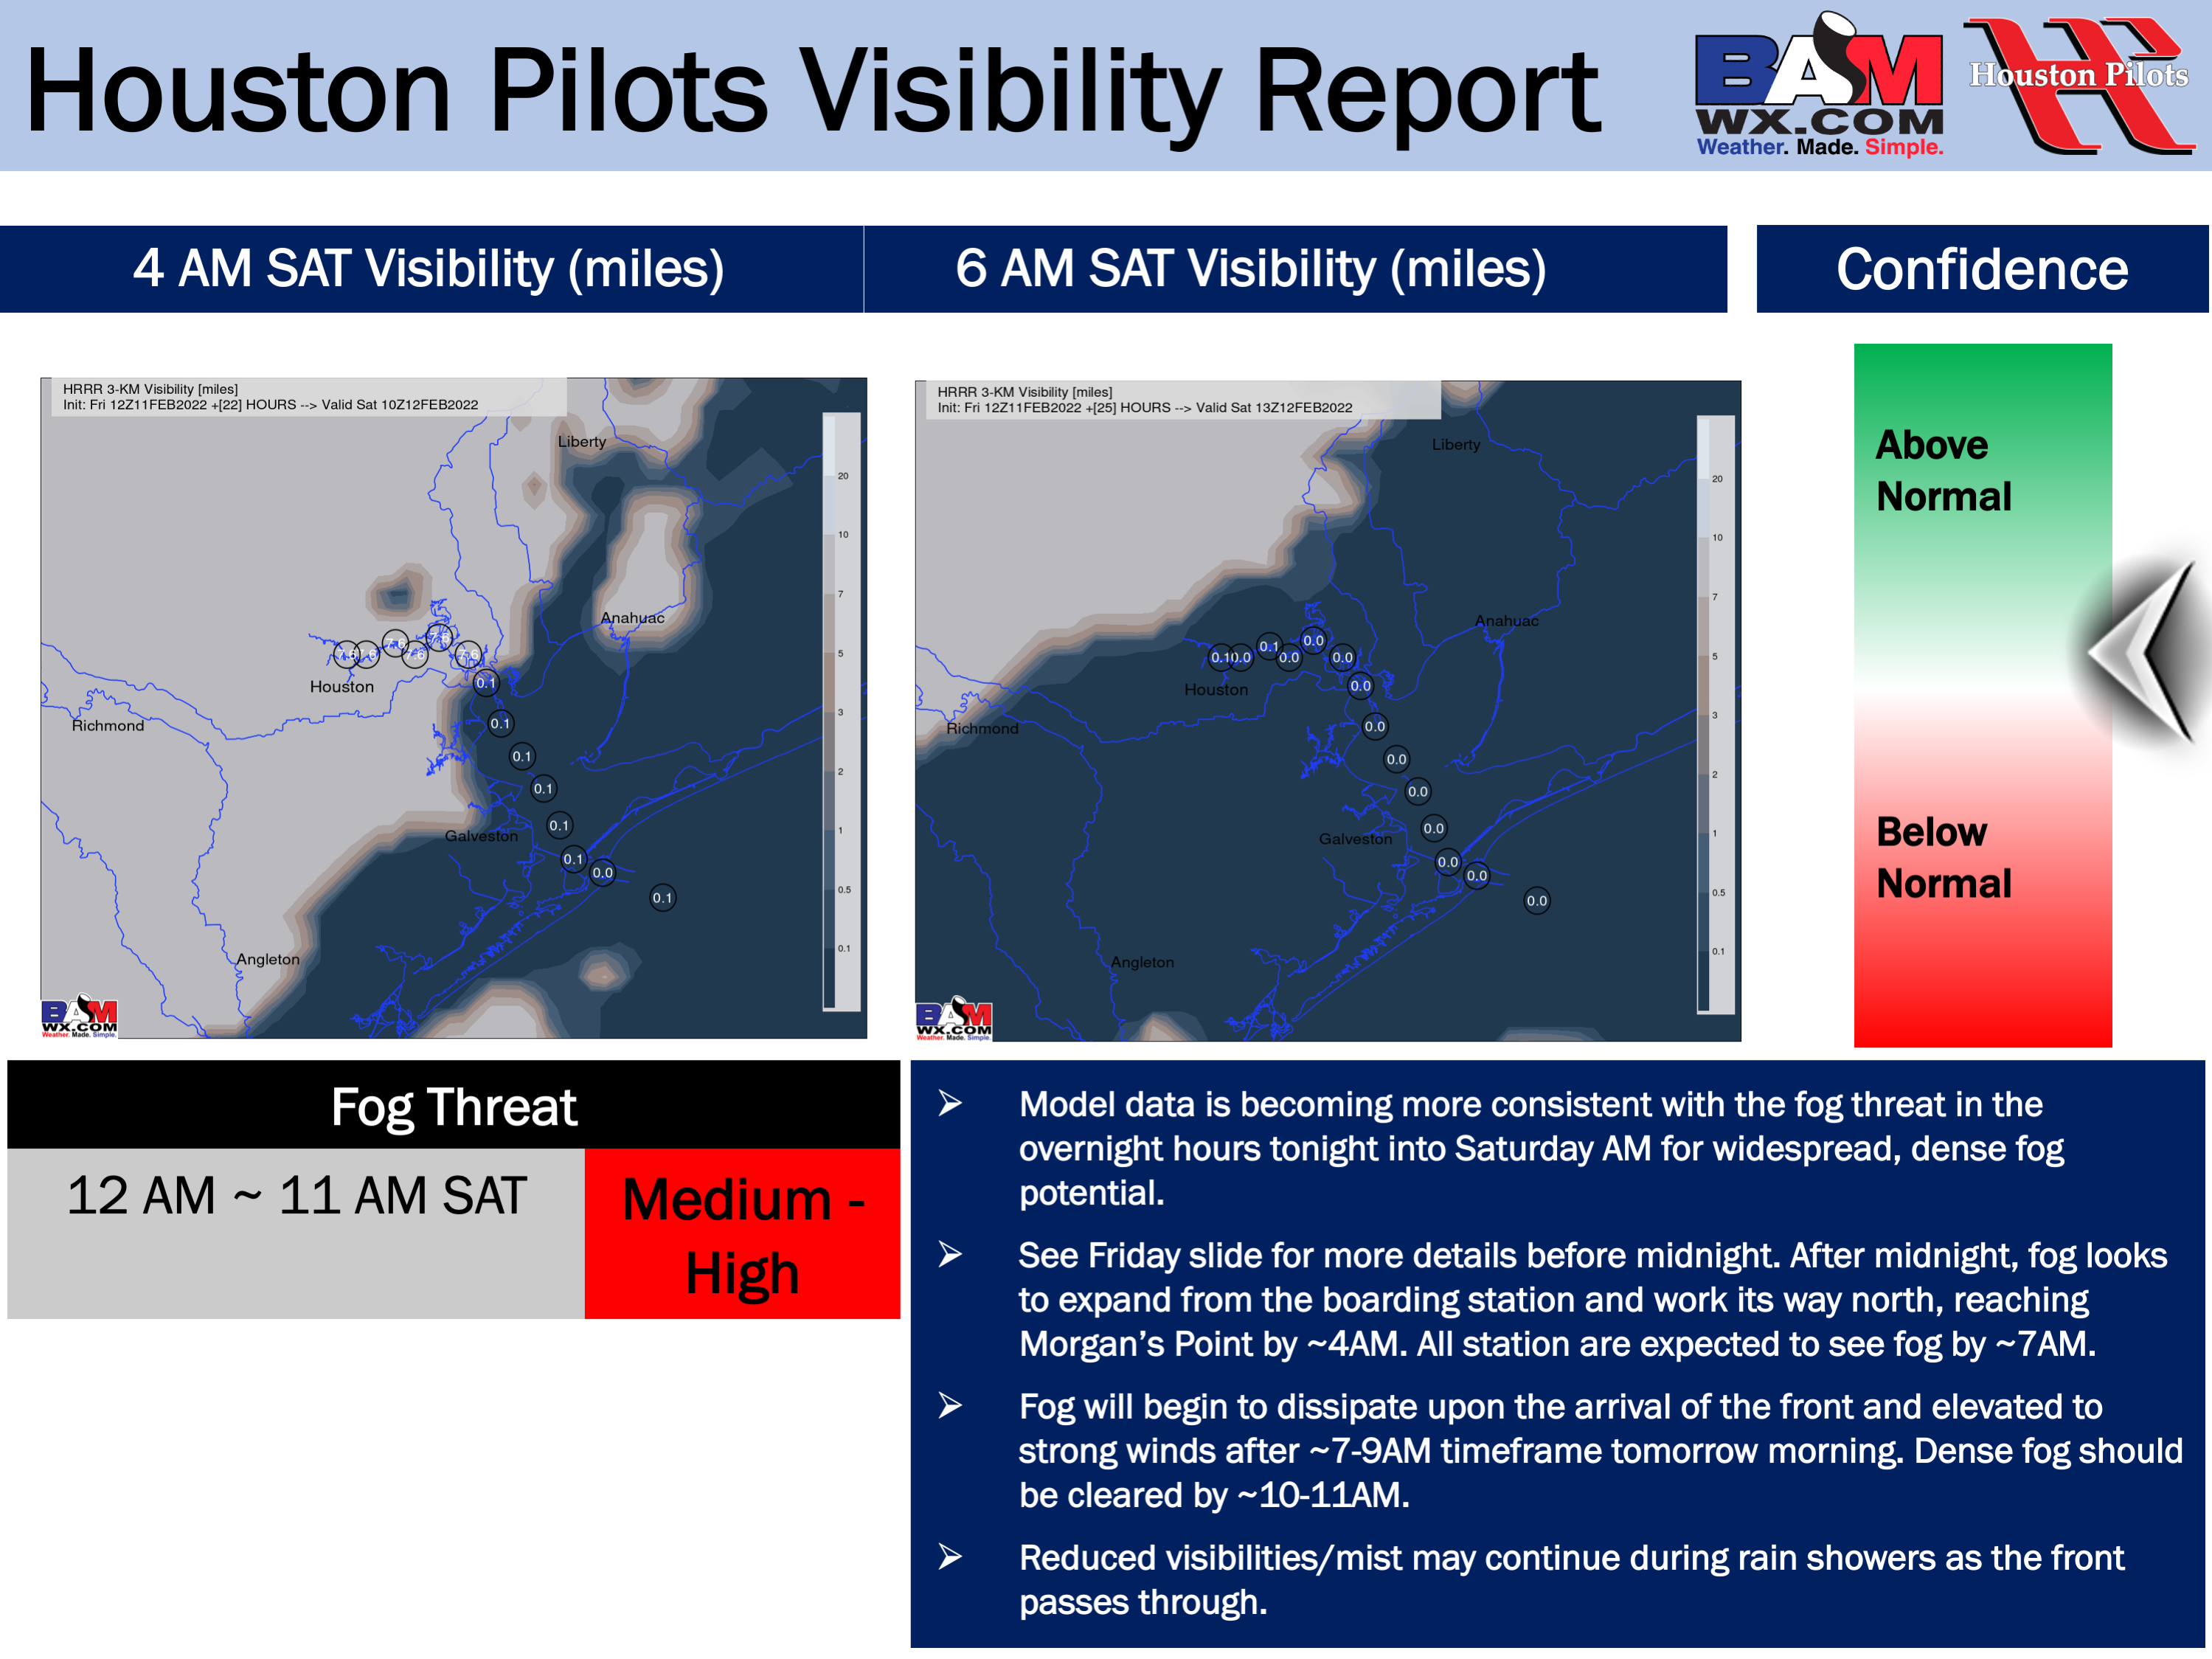
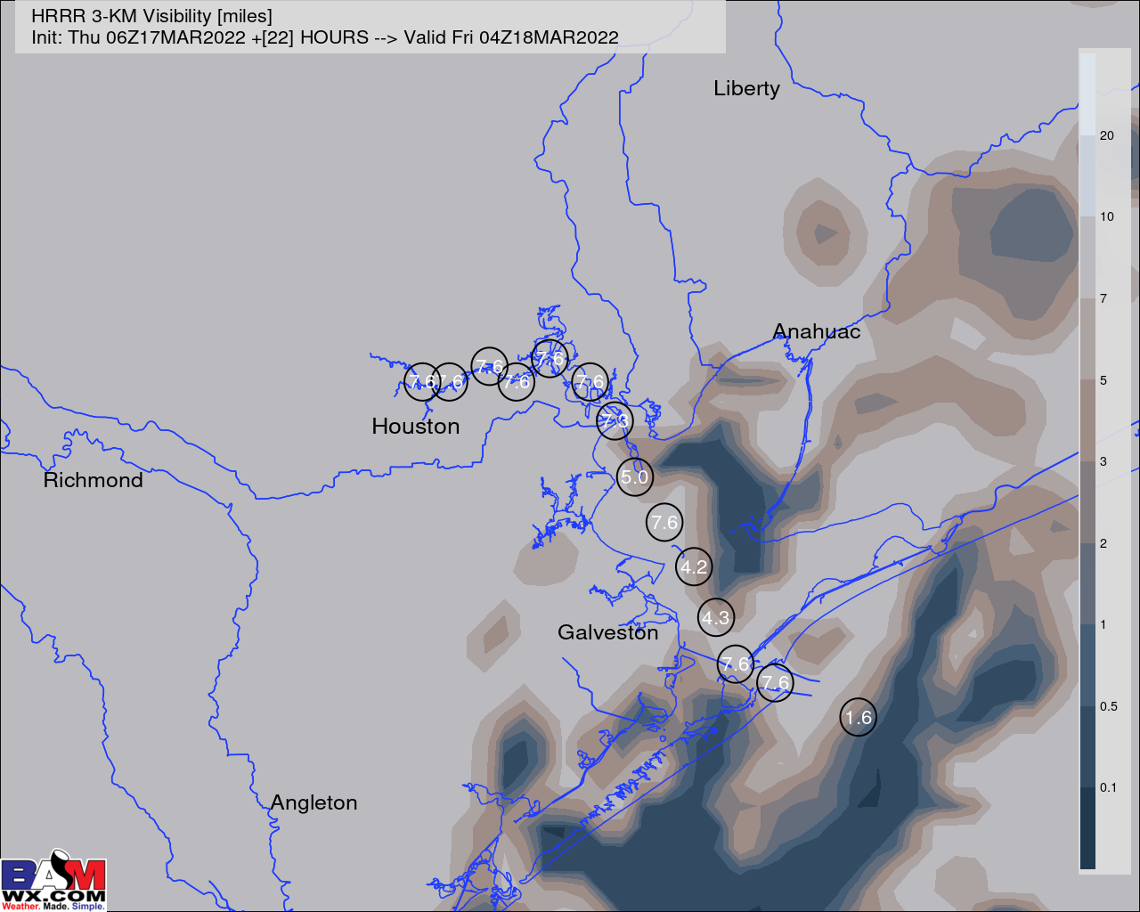
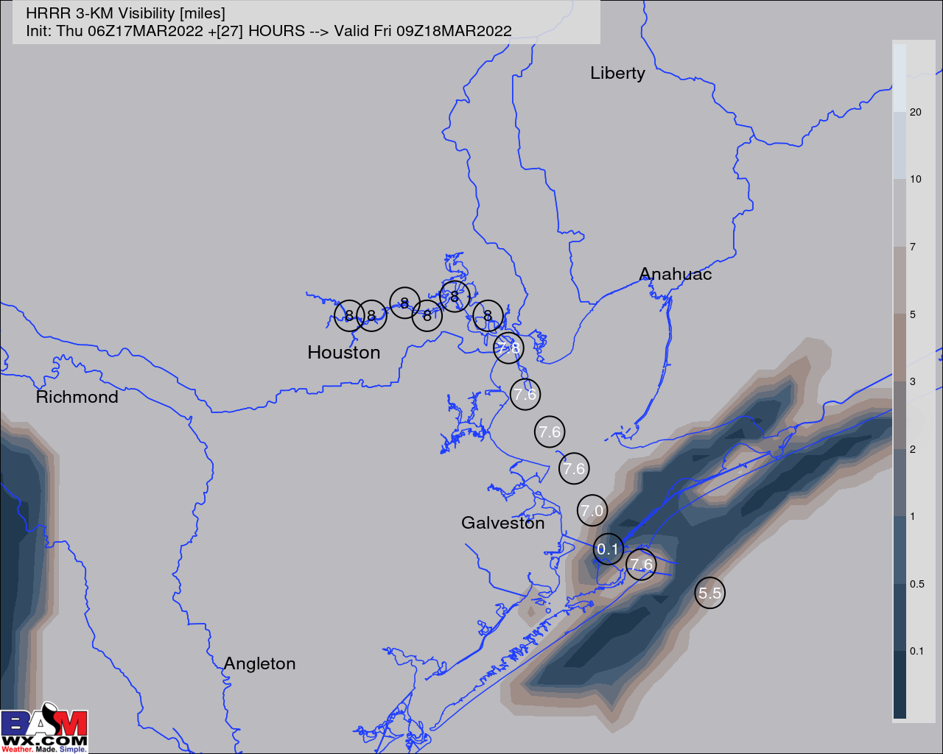
Houston Pilots Visibility Report
11 PM THU Visibility (miles)
4 AM FRI Visibility (miles)
Confidence
Above Normal
Below Normal
Reduced Visibility Threat | Max Wave Heights
10 PM THU – 6 AM FRI | Low-Medium
Patchy, hit and miss reduced visibilities coming in the form of rain/mist/patchy fog will all be possible late this evening into the early morning hours of Friday. The best window as it stands now for any patchy fog would be 3 – 6 AM. Regardless, we do favor for visibilities to lower to at least 3-5 miles (if not lower) periodically in this timeframe. Lowest confidence of the forecast comes as to whether any visibility issues come from 3-5 mile vis. mist or 1-2 mile vis. patchy fog.
Currently we are in favor of winds staying staying just elevated enough to make limited visibility likely come in the form of rain/mist/drizzle, however we want to make the note that if winds weaken any, a few instance of patchy fog would be possible for any stations S of Morgan’s Point.
After ~6 AM, the front should pass the area and sweep away any visibility concerns.

Slide 12
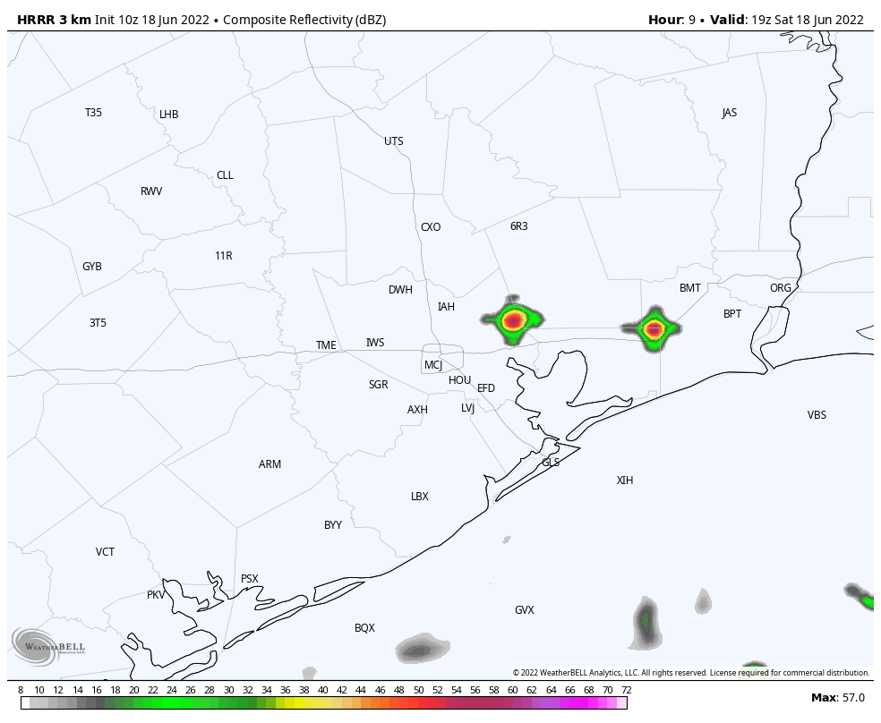
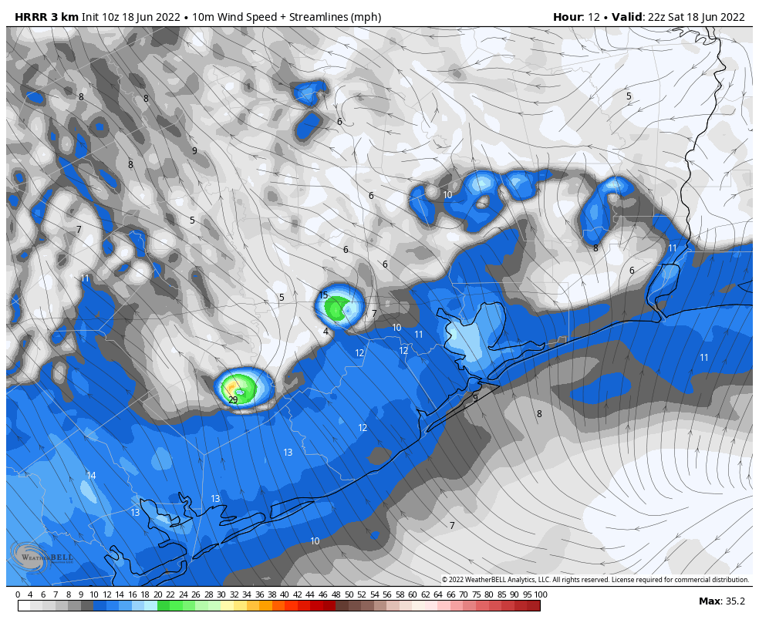
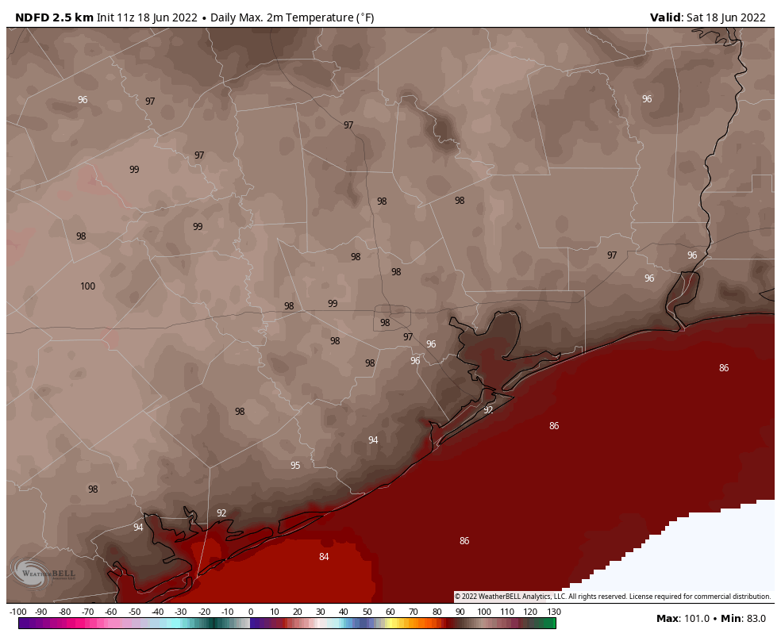
Houston Pilots: Sat. 6/18/2022
Forecast Discussion
Precip Forecast: 5 PM CT
Precip: Dry conditions are favored for most of Saturday, however a 10% chance of an isolated thunderstorm is possible from 4PM-9PM.
Wind: Variable winds between 3-8 MPH from the S in the morning through 1PM. After 1PM through midnight, southerly sustained winds of 10-15 MPH, with an occasional gust of up to 18MPH.
Temps: High temps Sat. again reach the mid to upper 90s F for the stations inland. Upper 80s expected further into the Gulf.
Visibility: Not anticipating any fog concerns.
Wind Speed
5 PM CT
High Temps
Saturday

Slide 13
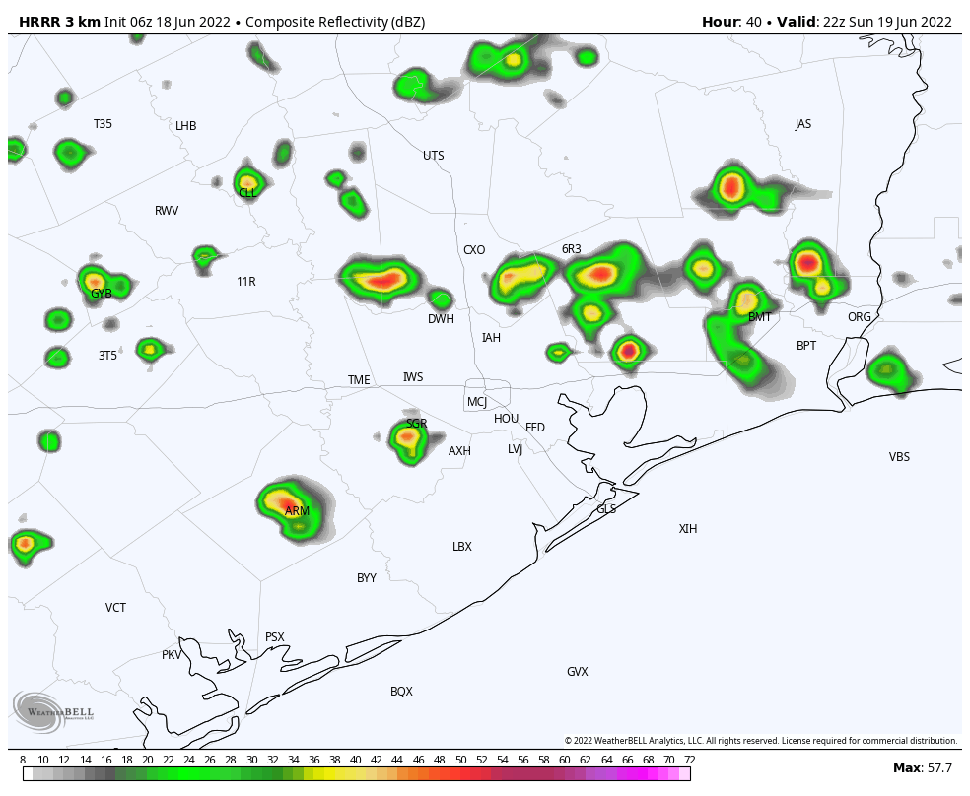
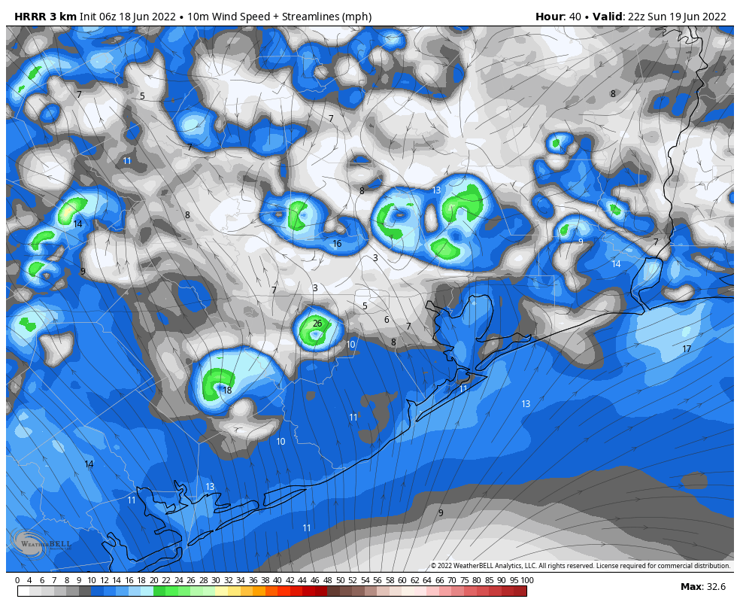
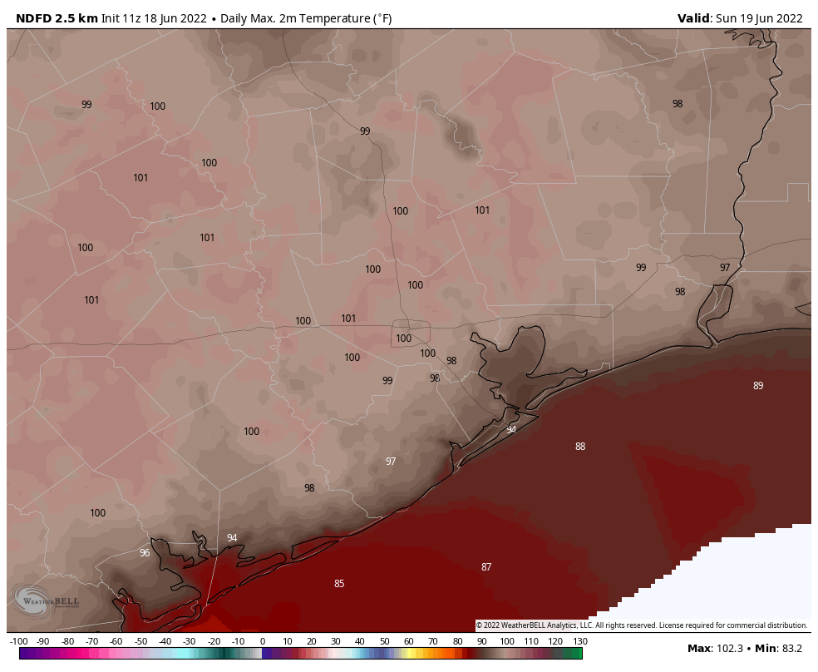
Houston Pilots: Sun. 6/19/2022
Forecast Discussion
Precip Forecast: 5PM CT
Precip: Dry conditions favored for AM period. 20%-30% chance of scattered showers/storms from 3PM-8PM, especially for inland areas around Houston.
Wind: Sustained winds of 5-10MPH out of the SW expected through 10AM, before becoming calm-6MPH with direction varying as high pressure system move in overhead. 8-13MPH sustained winds out of the S will resume after 4PM, with 13-16MPH gusts possible for the rest of the evening.
Temps: Expect high temps to reach the upper 90’s Visibility: No fog is expected for our stations.
Wind Speed
5PM CT
High Temps Sunday

Slide 14
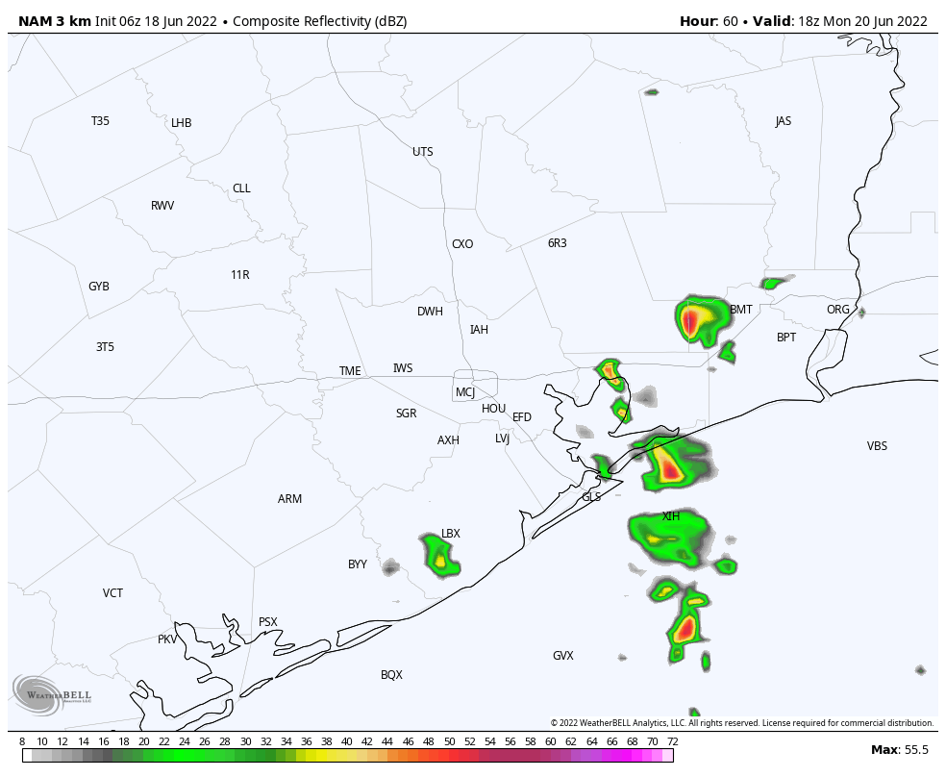
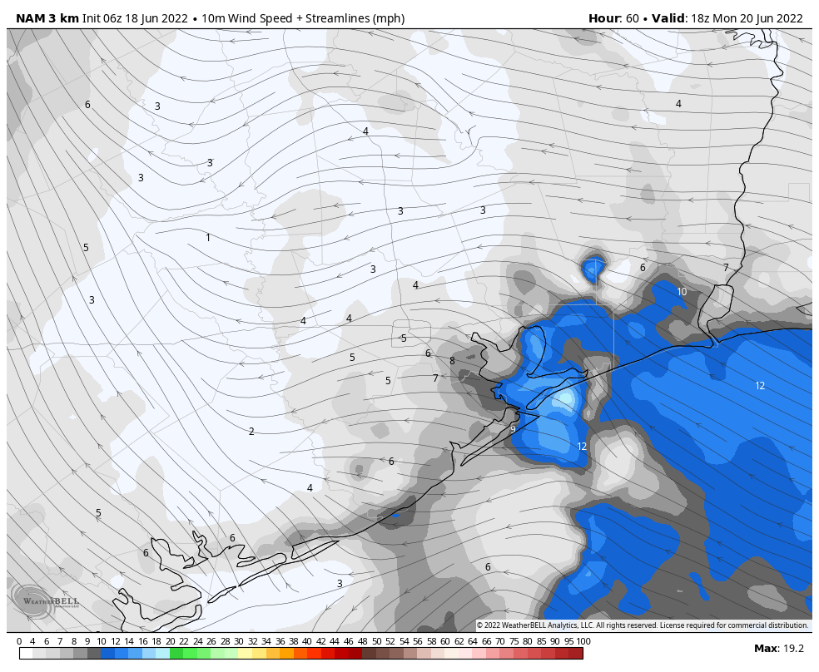
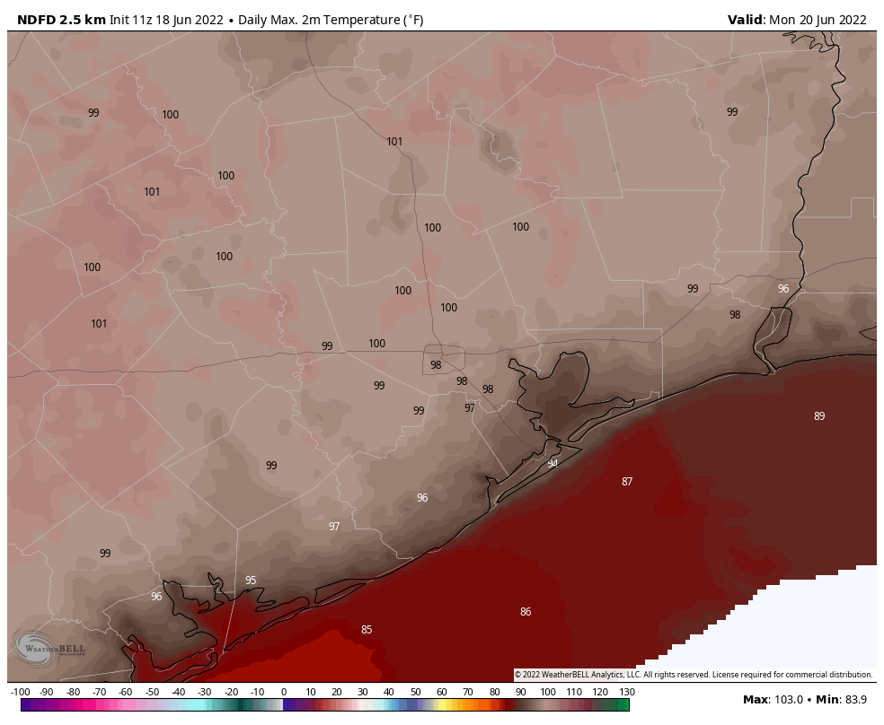
Houston Pilots: Mon. 6/20/2022
Forecast Discussion
Precip Forecast: 1 PM CT
Precip: A 20%-30% chance of scattered showers/isolated storm exists for Monday afternoon into early evening. Coverage expected to be more limited at this time.
Wind: Winds look to be 3-8 MPH sustained for most of Monday, increasing to 8-13MPH out of the E by 2PM and continuing into the late evening. An occasional gust of up to 20MPH will be possible from 6PM-12AM Tuesday.
Temps: High temps likely reach the upper 80’s to mid 90’s Monday.
Visibility: Not anticipating fog on Monday.
Wind Speed: 4 PM CT
High Temps Monday

Slide 15
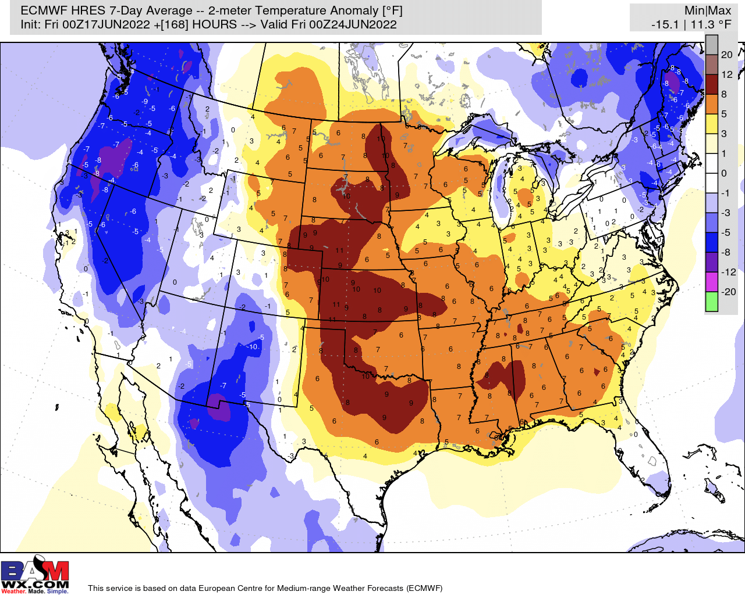
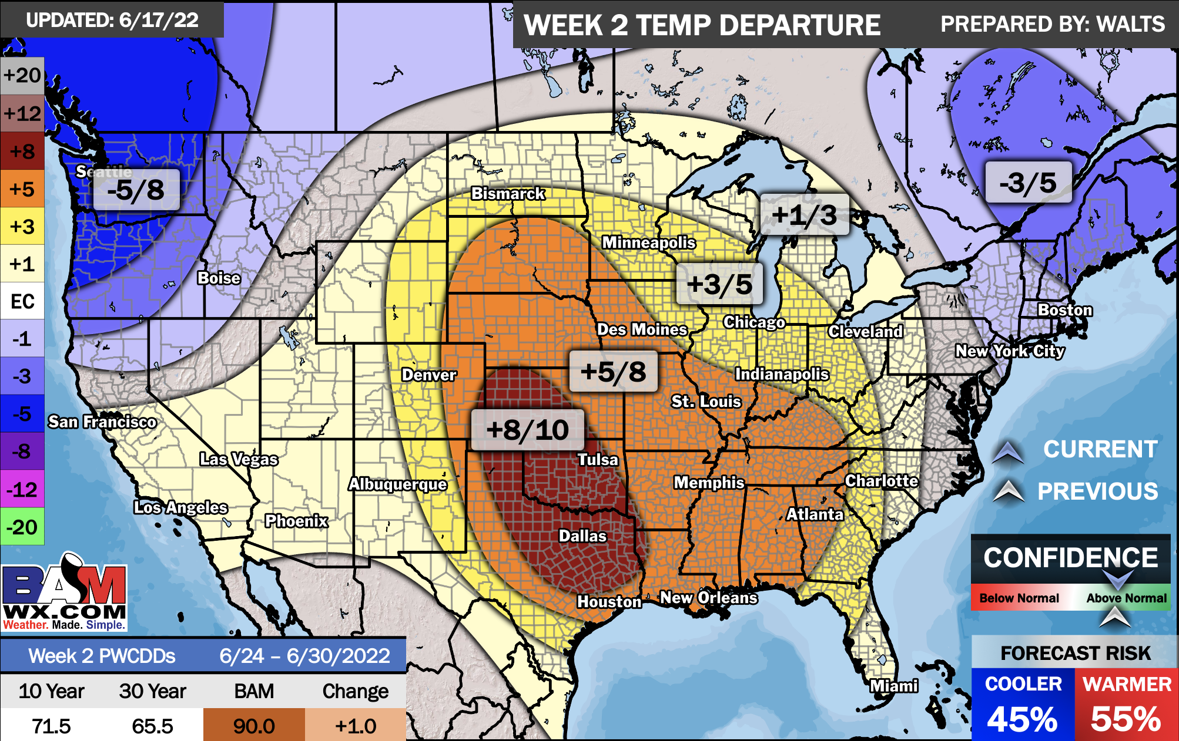
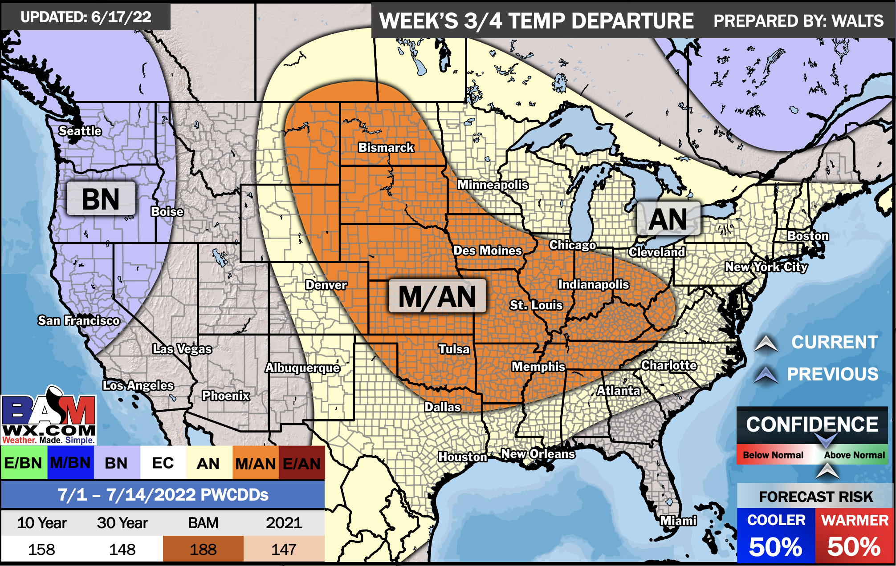
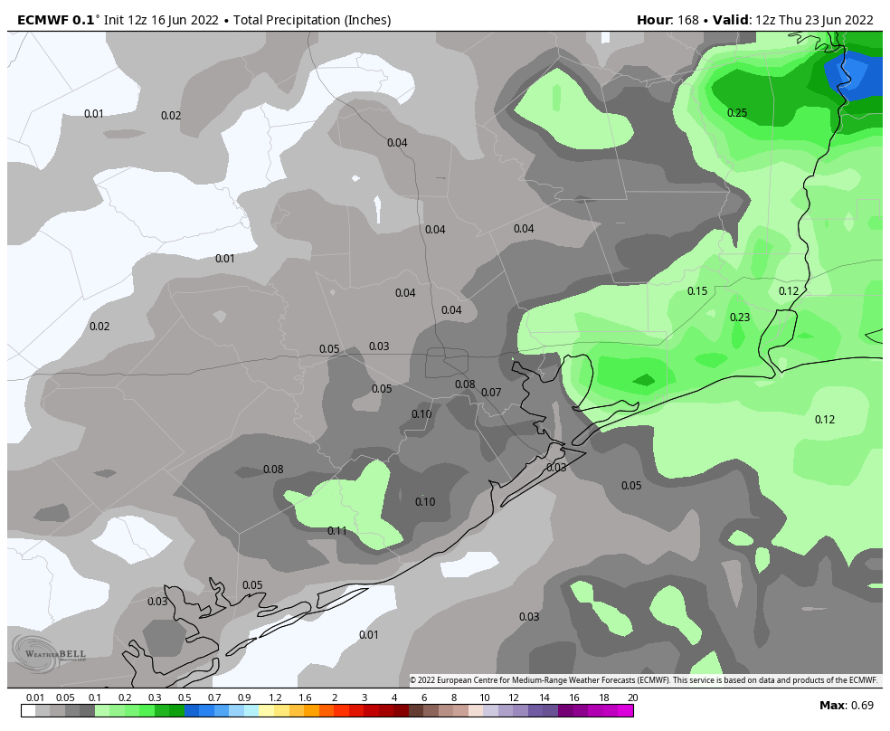
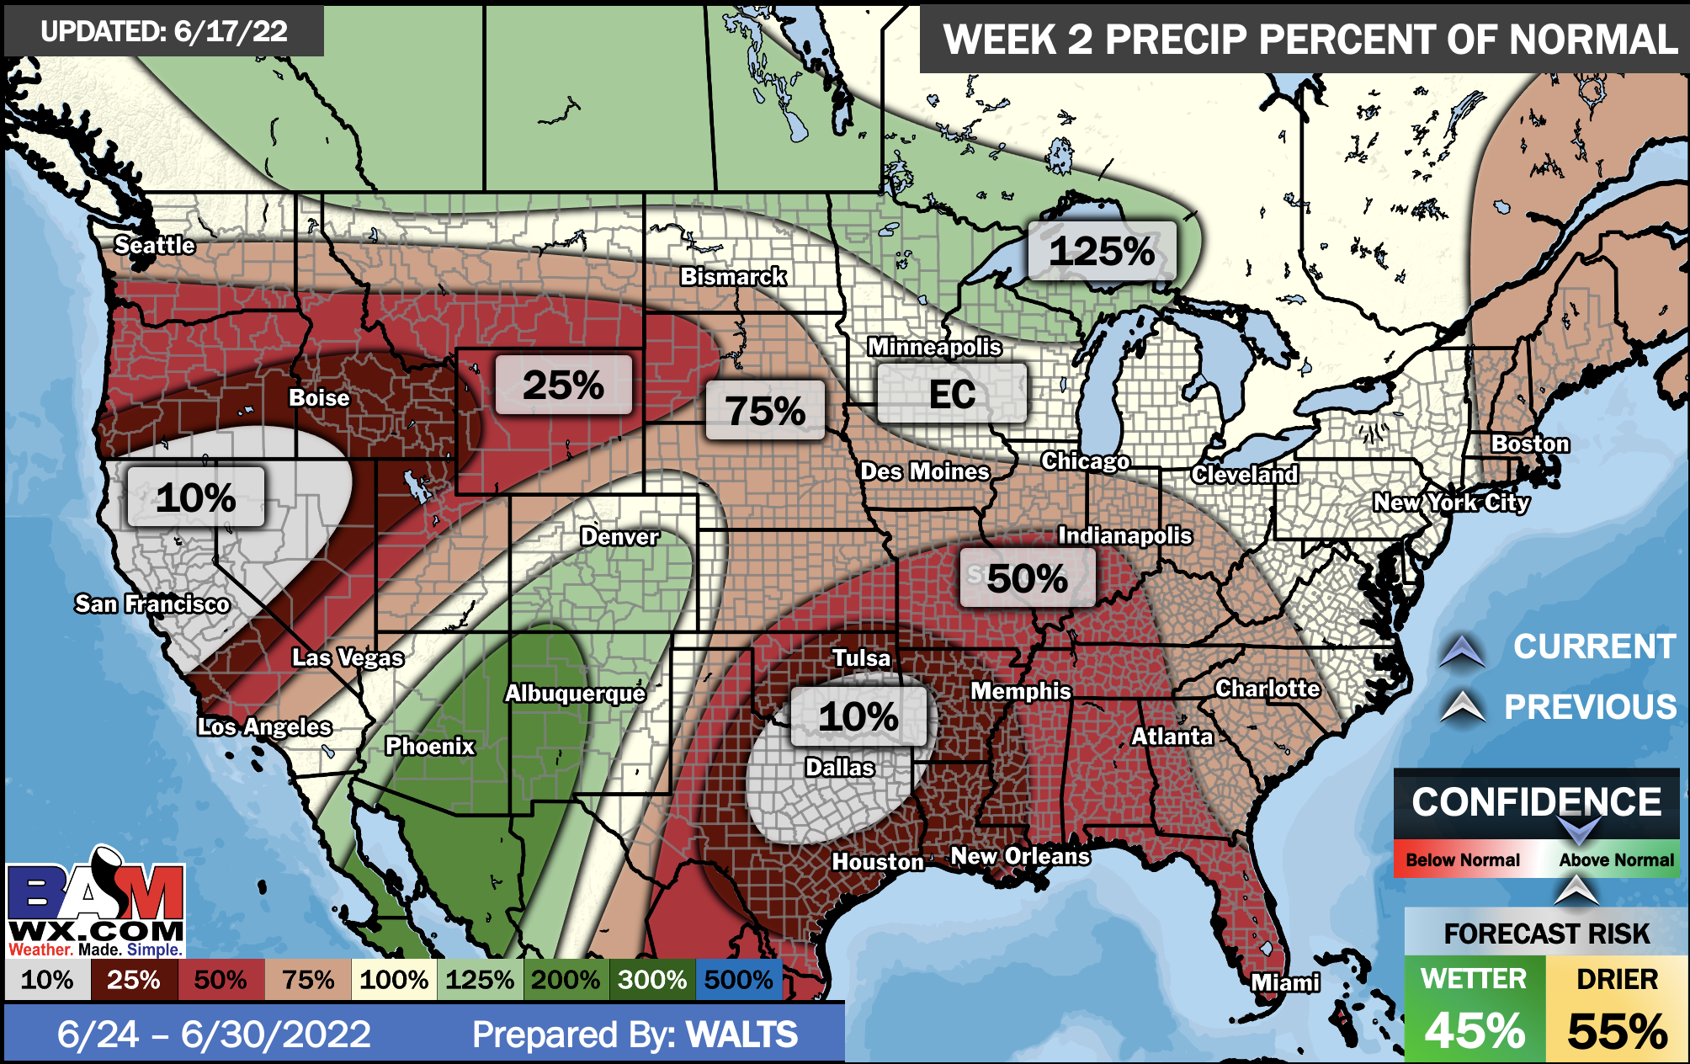
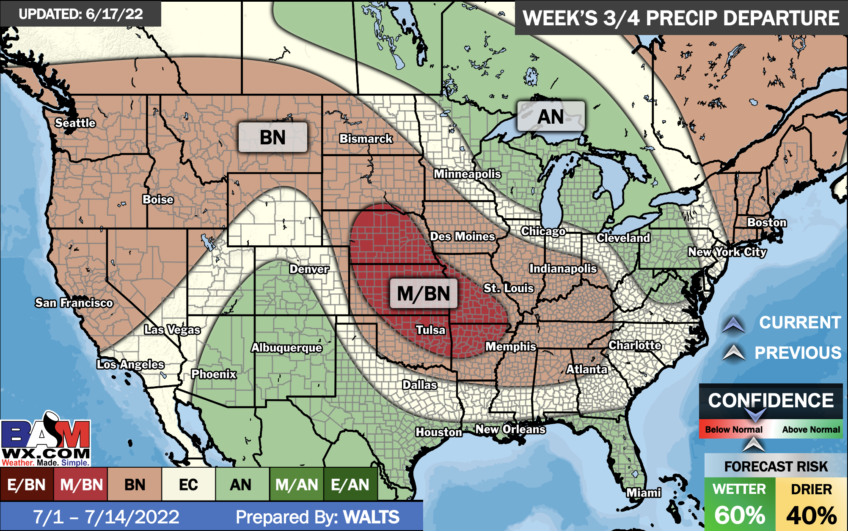
Houston Pilots: 6/18/22
Week 1
Week 2
Week’s 3/4
The week ahead looks rather inactive with a few minor chances at best. Temperatures continue to remain above normal
Week 2 likely features above normal risks for temperatures and below normal precipitation risks.
The weeks ¾ timeframe into July looks to feature above normal temperatures and above normal risks for precip.

